Slide 1
Geometric optics for an isotropic medium
LL8 sect 85

Slide 2


Slide 3







Slide 4





Slide 5









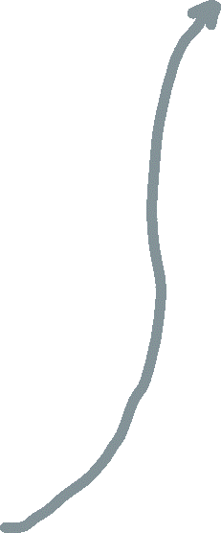
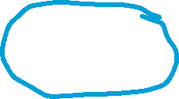


Slide 6
















Slide 8

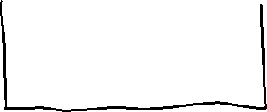








Slide 11
