Slide 1
Thermoelectric phenomena
LL8 sec26

Slide 2





Conductors
In thermodynamic equilibrium conduction electrons carry no current.
This holds when temperature is constant throughout the conductor
And
When the electrochemical potential energy is constant throughout the conductor
Electrochemical potential energy =
Electrostatic potential energy Chemical potential (energy) when

Slide 3





Inhomogeneous conductor, e.g. a thermocouple
Conductor 1 Conductor 2
More electrons Fewer electrons
Higher Lower
Even if T is constant throughout, is not constant. Electrons are then not in thermodynamic equilibrium.
If electrostatic potential φ_{ES} is constant everywhere, as in usual electrostatics of homogeneous conductors, then
electric field
But because is non-uniform, there would still be a diffusion current.

Slide 4




The ordinary electrostatic potential φ_{ES} is the spatial average of the true microscopic potential, but it isn’t convenient for inhomogeneous conductors.
Instead, use the electrochemical potential.
Just called “φ” in book.
This is the change in free energy per unit volume F when one electron is isothermally brought into the metal from infinity.

Slide 5




Slide 6


















Slide 7






α is also called the Seebeck coefficient S

Slide 8
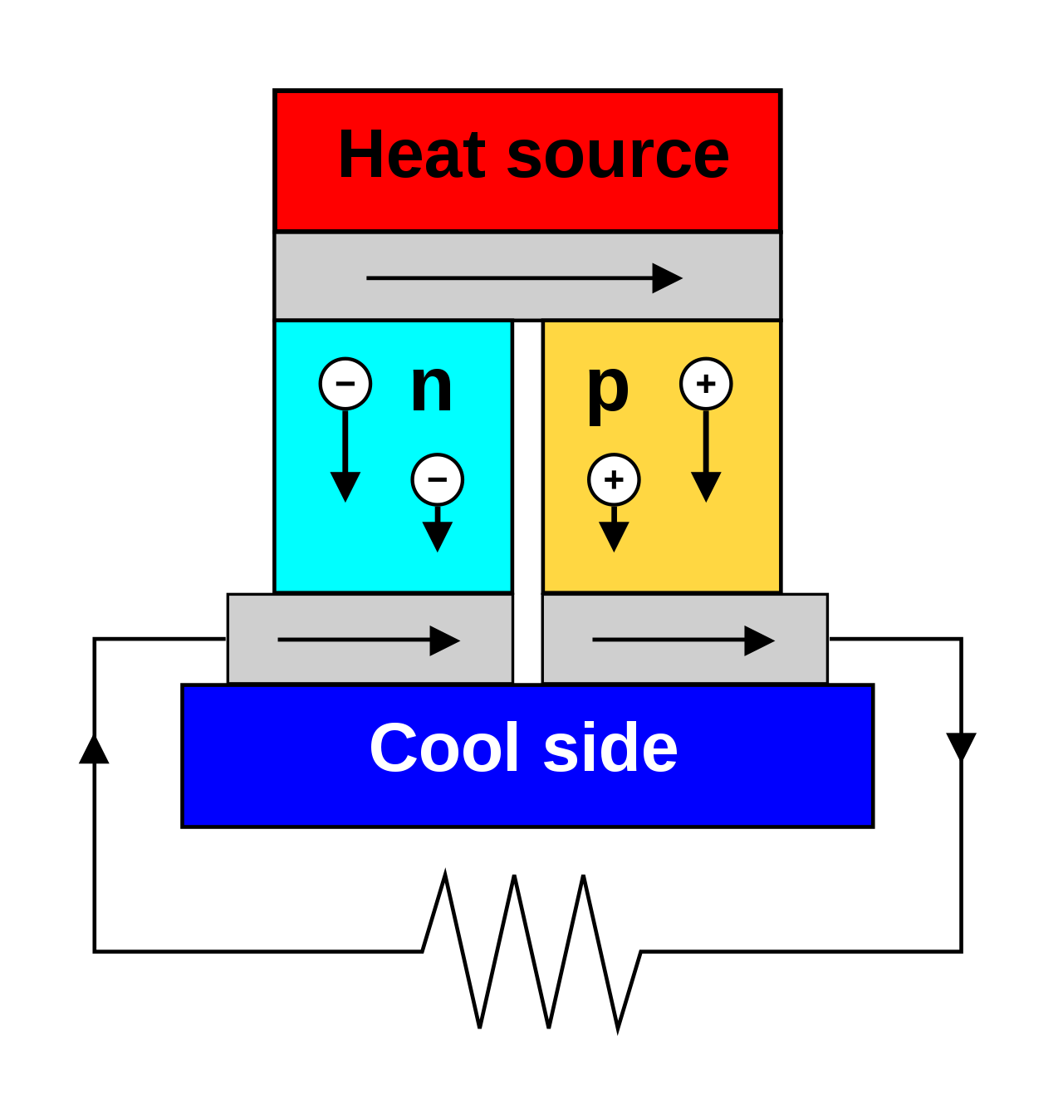


In a closed circuit, current can flow. Solve for j
A thermoelectric circuit composed of materials of different Seebeck coefficients (p-doped and n-doped semiconductors), configured as a thermoelectric generator, which are used for creating power from heat differentials.
If the load resistor at the bottom is replaced with a voltmeter, the now open circuit then functions as a temperature-sensing thermocouple.
A metal of unknown composition can be classified by its thermoelectric effect if a metallic probe of known composition is kept at a constant temperature and held in contact with the unknown sample that is locally heated to the probe temperature. It is used commercially to identify metal alloys.
Thermocouples in series form a thermopile, commonly used as infrared detectors, and as a way to increase V_{oc} of generator.

Slide 9












Slide 10

Application: TE cooler/heater
Finding that relationship is going to be hard, and will take the next several slides!

Slide 11

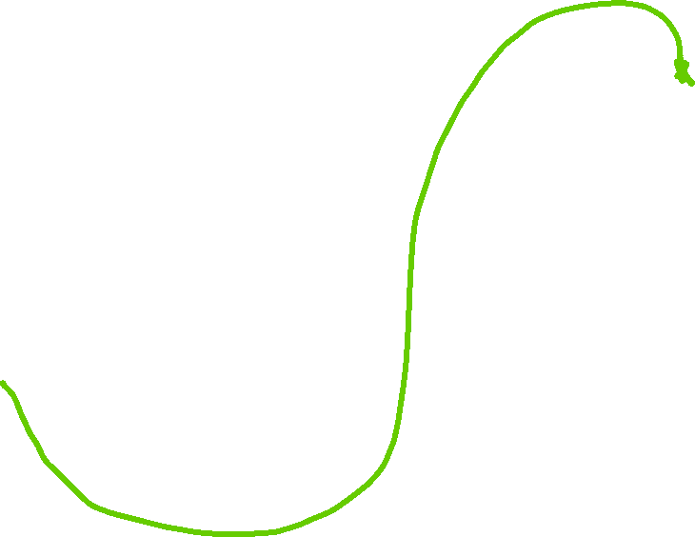



Slide 12



Now we have to finish a section from EDII

Slide 13





Slide 14








Slide 15








Back to section 26.

Slide 16







Slide 17


Now electrical current density and heat flux density are determined by 3 materials parameters
Electrical conductivity
Absolute thermopower (Seebeck coeff)
Thermal conductivity

Slide 18





Slide 19









Slide 20













Slide 21


















Slide 22









(Since Seebeck coefficient is a function of temperature it is non-uniform even in a single conductor)

Slide 23








Slide 24
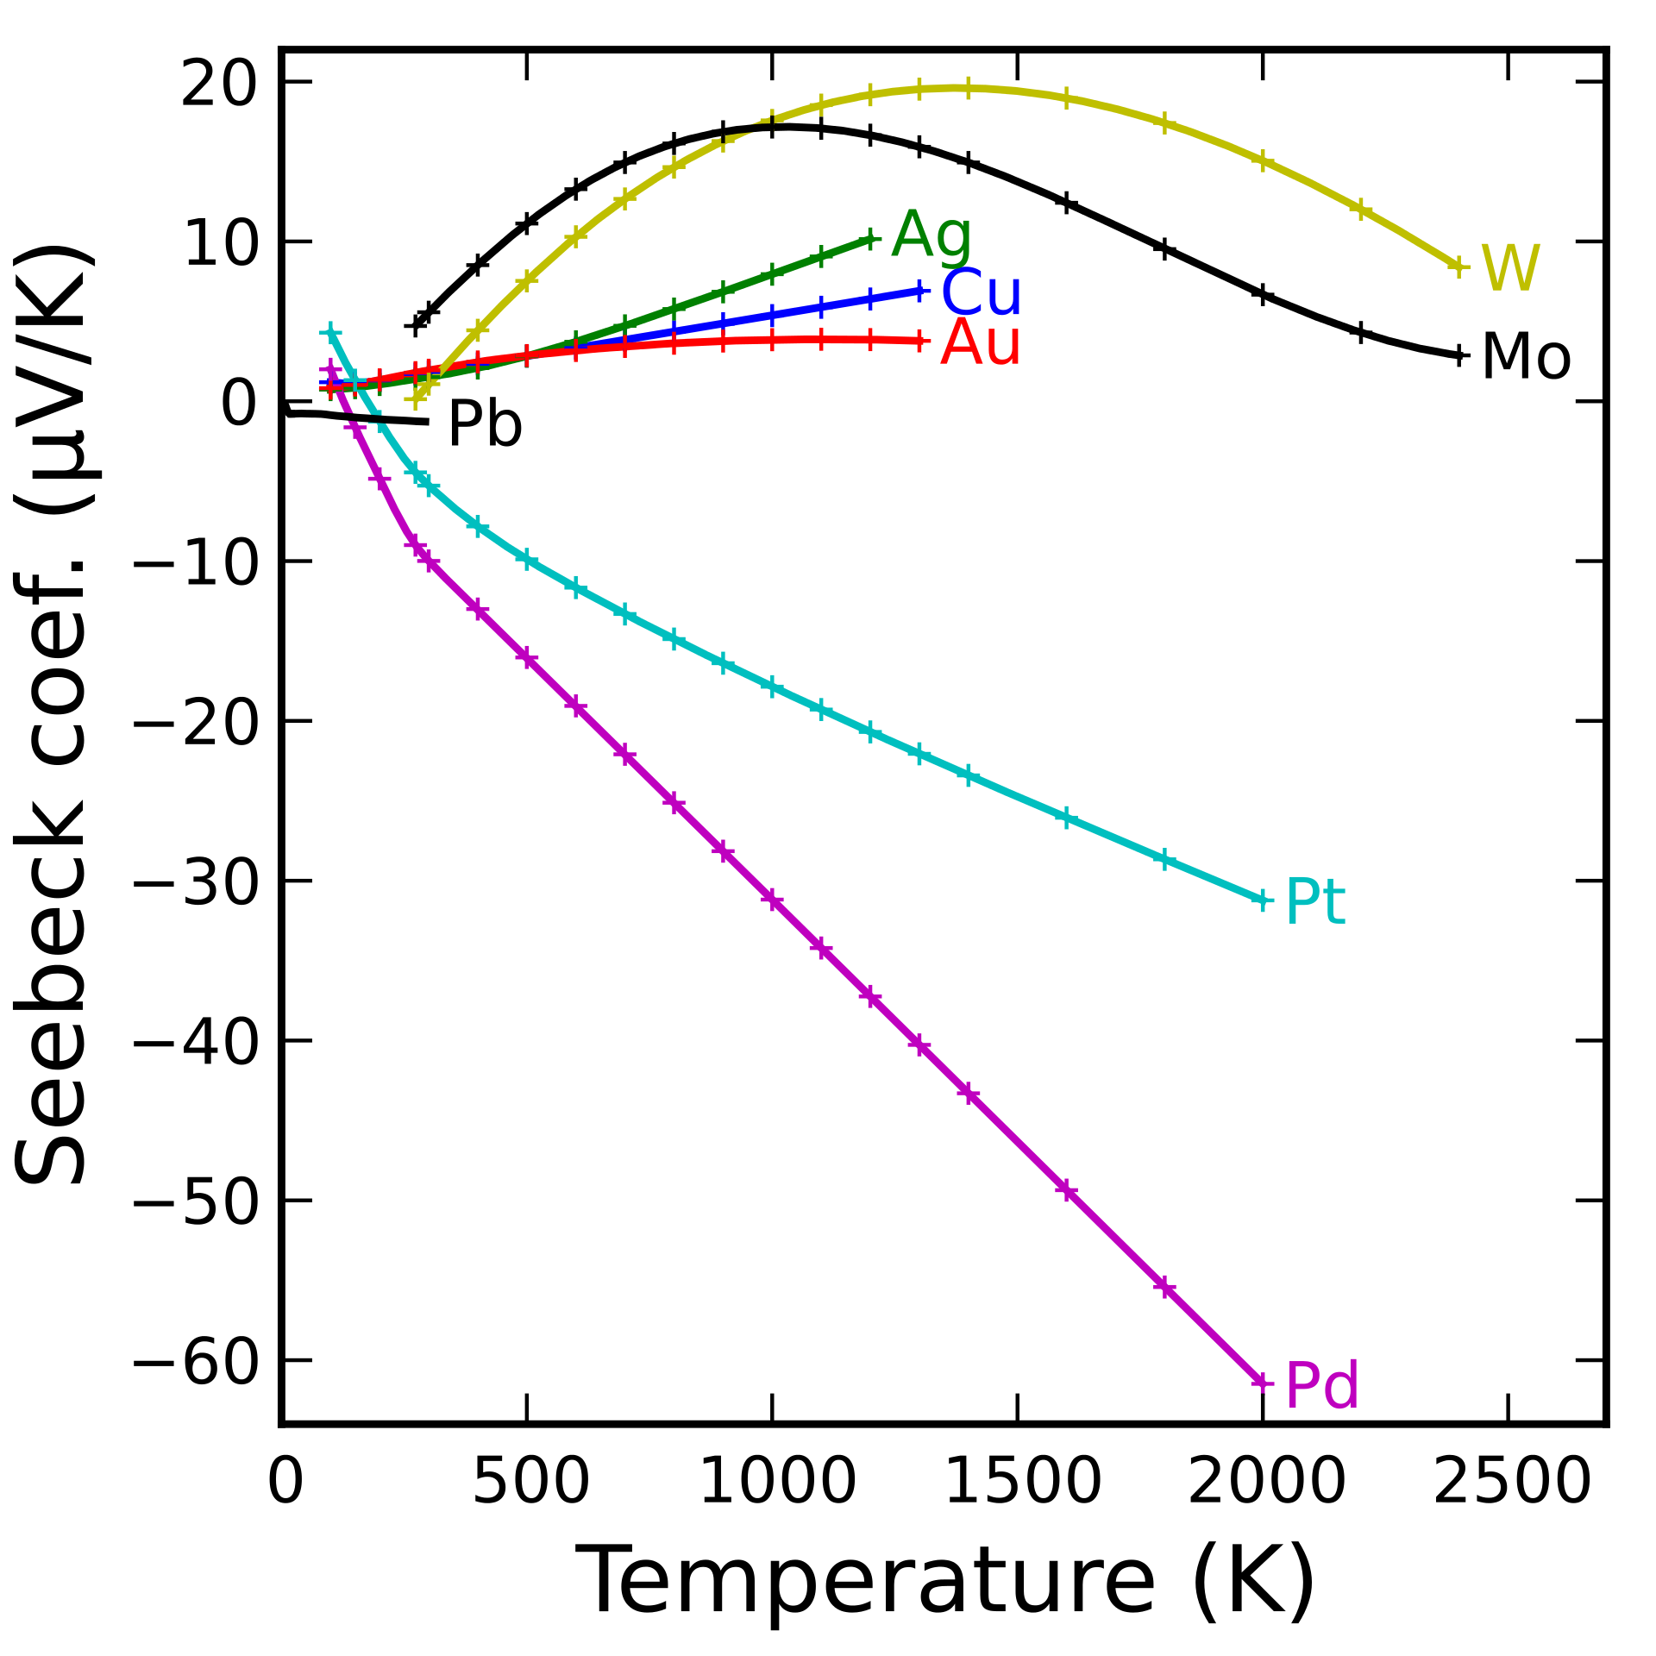






Sign of voltage for n-type sample is trickier

Slide 25
