Slide 1
Contact Potential
Section 23

Slide 2
Removing charge (electron or ion) from conductor requires positive work.
(a charge is always attracted to a conductor)
“work function” = eW
Conductor
Work potential
W<0 if e<0.

Slide 3
The work function depends on
The nature of the conductor
The thermodynamic state (T,ρ)
Whether it is an electron or ion that is removed.
The surface treatment.
Contamination
Crystallographic orientation

Slide 4
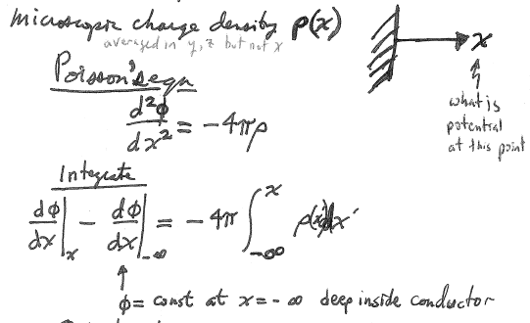
Define a microscopic charge density ρ(x), which is averaged in y and z, but not in x.
Then Poisson’s equation is
Problem: What is the potential φ(x) at position x?
(deep inside the conductor)

Slide 5
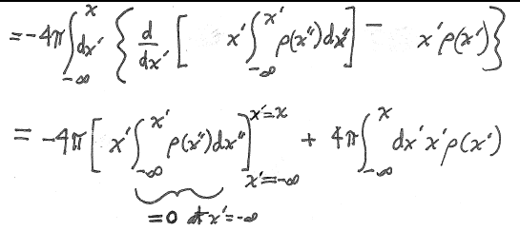
Second integration
parts

Slide 6
(area of blue rectangle)

Slide 7
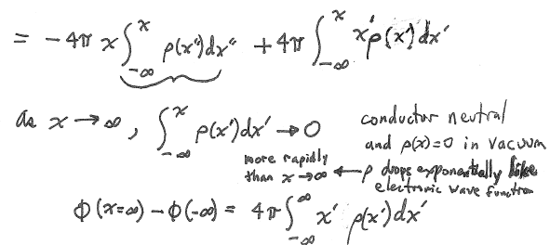
The conductor is assumed neutral, and ρ(x) = 0 in vacuum, so ρ drops exponentially like an atomic wavefunction.
The change of potential for a charge that is brought from deep in the conductor and transported far away from the conductor

Slide 8
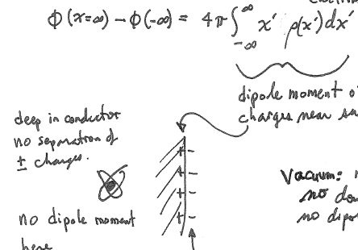
This is the dipole moment of charges near the surface
Deep in the conductor there is no separation of + and – charges
In the vacuum, there is no charge, no double layer, and no dipole moment.
No dipole moment here
Dangling bonds or reconstructed surface forms “Double layer”, which determines the work potential.

Slide 9
If two different conductors are in contact, charges flow from body with lower work function to the body with higher work function.
Bodies become charged.
A potential difference results, which prevents further flow.
This is the “Contact Potential”
(This discussion is all for charges of a single type, e.g. electrons. For conductors with different types at different concentrations, there is also chemical potential.)

Slide 10
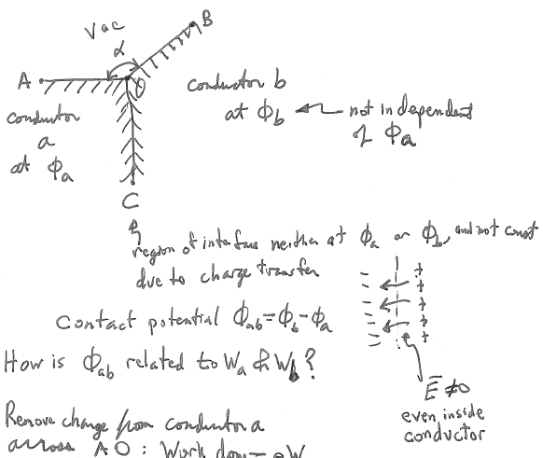

Slide 11
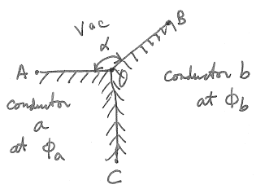
How is φ_{ab} related to W_{a} & W_{b}?
Remove charge from conductor a across AO: Work done = eW_{a}.
Transfer it to surface of conductor b: Work done = e(φ_{b} – φ_{a}).
Inject it into conductor b: Work done = -eW_{b}.
In thermodynamic equilibrium, charges inside a and b have the same energy.
eW_{a} + e(φ_{b} – φ_{a}) –eW_{b} = 0
(φ_{b} – φ_{a}) = W_{b} - W_{a}
Contact Potential φ_{ab} = W_{b} - W_{a}

Slide 12
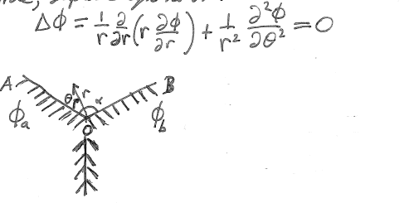
The contact potential causes an E-field outside the metals even though the metals are originally uncharged.
Laplace’s equation holds in the vacuum outide the conductors
Cylindrical coordinates

Slide 13
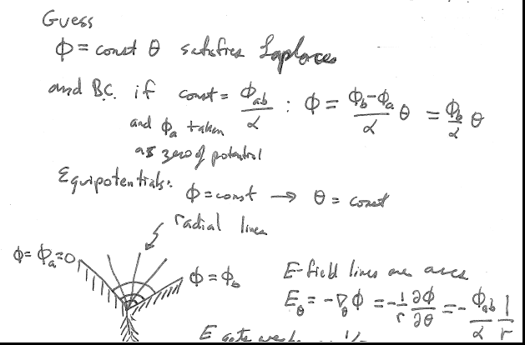
E gets weaker as 1/r

Slide 14
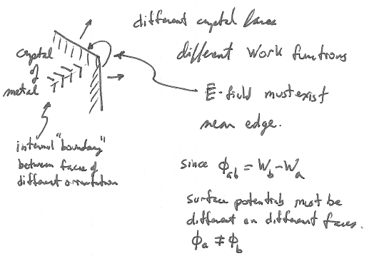
Different crystal faces have different work functions.
An electric field must exist near the edge between facets.
Internal “boundary” between facets of different orientation.
Surface potentials must be different on different faces.

Slide 15
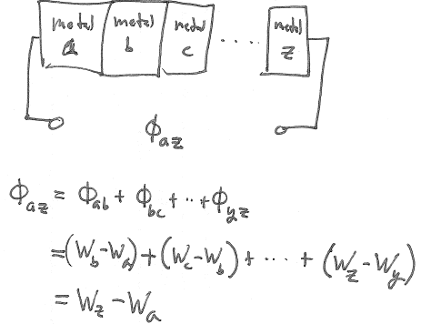
Stack of different metals in thermal equilibrium (all at the same temperature).
The potential difference of a stack of different metals is just the difference in the work potentials of end members.
If those are both copper wires, there is no potential difference.
Can’t make a battery out of a stack of dry coins.

Slide 16
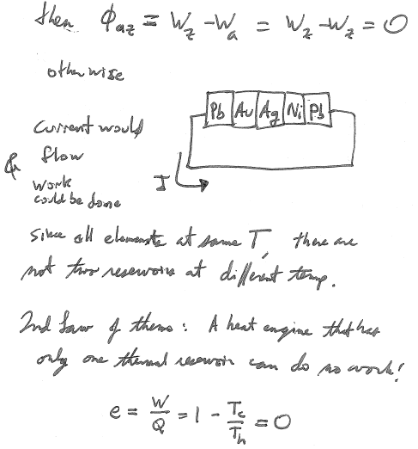
If the end members of the stack are the same metal
Otherwise, current would flow and work could be done.
Since all elements are at the same temperature, there are not two reservoirs at different temperature.
By second law of thermodynamics, a heat engine that has only one thermal reservoir can do not work!

