Slide 1
Dipole radiation during collisions
LL2 Section 68

Slide 2
What is the total radiation per unit current density of particles in a beam that scatter from a scattering center?
For unit current density
(1 particle per unit time across unit area of beam cross section)
Beam of particles
Scattering center
The number of particles per unit time with impact parameter between ρ and ρ + d ρ is 2 π ρ d ρ .

Slide 3
The total radiation from unit current density is
= “effective radiation”
Total energy of radiation from a single particle with a given impact parameter
units
Energy * area

Slide 4
What is the angular distribution of radiation emitted when a beam is scattered by a central field?
For each particle in the beam (67.7)

Slide 5
We need to average over all possible directions of in the plane perpendicular to the beam

Slide 6
This term depends on the orientation of with respect to n.
This squared magnitude does not depend on the orientation of

Slide 7
Scattering and radiation have axial symmetry, which we take to be along X.
not averaged

Slide 8
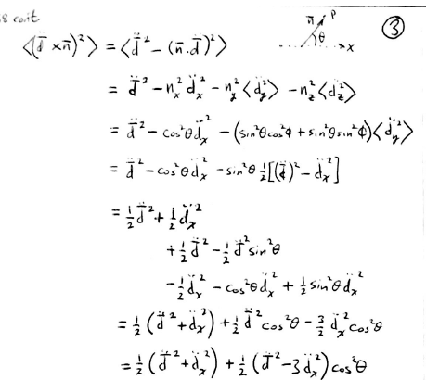

Slide 9
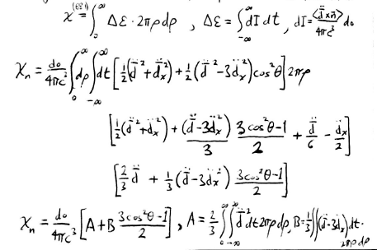
Integration over time and impact parameter gives the effective radiation as a function of θ.
()^2

Slide 10
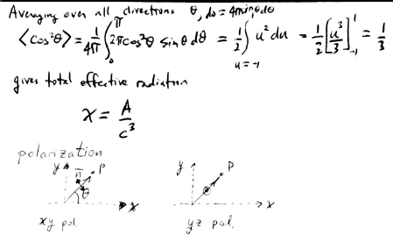
Averaging over polar angle with respect to beam direction gives total effective radiation. do = 4 π sinθ dθ.
π 1
Average of “B” term is zero, giving for the total effective radiation:
Next we consider polarization

Slide 11
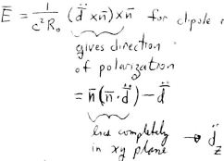
The electric field for dipole radiation from (67.6) is
Gives the direction of the polarization
The first term is the projection of in the XY plane
The difference is the component perpendicular to the XY plane

Slide 12
The magnetic field for dipole radiation is given by (67.5)
Where is evaluated at the retarded time t’ = t-R₀/c.
The Z component is perpendicular to the XY plane that contains the scattering center and tbe field point. It is given by
This also gives the projection of E on the XY plane.
Take the square of E and average over directions of in the YZ plane.

Slide 13
=
since

Slide 14
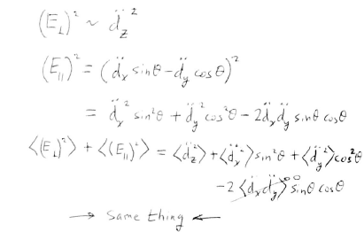
Alternatively, square the components of E that are perpendicular and parallel to the XY plane,
and average over directions of in the YZ plane, then add the results.

Slide 15
Thus, the intensity
is the sum of two independent parts, which are polarized in the mutually perpendicular planes XY and YZ.
The part that is perpendicular to the XY plane is given by
<cos²ψ>_{xy} = 1/2
ψ
Projection of on the YZ plane

Slide 16
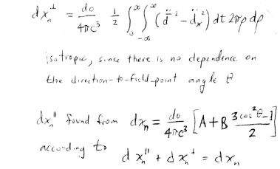
The effective radiation for the part of the intensity polarized perpendicular to the XY plane is
This is isotropic, since there is no dependence on the polar angle θ for the direction vector n to the field-point P
The effective radiation for the part of the intensity polarized parallel to the XY plane is
which is found from
according to
not isotropic
isotropic
not isotropic

Slide 17
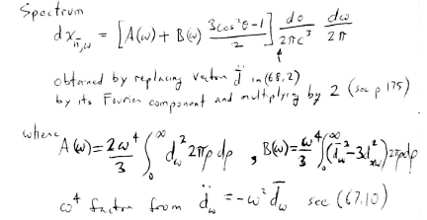
The spectrum of the total radiation is
Is obtained by replacing the vector in
by its Fourier component and multiplying by 2
(see p175, section 67)
where
The ω⁴ factor comes from

