Slide 1
The Angular Eikonal
LL2 sec 55

Slide 4
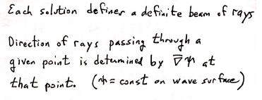

Slide 10
r’

Slide 14
Before, the conditions applied to the functions ψ of the independent variables r and r’.

