Slide 1
Energy momentum tensor of macroscopic bodies
Section 35

Slide 2
Momentum flux through df = force on this surface element
α-component of force on df
Amount of α-component of momentum passing through unit surface area perpendicular to the x^{β} axis per unit time.

Slide 3
Choose a reference system in which dV is at rest. Then Pascal’s law holds:
“Pressure p applied to dV is transmitted equally in all directions and is everywhere perpendicular to the surface on which it acts.”

Slide 4
Momentum density = 0 for volume element at rest

Slide 5
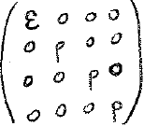
dV has energy density due to motion and interaction of its constituents, even though its velocity is zero
Relativistic. Velocity of particles in dV is not necessarily small
For dV in its rest frame.
Mass density
(mass per unit proper volume)

Slide 6
Arbitrary reference frame: components of T^{ik} transform into combinations of each other
u^{i} = 4-velocity for dV
In rest frame of dV, u^{i} = (1,0)
Then…
is the 4-tensor that reduces to
when u^{i} = (1,0)
Energy momentum tensor for macroscopic bodies
T_{i}^{k} = (p + ε) u_{i} u^{k} – p δ_{i}^{k}

Slide 7
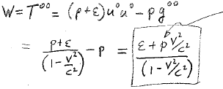
Energy density of a macroscopic body
Pressure, not momentum

Slide 8
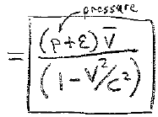
Energy flow vector for macroscopic body

Slide 9
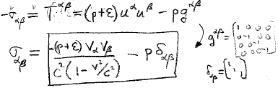
Stress tensor for macroscopic body

Slide 10
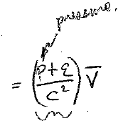
Motion of dV as a whole for v<<c
S
Plays the role of mass density

Slide 11
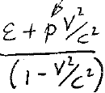
Suppose all particles in dV are slow, though dV might be moving fast.
pressure
Rest energy density
μ₀ = sum of particle masses per unit proper volume.
Neglects mass due to internal motion.

Slide 12
Continuing with slow internal particles
Pressure << rest energy density = μ₀c²
Determined from the energy of microscopic motion inside dV
Then…

Slide 13
Trace of full energy-momentum tensor for macroscopic bodies
Equality holds for E-M field without charges (34.2).
Pressure of a macroscopic body < 1/3 energy density

Slide 14
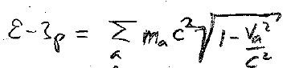
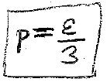
For macroscopic body
For particles (34.1)
Macroscopic body is obtained by spatial averaging over distances large compared with interparticle distances
dV
Already normalized spatial distribution with units 1/V
Ultra-relativistic equation of state of matter:

Slide 15
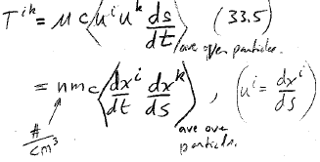
Ideal gas of identical particles
No interactions
Average over particles
#/cm³
Average over particles

Slide 16
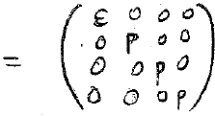
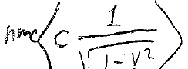
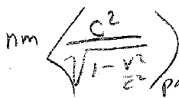
dV at rest
Energy density
dx⁰ = c dt
ds = c dt
=
=
particles

Slide 17
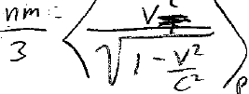
dV at rest
pressure
For random motion
=
Energy density and pressure of relativistic ideal gas
p
particles
Non-relativistic version
p

