Slide 1
H₂O and/or -OH NIR signatures at the surface of dark asteroids
P. Beck¹, E. Quirico¹, A. Pommerol², D. Sevestre¹, G. Montes-Hernandez³, B. Schmitt¹, J. Labbé¹
¹Université de Grenoble, Institut de Planétologie et d’Astrophysique OSUG, UJF/CNRS, Grenoble France. pierre.beck@obs.ujf-grenoble.fr.
²Physikalisches Institut, Universität Bern. Sidlerstrasse 5, CH-3012 Bern, Switzerland.
³Université de Grenoble, Institut des Sciences de la Terre, OSUG, UJF/CNRS, Grenoble France

Slide 2
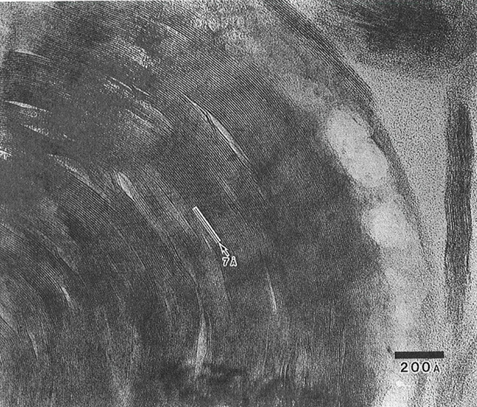
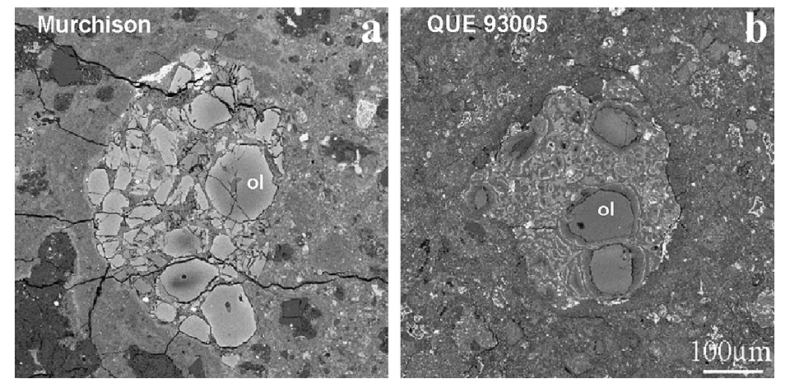
‘Water’-rich meteorites
Mighei
Up to 10 wt % « water » in carbonaceous chondrites (Kerridge et al. GCA, 1985)
within H₂O and –OH bearing minerals:
serpentines, tochilinites, montmorillonites, ferrihydrite, …
« Hydrated » asteroids?
« Dried » comet?
Murray
(Photo Guy Consomagno, Vatican city)
Tomeoka and Buseck, NIPR (1985)
Rubin et al., Geochim. Cosmochim. Acta (2007)

Slide 3
How much/many « water » ?
Thermogravimetric (TGA) analysis
Mass loss
Derivative
Different amount of water
Orgueil 30 % mass loss below 1000°C
10 % mass loss below 200°C
Different types of « water »
Adsorbed water
Mesopore water
OH in Fe-hydroxides
OH in phyllosilicates

Slide 4
How much/many « water » ?
Orgueil (CI)
H₂O
CO₂
(carbonates)
-OH
(« ferrihydrite »)
-OH
(phyllosilicates)

Slide 5
The necessity of dry spectra
Orgueil (CI)
Dehydration
NIR transmission spectra of Orgueil.
(Beck et al., Geochim. Cosmochim. Acta, 2010)

Slide 6
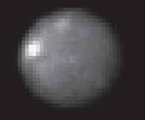
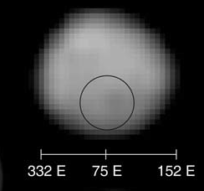
Hydroxylated asteroids
1-Ceres
Thomas et al., Nature (2005)
2-Pallas
1-Ceres: Rivkin et al., Icarus (2006)
Schmidt et al., Science (2010)
2-Pallas: Jones et al., Icarus (1990)

Slide 7
Hydrated asteroids
24-Themis
Ice coating model
Rivkin and Ehmery, Science (2010)
Licandro et al., A&A 2011
24-Themis: Rivkin and Ehmery, Nature (2010)
Campins et al., Nature (2010)
1-Ceres: Rivkin et al., Icarus (2006)
2-Pallas: Jones et al., Icarus (1990)

Slide 8
Diversity of the 3 microns band
Goethite= FeO-OH
Large diversity in term of band shape and position for (–OH) bearing minerals.
The 3-μm feature of goethite mimics that of water-ice.
(24-)Themis: Rivkin and Ehmery, Science (2010) Ice: Grundy and Schmitt, JGR (1998) Goethite (T): Ruan et al., Spectrochimica Acta (2002). Minerals: this study

Slide 9
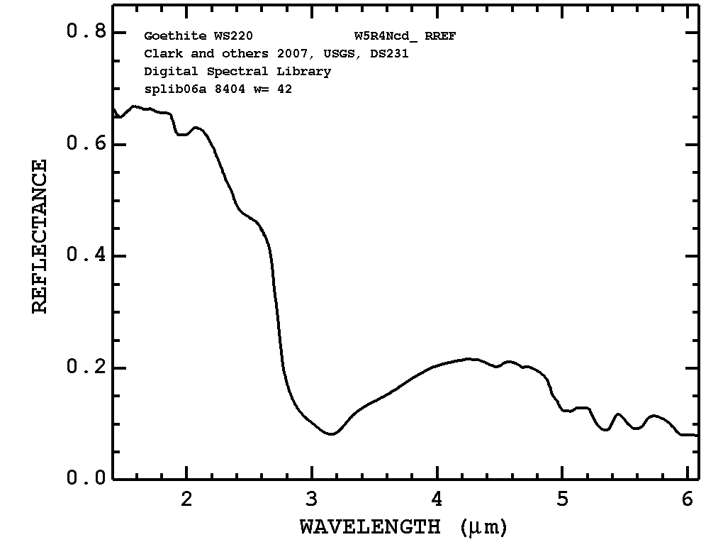
Spectra of hydroxydes, difficulties
Two « obstacles »
Spectra from libraries are usually saturated in the 3 microns region
Spectra are contaminated by adsorbed water
From USGS spectral library
Beck et al., GCA (2010)

Slide 10
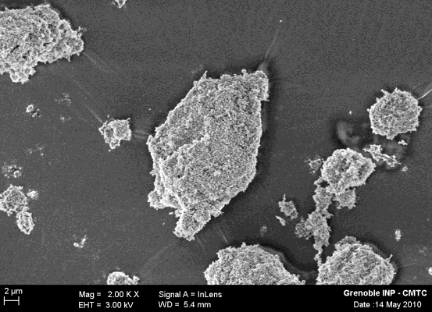
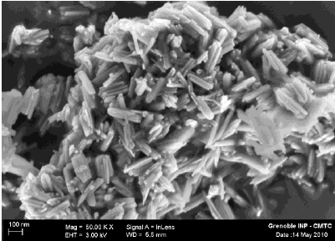
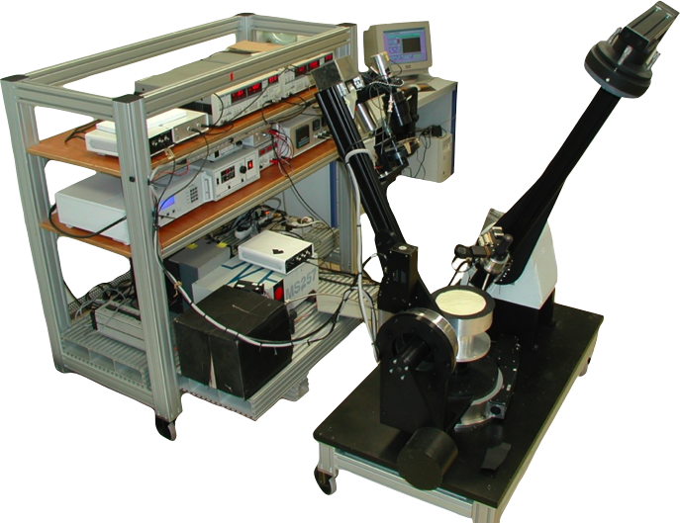
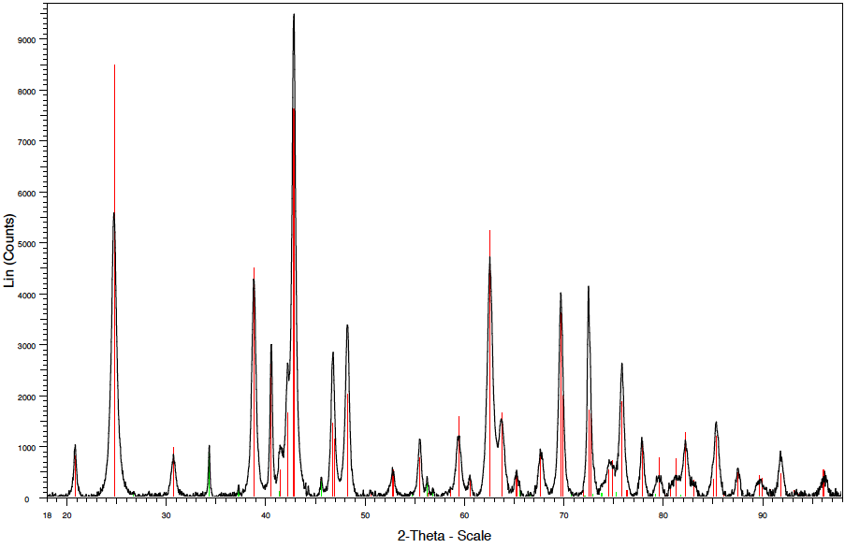
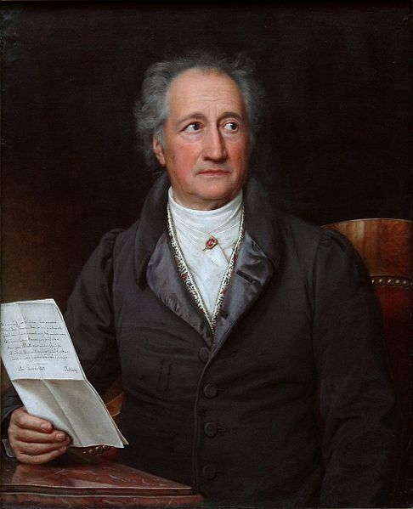
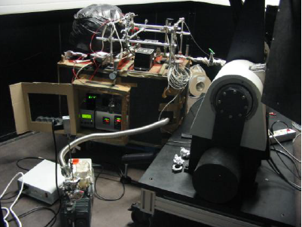
Geothite synthesis
NIR spectroscopy
Brissaud et al., Applied Optics (2004)
Synthesis by chemical reaction between NaOH and Fe(NO)₃ under
hydrothermal conditions (70°C).
✔
Montes-Hernandez et al., J. Crystal Growth and Design (2011)
Pommerol et al. Icarus (2009)

Slide 11
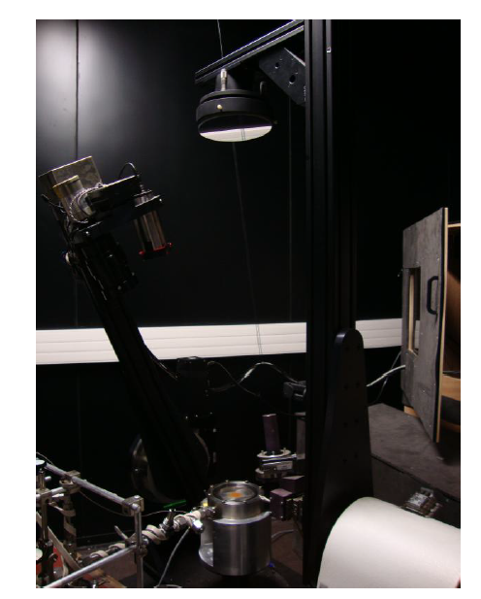
NIR spectrum of goethite

Slide 12
Goethite vs Ice on Themis (and Cybele)
Data
(24-)Themis: Rivkin and Ehmery, Science (2010)
Goethite (Reflectance): this study
Ice: Grundy and Schmitt, JGR (1998)
Goethite (Transmission): Ruan et al., Spectrochimica Acta (2002)

Slide 13
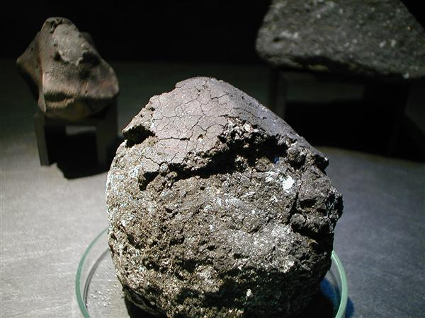
A mechanism for goethite synthesis
Ferrihydrite is abundant in CI meteorite (Zolensky, 1993; Tomeoka and Buseck, GCA, 1988).
In CI’s most iron is present as Fe³⁺
.
Upon moderate heating (500-600 K) it should readily transform to goethite…
Sasaki et al. Nature (2001)
How to reach 500-600 K?
-solar heating? Difficult, quite far from sun.
-space weathering (micrometeorite)
-impact induced heating (macrometeorites)

Slide 14
A mechanism for goethite synthesis

Slide 15
How to discriminate –OH from H₂O
H₂O
X-OH
Solid water: Grundy and Schmitt, JGR (1998)
Liquid water: Segelstein, Master’s Thesis, (1981)
Structural water: Pommerol et al., Icarus (2009), this study
Adsorbed water: Pommerol et al. (2009), Icarus, this study
Minerals: this study

Slide 16
Ice vs Mineral on Themis (Cybele)?
?
Solid water: Grundy and Schmitt, JGR (1998)
Liquid water: Segelstein, Master’s Thesis, 1981
Structural water: Pommerol et al., Icarus (2009), this study
Adsorbed water: Pommerol et al. (2009), Icarus, this study

Slide 17
CONCLUSIONS
We have measured the NIR reflectance spectra of « diluted » goethite (FeO-OH) under dry conditions.
3-μm feature very much alike that of water ice
Minor amount of goethite might explain the shape of the 3-μm band of Themis and Cybele.
If so, surface material are likely very mildly metamorphosed CI-like material
Strong need of dry unsaturated spectra of « diluted » hydroxides
Themis and Cybele still remains « hydrous »

Slide 18
NEXT
Observations
Does goethite really fits the 3 μm band?
Correlation between 1.9 and 3 μm?
Correlation between VIS/VNIR and NIR (0.9 μm)?
Is there a 2.7-2.8 μm feature on Themis/Cybele?
Laboratory
How much Hydrogen (-OH and H₂O) in chondrites through TGA
Reflectance spectra in dry conditions
improve models of the diurnal cycle: transport properties of CC
H₂O diffusion coefficient under range of p_{H2O}
Thermal inertia at low-T
Adsorption properties
(de)hydration kinetics
How fast does a « frozen asteroid » loses his water

Slide 19
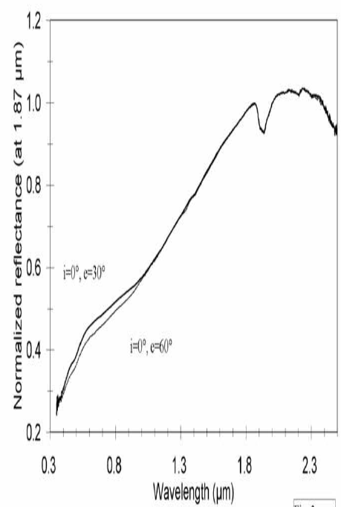
Cloutis et al. 2011

Slide 20
THANKS

Slide 21
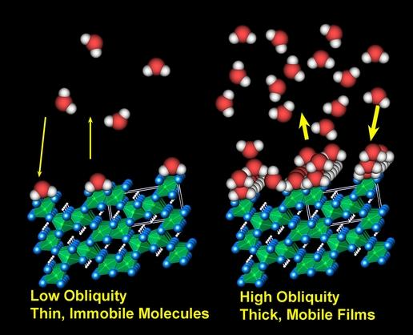
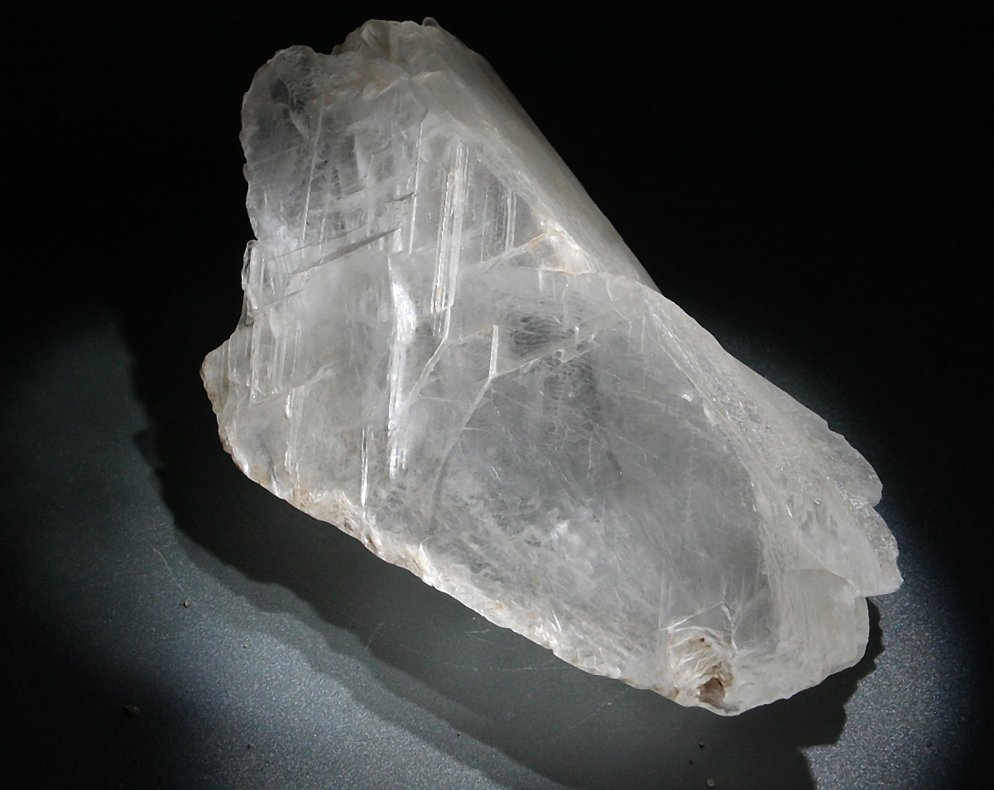
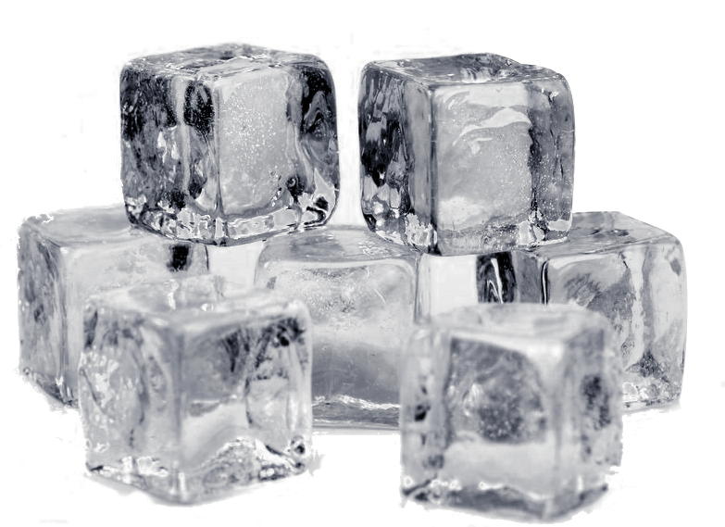
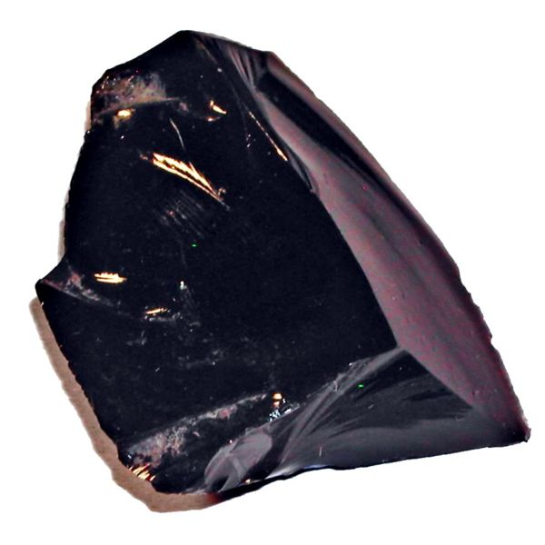
Condensed molecular water
Liquid water
Adsorbed water
Structural water
Ex: Gypsum,
CaSO₄ 2H₂O
Solid water
Magmatic water

Slide 22
NIR signature of molecular water
Reflectance (a.u.)
-ln(k) (a.u.)
Solid water: Grundy and Schmitt, JGR (1998)
Liquid water: Segelstein, Master’s Thesis, 1981
Structural water: Pommerol et al., Icarus (2009), this study
Adsorbed water: Pommerol et al., Icarus (2009), this study

Slide 23
H₂O vs –OH signature, Mars
Pommerol et al. (submitted)
+H₂O
+OH

Slide 24
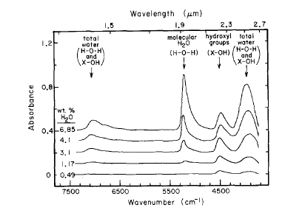
The NIR signature of –OH/H₂O
X-OH
and
H-O-H
3-μm band
3500
2500
1500
1000
Stolper et al., CMP (1982)

