Slide 1
WELCOME TO THE techPATH 2010 Annual Meeting
September 21, 2010

Slide 2
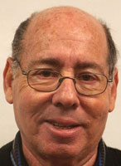
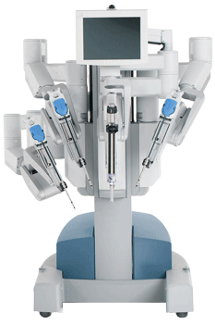
SPECIAL THANKS TO
FLORIDA HOSPITAL, CELEBRATION
for hosting this meeting
and for
the post-meeting tour that will include
the da Vinci Robot (right)

Slide 3
Preliminaries
Welcome –Jeff Bindell, FHTCC techPATH Director
Introduction of the techPATH Team
Florida High Tech Corridor Council, STEM Florida Award – Roger Pynn, Curley & Pynn Public Relations
Welcome: Rick Wassel, Executive Director, Florida Hospital Celebration Health – Nicholson Center for Surgical Advancement

Slide 4
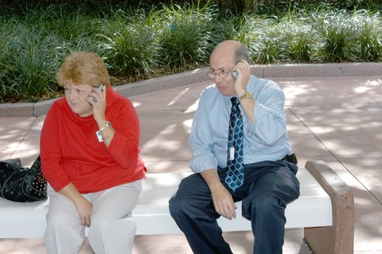
The Real Boss
Vicki Morelli
Vicki Jeff
Photo taken at Disney Program

Slide 5
Agenda Areas
What have we done recently and what are we in the process of doing?
Special Presentations
Discussion and New Business
Working Lunch
For dessert: the tour
Speakers: the meeting must end at noon so we can stick
to the tour schedule. Please help.

Slide 6
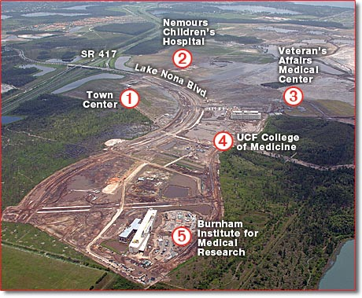
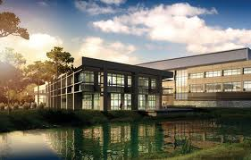
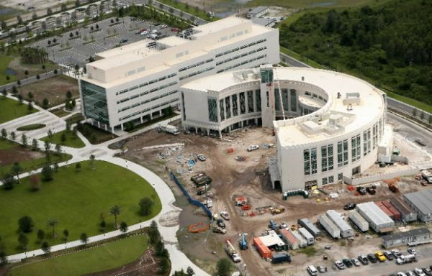
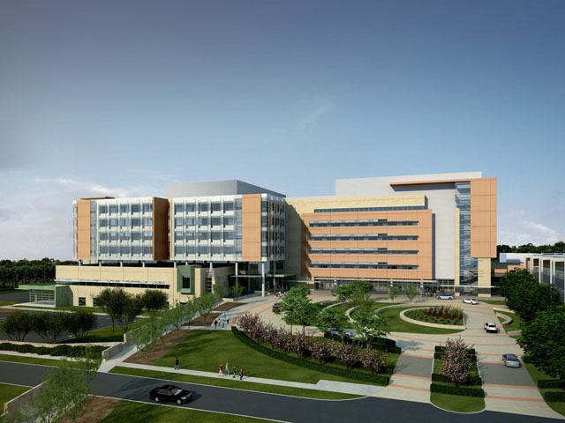
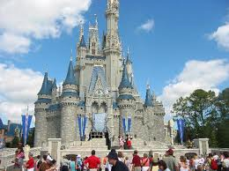
MEDICAL CITY, ORLANDO

Slide 7
Educational
Thrust
techPATH
1
Programs for Teachers
Technology Updates
2
Program for 6th Graders (Usually)
Math & Physics Day
3
Program for Teachers
Update on Microscopy

Slide 8
Program Goals
Teachers
Add to High Tech Knowledge
Explore a real High Tech Business
Return to classroom tell students about what you did.
Students
Exposure to material related to a High Tech education.
See the connection between STEM and the workplace, jobs and salaries.

Slide 9
techPATH Provides
The program
The food
The speakers/demonstrators
Transportation when necessary
School Cost
=
$ 0.00

Slide 10
Approximately 2500 Teachers / students have participated in our programs.
Factoid:

Slide 11
Program Summaries
Approximately following the Agenda

Slide 12
I/ITSEC – Hank Okraski, JBB
Largest Military Simulation Conference/Display in the Milky Way. Held at Orlando Convention Center
techPATH programs also supported by I/ITSEC
Student Program – One group of Middle School Students using the Math and Physics Program in the Morning and a tour of the convention center floor in the afternoon.
Teacher Program – 40 to 50 teachers spread over a number of counties. Morning will be presentations about simulation and the afternoon will be a walk around the convention center floor.

Slide 13
Biomedical Program at Burnham Institute – April 20, 2010
UCF College of Medicine, Jeanette Schreiber, Associate Dean, Special Projects and Chief Legal Officer
Sanford-Burnham Medical Research Institute , Dr. Gregory Roth, Associate Professor, Director of Medicinal Chemistry
Medical City – Moderator Overview and Introduction of Panel Speakers, Thad Seymour, Ph.D. – Tavistock – Vice President and General Manager of Health and Life Science Investments, Lake Nona Management Company

Slide 14
Biomedical Program at Burnham Institute – April 20, 2010
Preparing Today’s Students for Tomorrow’s Workforce – Panel Discussion and Q&A
Sherri Marinovich, Vice President, Community Support, Sanford-Burnham
Owen Wentworth, Chairman, Workforce Central Florida
Lygia Lee Arcaro, Education Officer, Veterans Administration
Dr. Jim Sylvester, Director, Cell & Molecular Medicine Lab, Nemours Children's Clinic

Slide 15
Biomedical Program at Burnham Institute – April 20, 2010
Valencia Collegiate Academy, Dr. Michael Bosley, Assistant Provost
Medical Robotics, Sherrick T. Wassell, Nicholson Center for Surgical Advancement, Florida Hospital
Strawberry DNA Presentation, Dr. Donna Poniatowski, Journeys Academy
Strawberry DNA Lab Experiment – Group Rotations 45 Minutes Each
Tour of Sanford-Burnham Laboratories, George Kyriazis, Ph.D., and Daniela Divlianska, Ph.D.

Slide 16
Biomedical Program at Burnham Institute – April 20, 2010
Teachers were award winners and were recognized by Dr. Schott – PRISM
Program was a “one shot” deal but provided ideas about how to do a program Medical Technology/Robotics around the corridor with
USF Health
UCF & Medical City
Shands in Gainesville
Numerous smaller local hospitals & associated local industry.
IS THERE INTEREST?

Slide 17
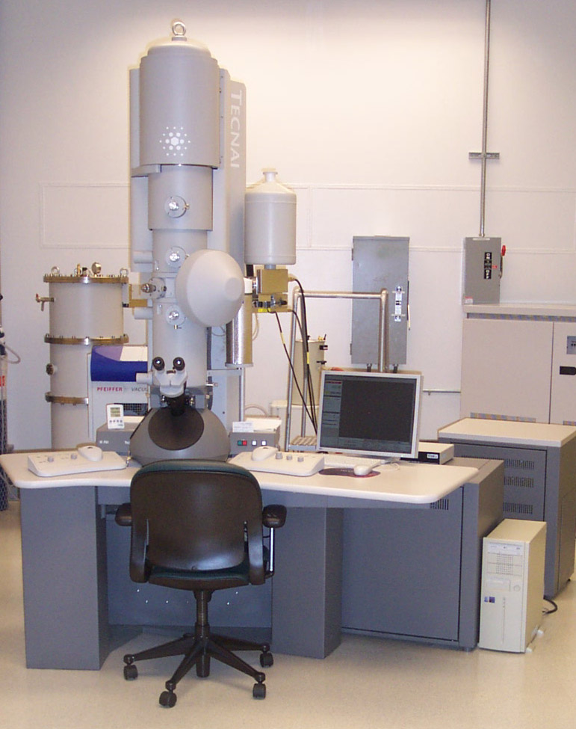
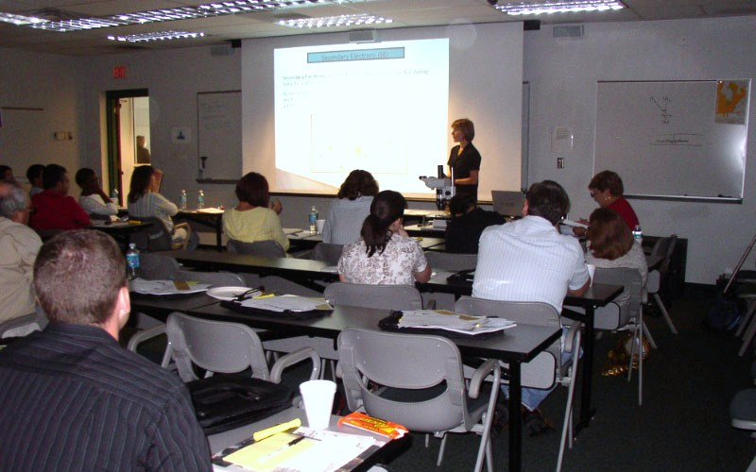
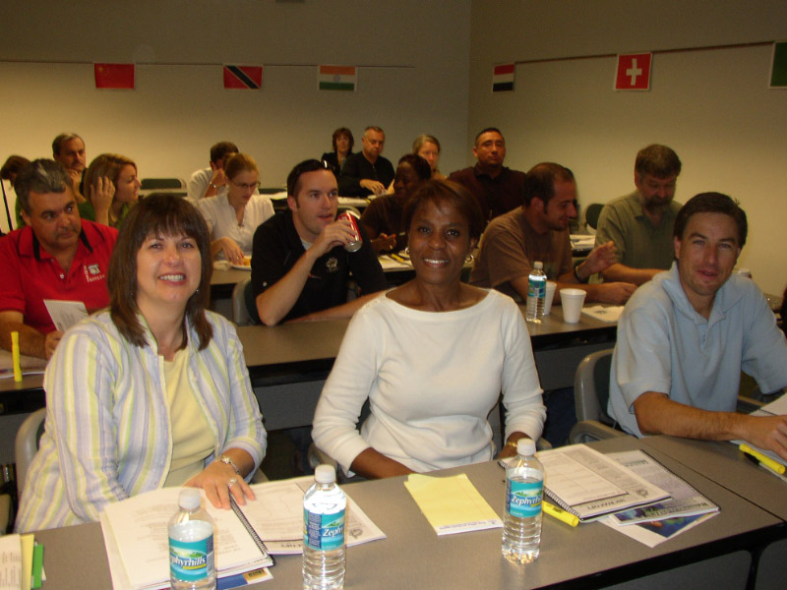
Microscopy Program
Program is offered to teachers and has been held at UCF, UF and USF for a few years.
Learn about microscopes and other high-tech tools
Get to see them up front.

Slide 18
Microscope Program (Teachers)
Review/Learn about Microscopes
Magnifying Glass
Optical Microscope
Scanning Electron Microscope
Transmission Electron Microscope
Other high-tech characterization techniques
There is a scanning electron microscope that is available at the Orlando Science Center that can be used in a program over the internet or as a class trip.

Slide 19
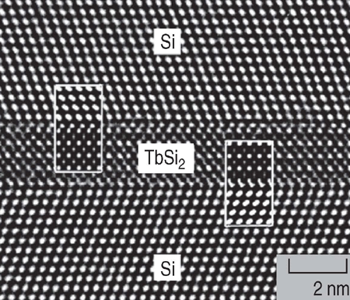

Slide 20
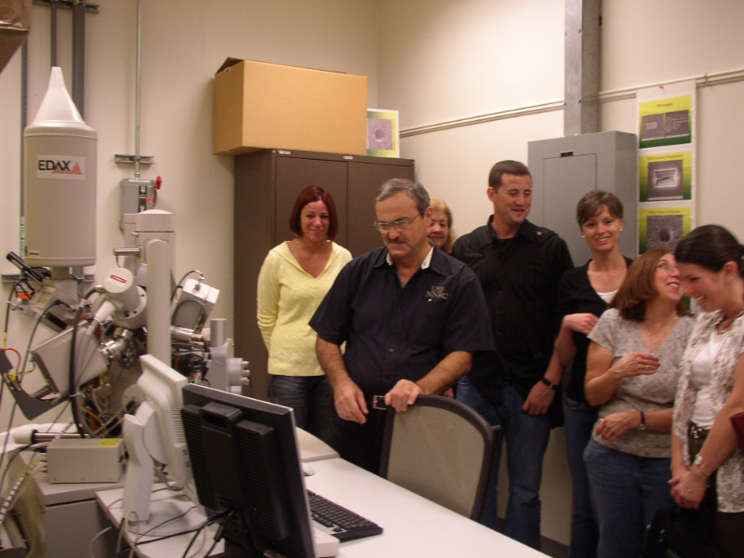
Limited Hands-On!

Slide 21
Math and physics program
Program for Students – Middle School targeted

Slide 22
The Program
Discuss futures
Describe the fundamental laws of physics via popular demonstrations.
Students participate in most of them
Connect physics to
simulation
gaming
digital media
Show the importance of mathematics
Weave together with a tour

Slide 23
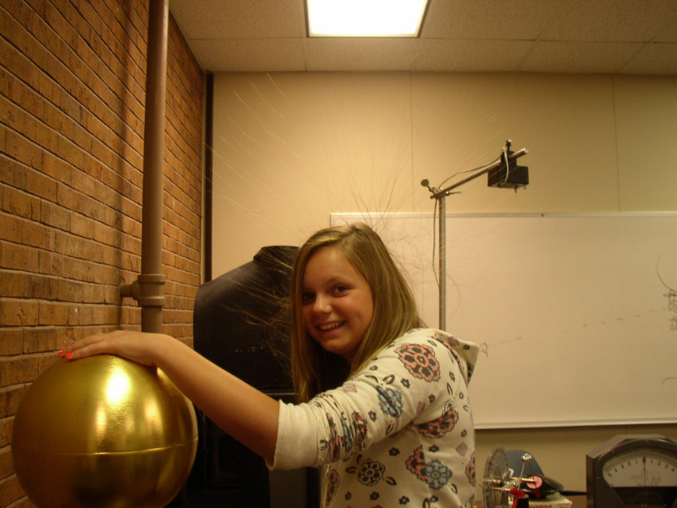
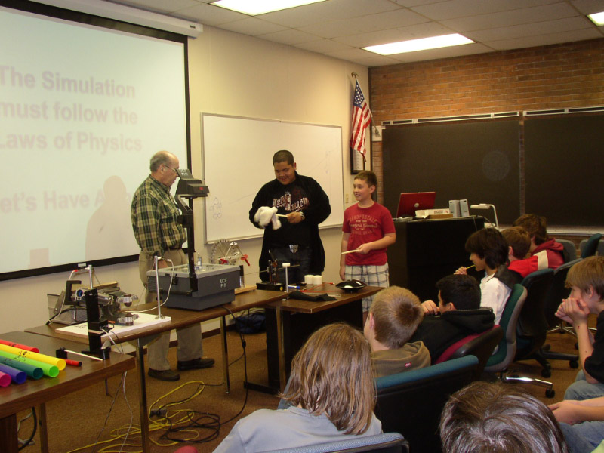
MUSIC & WAVES
MECHANICS
ELECTRICITY
MAGNETISM
MAXWELL’S EQUATIONS
LUNCH
Bad Hair Day
PHYSICS & MATH DAY

Slide 24
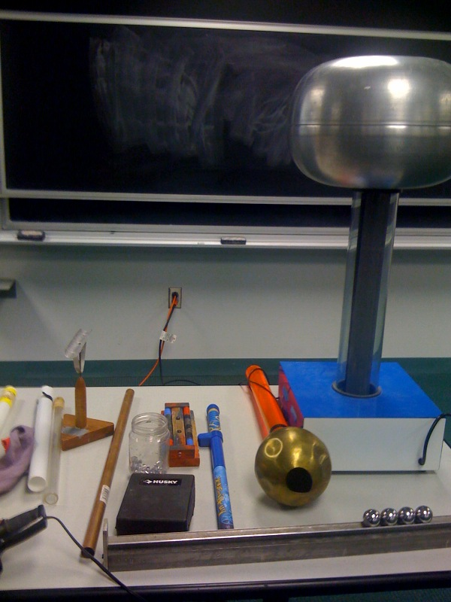

Slide 25
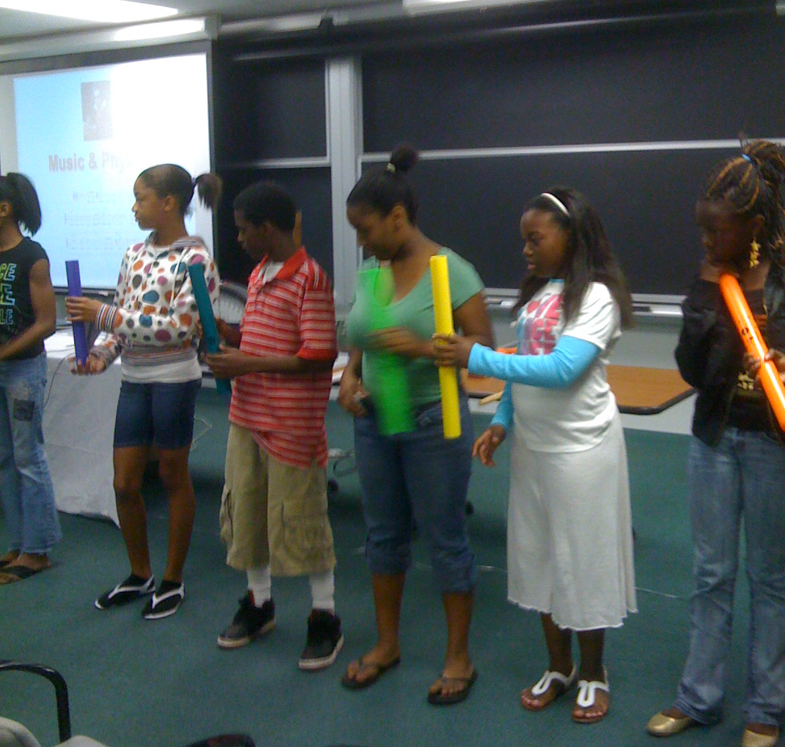

Slide 26
Who are these students?
SAIC

Slide 27
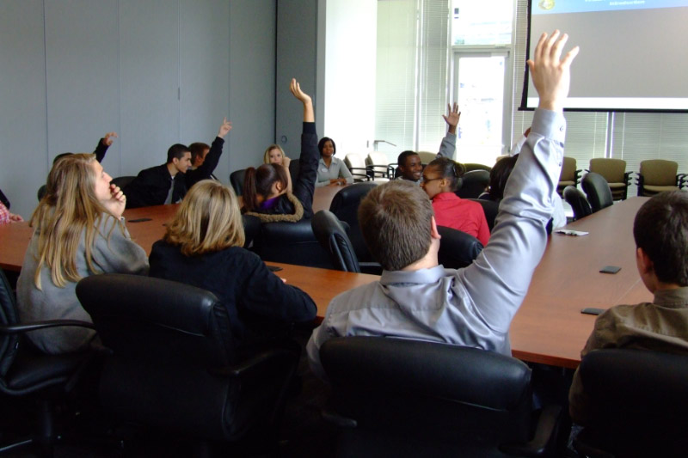
SAIC
Journeys

Slide 28
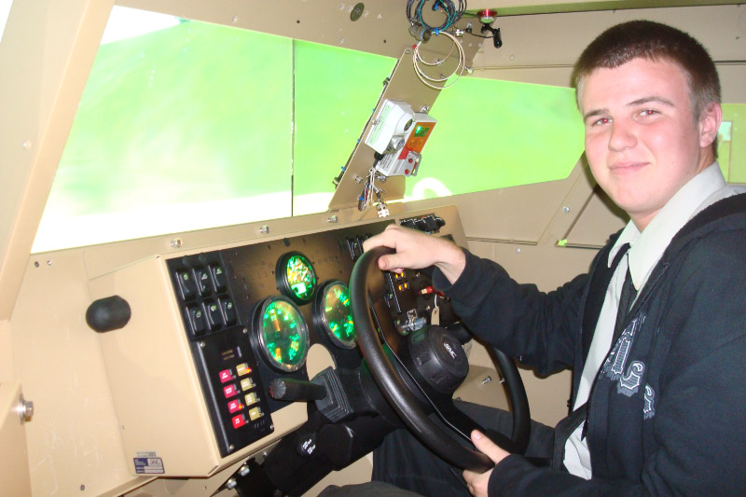
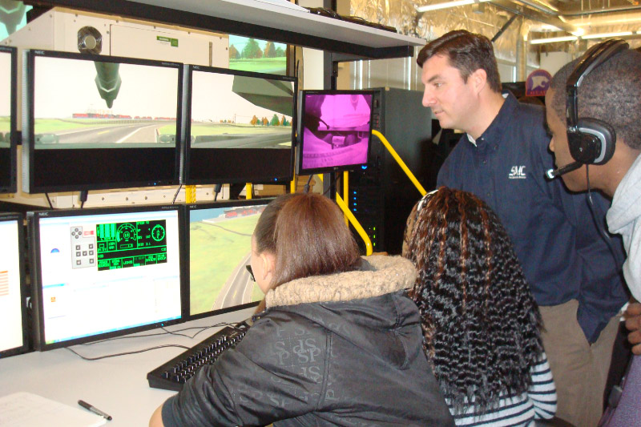
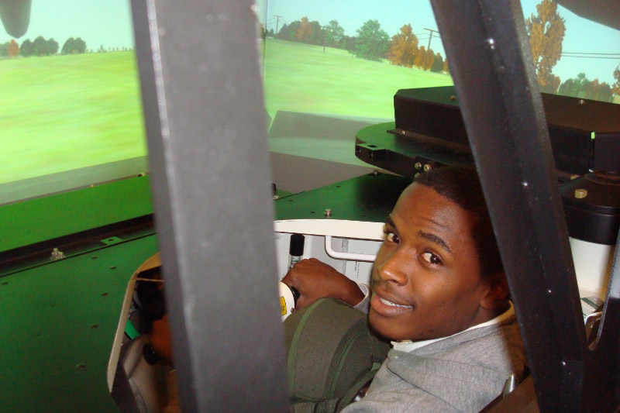
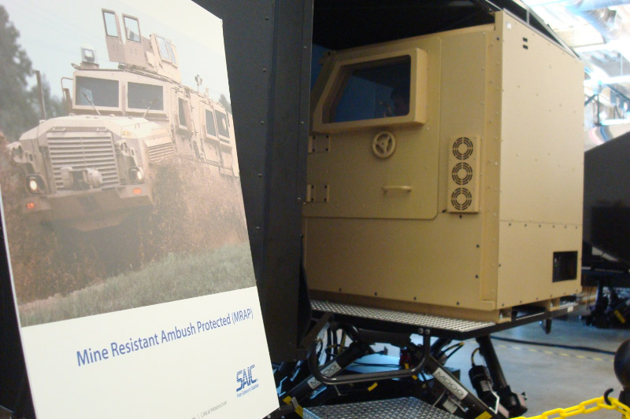
SAIC - Journeys

Slide 29
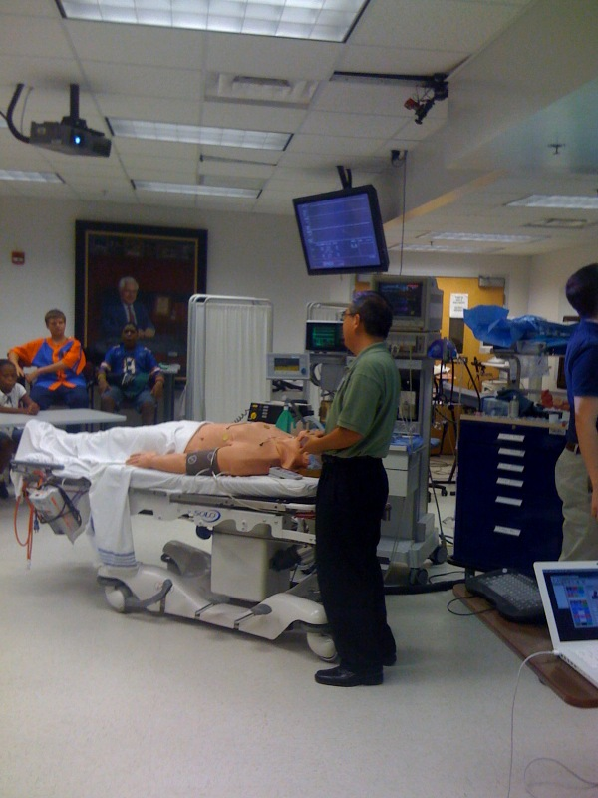
G
A I N E S V I L L E
Alachua County

Slide 30
New Stuff.
techPATH has acquired a complete equipment set. So far, we borrow mostly from the universities.
Math and Physics program can be delivered to “remote schools”
Orlando Science Center will partner with techPATH in this effort.
We can bring the program to remote areas.
We could visit one school and do the morning program twice in a classroom setting if no tour sites are available.

Slide 31
NEW Programs and Guest Reports

Slide 32
Cyber Security Program with Valencia College
Dean Nasser Hedayat

Slide 33
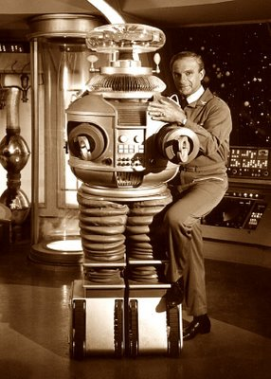
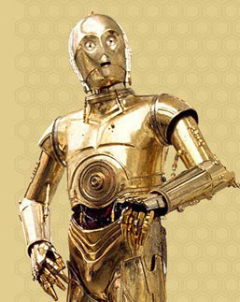
Robbie the Robot
When you think of Robots, DO you think of …

Slide 34
New Program With FLATE
High-Tech Manufacturing

Slide 35
valpak??

Slide 36
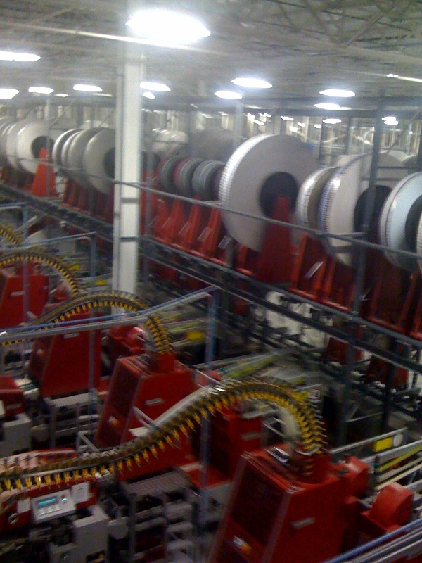
Valpak

Slide 37
FLATE UPDATE
Marilyn Barger

Slide 38
Orlando Science Center Updates
JoAnn Newman (CEO)
Heather Norton
Kellen Nixon

Slide 39
NAVAIR & STEM
Robert Seltzer & Sunny Simmonds

Slide 40
FLVEC
Steve Burley & Michael Zaharios

Slide 41
Workforce Issues
Owen Wentworth – FHTCC & Chairman of Central Florida Workforce Board.

Slide 42
UCF – NSF STEM GRANT for STEM TALENT EXPANSION
David Metcalf

Slide 43
INTERESTED IN ANY OF OUR PROGRAMS????
EMAIL VICKI MORELLI
vemorelli@cfl.rr.com
EMAIL JEFF BINDELL
bindell@mail.ucf.edu
Also see
www.floridahightech.com
click on “Workforce” in menu

Slide 44
Thank You

