Slide 1
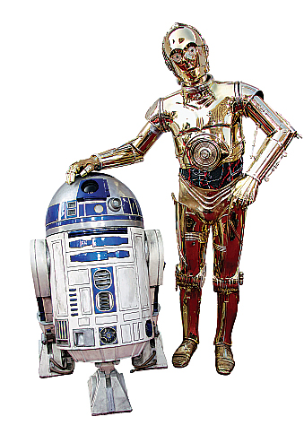
Welcome!

Slide 2
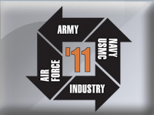
Welcoming: Carver Middle School, Lake County Public Schools
Robotics
Dec 1, 2011

Slide 3
Starring
Dr.Al-Rawi
Ms. Morelli
Dr. Bindell

Slide 4
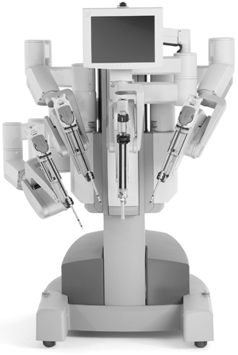
and the I/ITSEC folks + Florida Hospital’s Da Vinci Robot

Slide 5
A Wake Up Exercise
See if you can trace the circuit around the office....Find the red dot then click on it to move on...
If you’ve seen this one, please keep it to yourself!

Slide 6
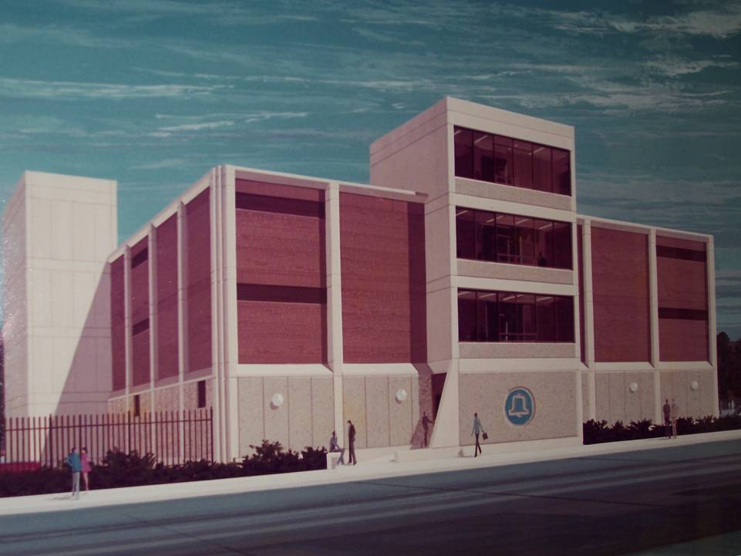

Slide 7
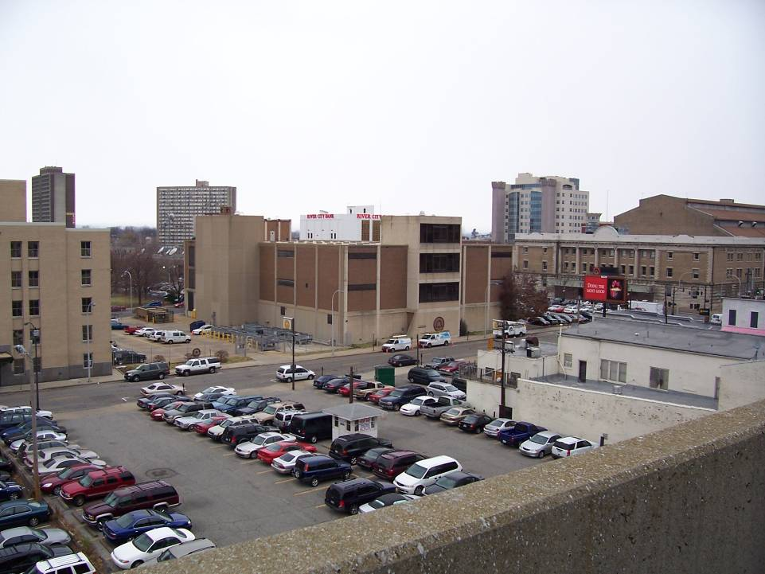

Slide 8
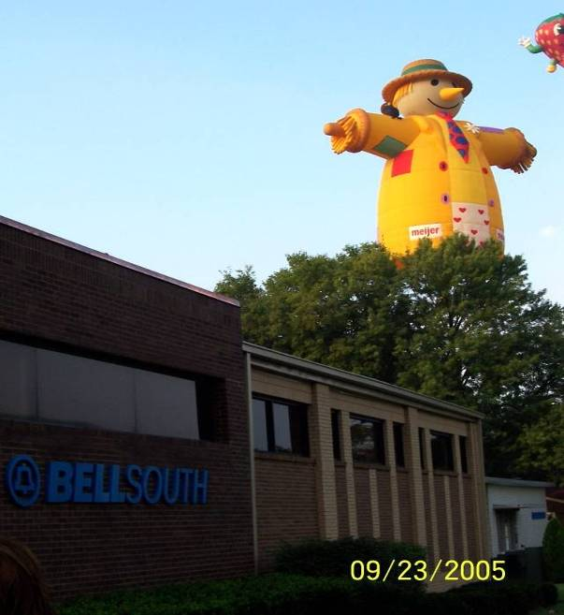

Slide 9
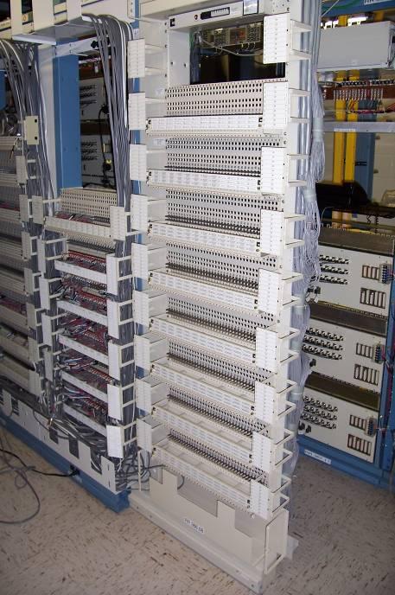

Slide 10
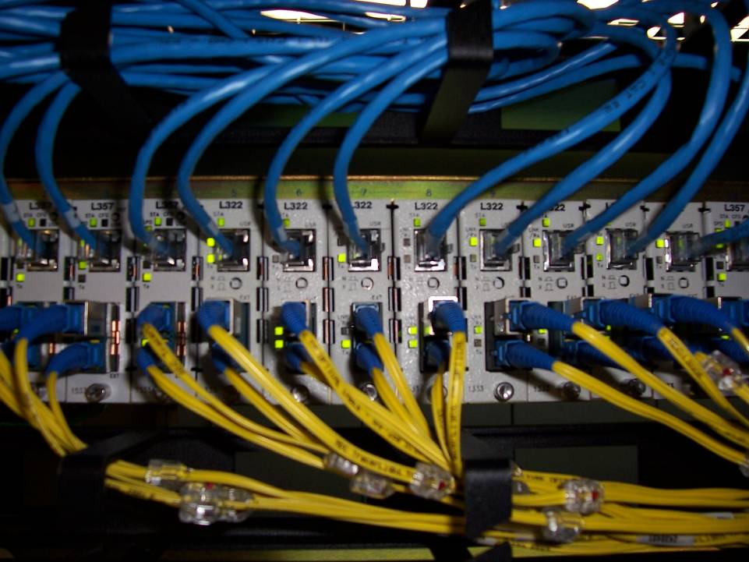

Slide 13
☺
Are you all
AWAKE??? !

Slide 14
Why talk about robots to students who know a lot about robots?
We know that you already know a lot about robotics.
We want to do the following for you:
Give you a broader view of what robotics is.
Emphasize that robotics cab be a great career option
Connect robotics with other related careers
Let you do some “unusual” programming
Introduce you to a few robots .. serious ones!
Jeff, Max and Leonardo
Lunch
Tour of the I/ITSEC convention displays.

Slide 15
what is a robot?
?
An important question for you to answer …

Slide 16
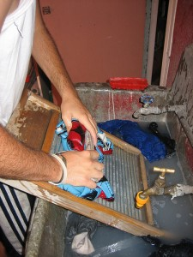
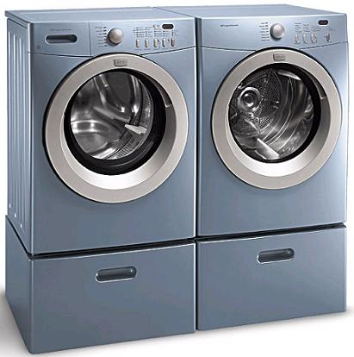
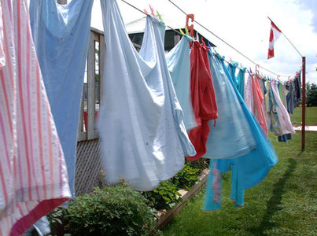
Robots are NOT New!
Air Dry
Wash
“Robot”

Slide 17
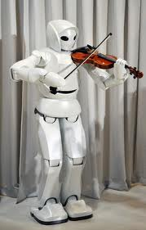
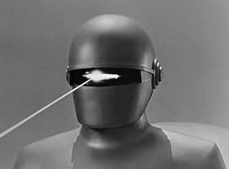
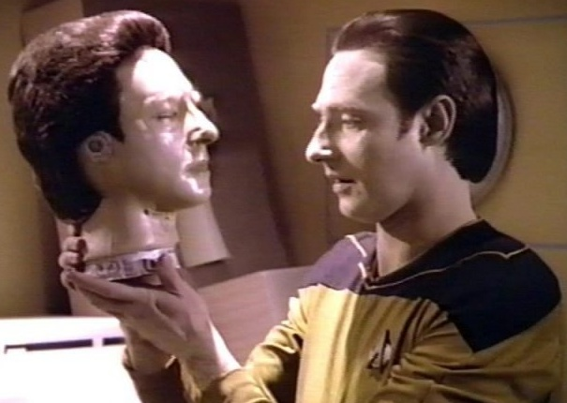
Are any of these Robots are Real??
NO!
YES!!
NO!

Slide 18
Check This Out

Slide 19
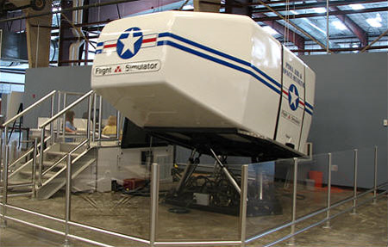
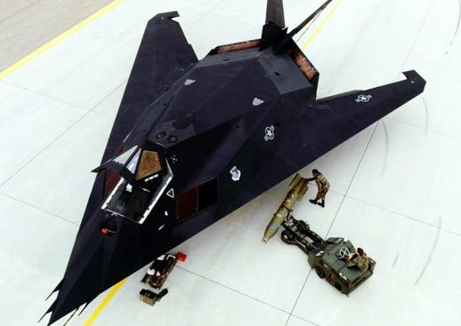
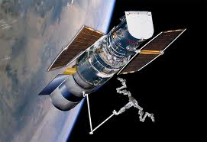
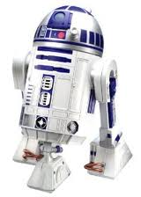
Are These Things Real?? Are they robots??
YES!

Slide 20
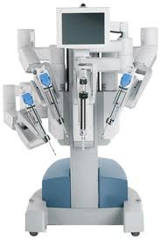
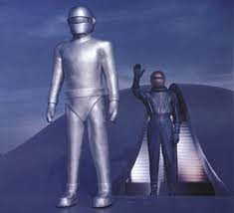
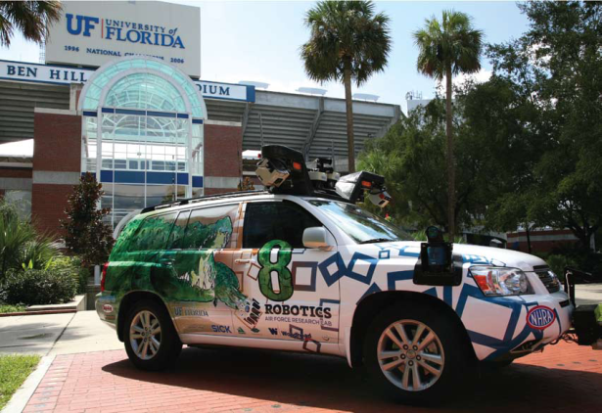
Robots
Autonomous Remotely Controlled Next??

Slide 21
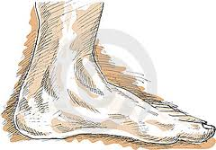
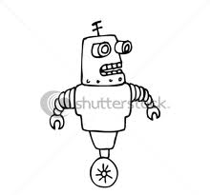
Computer
Remote or Resident
Human - Remote
Sensors
with above
Human
Programmer
Humans Win!

Slide 22
Connections
Simulation is a relatively new field of science and engineering
Makes you think you are someplace else.
Think Disney (Mission Space, Disney Quest)
Think Games like Madden (invented in Orlando!)
Yes, think ROBOTS!

Slide 23
All Comes Together
Robots
Intelligent
Control
Games
Simulators
Trainers

Slide 24
So we add to all of this …
Physics
Math
Engineering
You need {
Robotics

Slide 25
MATH?? WHY MATH ??

Slide 26
Here is the “why” of “why math”?

Slide 27
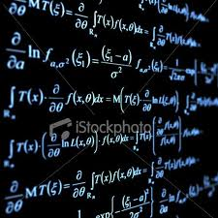
that’s why!

Slide 28
Do you want to be a Robotics Engineer?
Are You Going
to be Ready??

Slide 29
A test: Which of the following statements are true?? Are any untrue?
Technology can be fun.
You can get a good job in technology
You need a good education to take advantage of the future of technology
You need math and science to understand technology
The Unites States is the world’s leader in new technology.

Slide 30
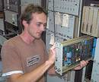
What is Your Job going to be?
It’s YOUR Choice!
9-12ish State College (2 yr) University

Slide 31
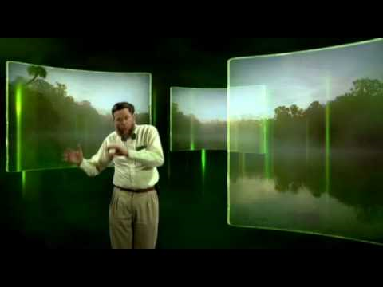
The Far Future?
Education is critical!

Slide 32
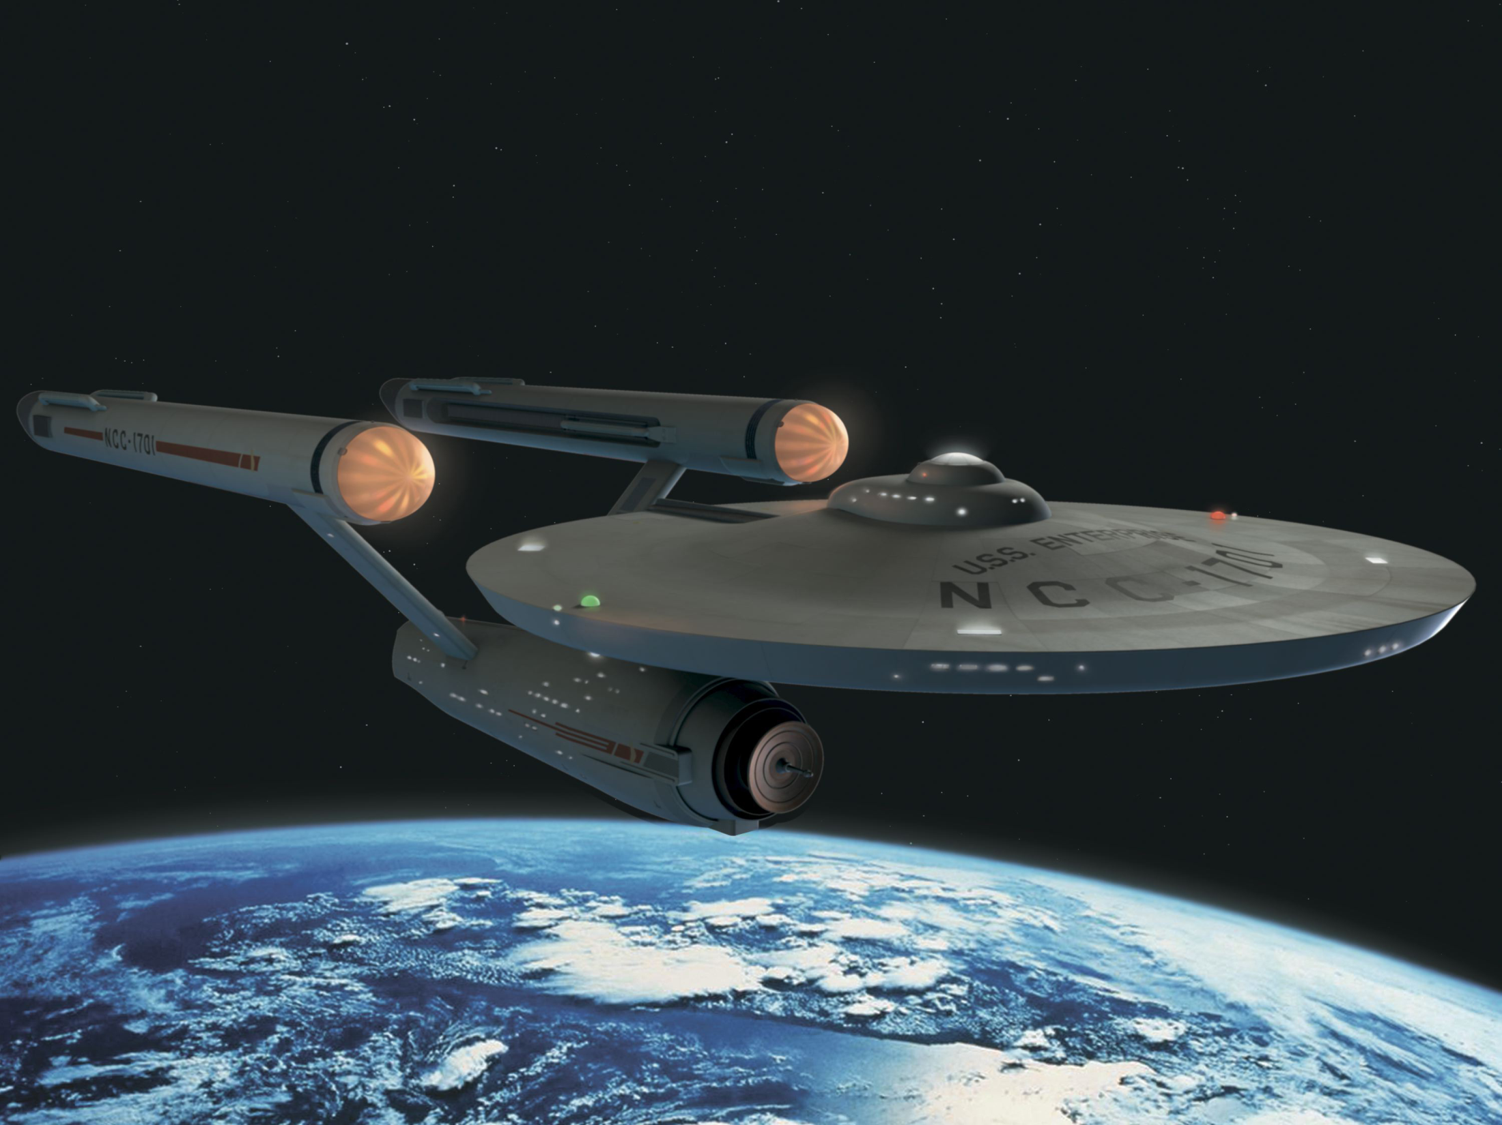
Because TOMORROW, this will be REAL!

Slide 33
What should you be doing to prepare??
Take lots of science.
Take lots of math.

Slide 34
Well … it’s YOUR future. Now for a taste of ROBOTICS!
Get Ready
For It!!

Slide 35
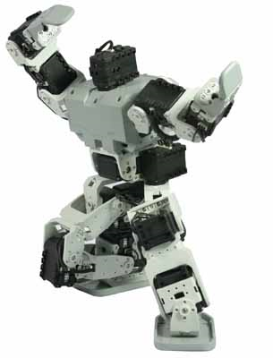
BRING THEM ON!!

Slide 36
PLEASE WELCOME!
A Robot??
Dr. Ahlam Al-Rawi
Physics
Department

Slide 37
STOP

Slide 38
ROBOTICS: COOL AND FUN!
Jeff and Max

Slide 39
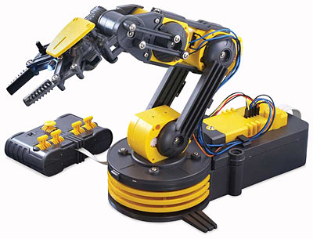
And This

Slide 40
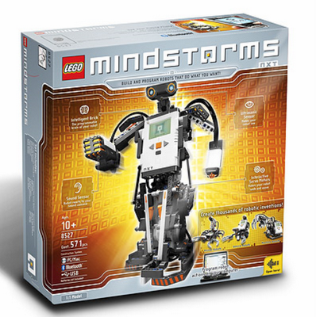
And Even This

Slide 41
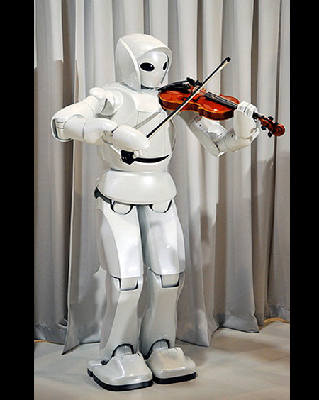
What’s the Difference?
Computer Computer Control Unit
Each does what it is TOLD to do ..
directly by a human operator
by a computer program that was written by a human operator

Slide 42
What is a ROBOT?
A device that is built to independently perform actions and interact with its surroundings
If we control the Robot it will become a Remote-controlled device.
We would like our robots to have ears to listen and eyes to see. They also should be able to walk on legs or wheels.
They should also be able to examine its surrounding, respond to obstacles, such as chairs, walls, distinguish colors

Slide 43
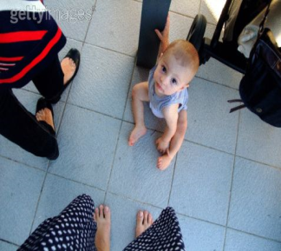
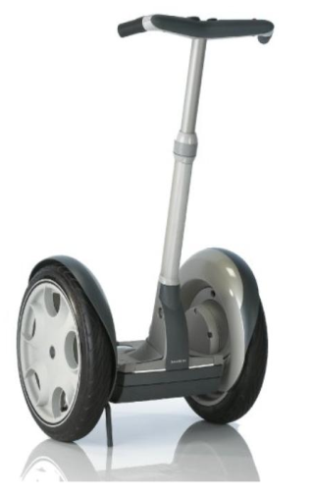
A robot should to be able to:
sense its surroundings
detect Colors
move around

Slide 44
And be able to follow instructions
From a human
From a computer

Slide 45
Let’s meet Jeff and give him something to do.

Slide 46
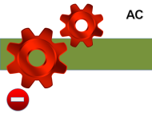
WHAT JEFF UNDERSTANDS
STOP
GO FORWARD N STEPS
GO SLOWER
TURN LEFT
TURN RIGHT
OPEN A DOOR
CLOSE A DOOR
POWER OFF
POWER ON
RoboJeff
each step is 20 “

Slide 47
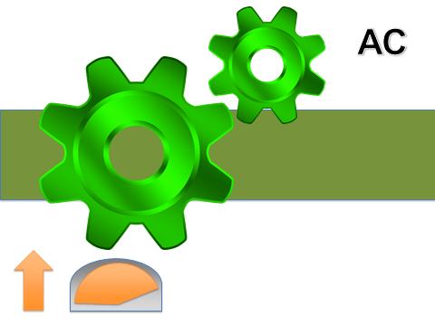
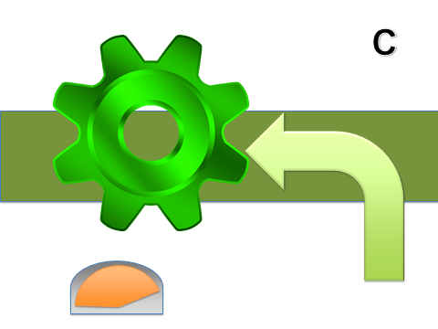
Commands Jeff can do
Write Number of steps Jeff can moves

Slide 48
The Assignment
Jeff stands at one end of the room with a set of obstacles between him and the door.
Let’s write a program (a list of commands) to get him get from one place to another.

Slide 49
Let us program Jeff Robot
We will have three groups
Each group will put a sequence of commands ( program) using the command cards.
We want Jeff to enter the room from one door
and leave from another.
Each group will decide on finalizing their program

Slide 50
Commands Jeff can do
Number of steps Jeff can moves

Slide 51
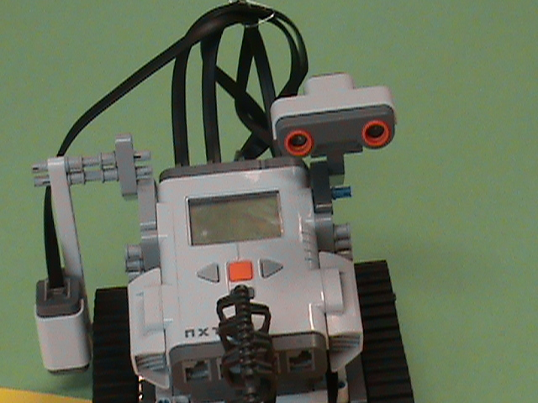
Meet Max The Robot
Hi!
I’m Max

Slide 52
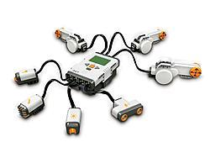
Max’s Innards
Three Motors
Ultrasonic Sensor
Color Sensor
Two touch Sensors

Slide 53
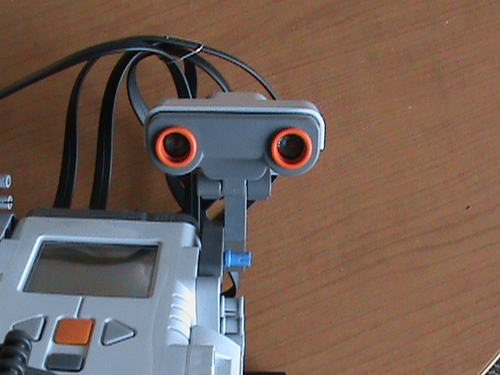
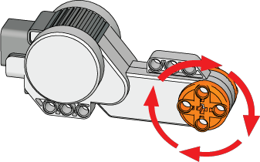
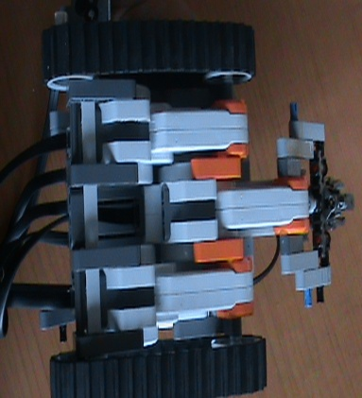
Introducing Max
Motors
B
Sound sensor
A
C
Color and light sensor

Slide 54
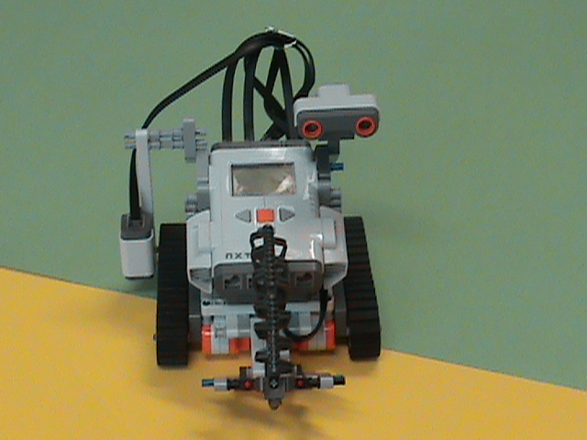
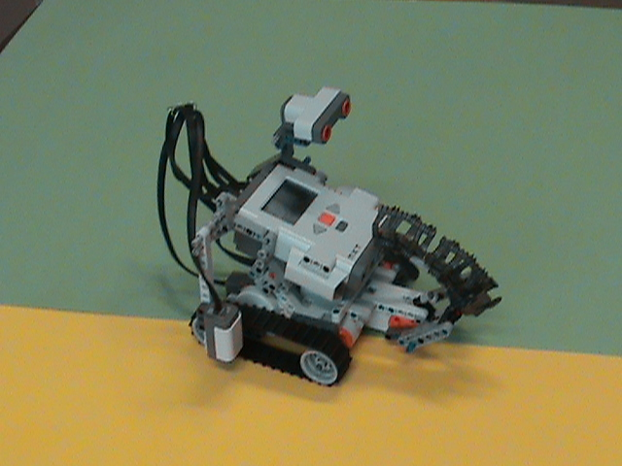
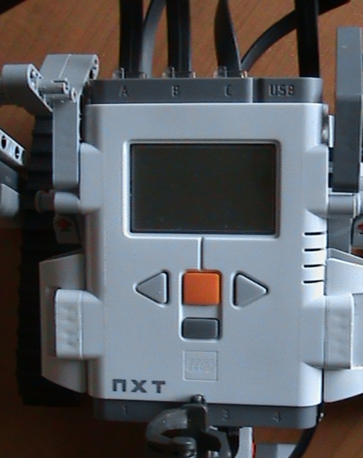
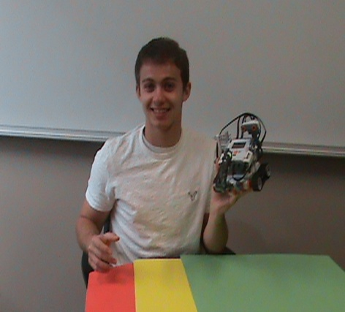
Up Front With Max?
Screen Display

Slide 55
Commands That Max Understands

Slide 56
We have already programmed Max
Max is to go over a road with red, yellow and green areas.
These colors mean what they mean on a traffic signal.
Let’s see how max can be “programmed” to follow the law!

Slide 57
Traffic Light Program
GOTO 1
IF
1
IF
GOTO 1
IF

Slide 58
Let’s Do It!

Slide 59
Now, The Nicholson Center’s Da Vinci Robot

Slide 62
What is a Program?
A program is a set of instructions. Programming is what we do when we create a program.
How we write our first program?
Let us name our robot MAX.
Start with Instruction that we understand and we think that Max will too. These Instruction called
Pseudo-code. Let us do that so let us:
Max move forward until your touch sensor is pressed and released, then stop
Max turn 90 degree, then give a loud Beep. Move backward until you hit a black object.

Slide 63
How can we give the robot a life? How can we let it do what ever we want it to do??
Programming !!!!!!!! This is the component that we need to add our self to make Jeff and Max comes to life…..FUN
Look at JEFF and MAX all what they do is stand
I think we all agree that Jeff and Max should do something .

Slide 64
How can we make them do some thing any thing???
We need to give them instruction… special one that they can understand,
Its not enough that we do understand the instruction The most important part is
IF Jeff and Max understand our instruction We need to understand their language
The instruction called PROGRAM (the information that Jeff and Max UNDERSTAND).

Slide 65
Programs are for US too
Parents, Teachers and Bosses…. Program us to LEARN and DO tasks
They give us Instruction that we understand and we accomplish the tasks

Slide 66
PROGRAMMING JEFF AND MAX
Move FORWARD
OR
75% POWER
USE BOTH LEGS
OR
OnFwd(OUT_CB, 75);

