Slide 1
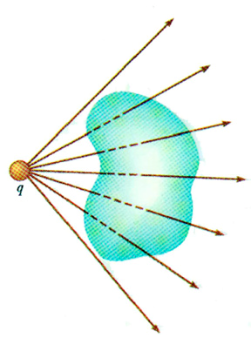
Gauss’s law
How much
flux is leaving
this surface?
3.3 28-Jan-11

Slide 2
Occurrences Now and Later
Today
Quiz
Gauss’s Law
Watch for WA
Monday
Finish Gauss – Start next unit.
Wednesday
Potential
Friday
Quiz, of course
Finish Potential if possible

Slide 3
Problem Solving Experiment: Next Week
Wednesday – 8:30
Friday – 12:30
Working on finding rooms. Will let you know on Monday.

Slide 4
Exam #1
Will be after we complete the next chapter on Potential.
Probably a Wednesday.

Slide 5
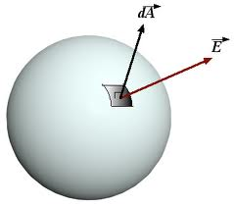
Let’s see what those Area Vectors are all about!
ΔA

Slide 6
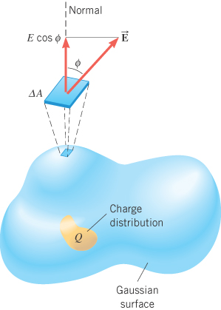
FLUX

Slide 7
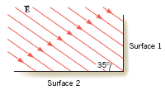
The drawing shows an edge-on view of two planar surfaces that intersect and are mutually perpendicular. Surface 1 has an area of 1.6 m², while surface 2 has an area of 3.4 m². The electric field E in the drawing is uniform and has a magnitude of 245 N/C.

Slide 8
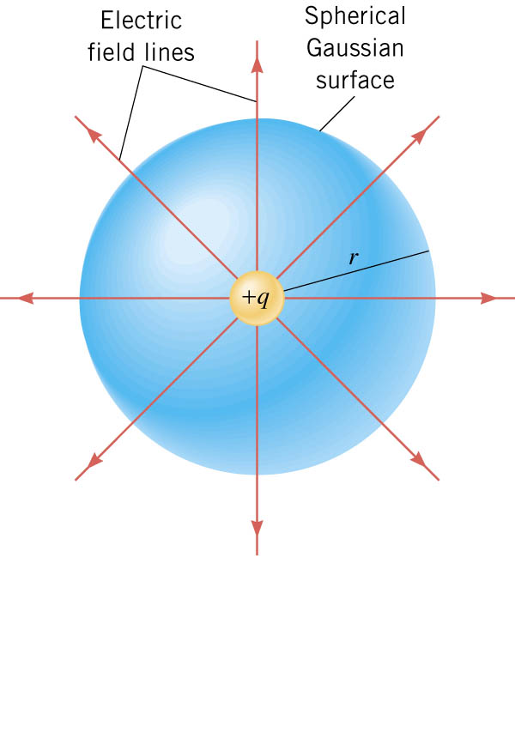
Flux Leaving A Sphere from a point charge
= 8.854187817...×10⁻¹² A·s/(V·m) = 8.854187817...×10⁻¹² F/m

Slide 9
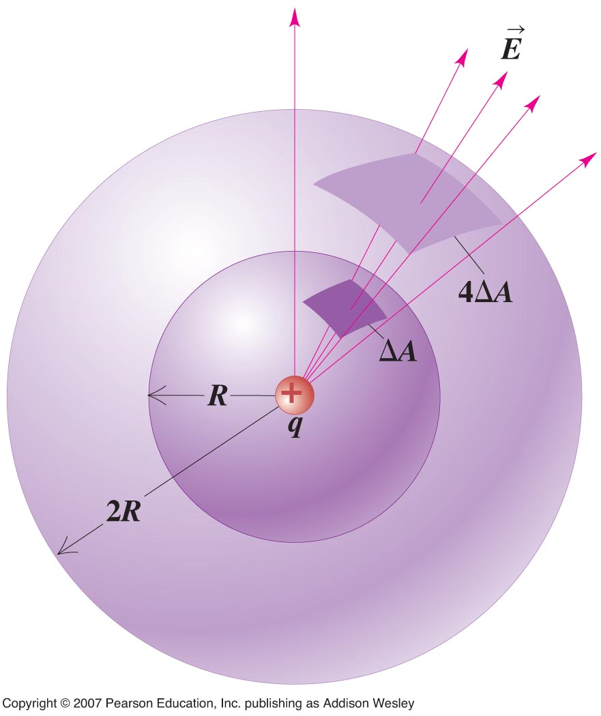
Gauss’s Law
Gaussian Surface

Slide 10
GAUSS’ LAW
The electric flux leaving any Gaussian
surface is equal to the net charge
enclosed in that surface divided by
the permittivity of free space:
SI Units of Electric Flux: N·m²/C

Slide 11
Gauss’s Law

Slide 12
Simple Example UNIFORM FIELD
E
No
Enclosed Charge
A
A
E
E

Slide 13
Charge Density (Definition)
A
Q

Slide 14
Infinite Sheet of Charge
+σ
h
A
A
E
cylinder

Slide 15
Conducting Materials
Conductors
Electrons are free to move.
In equilibrium, all charges are a rest.
If they are at rest, they aren’t moving!
If they aren’t moving, there is no net force on them.
If there is no net force on them, the electric field must be zero.
THE ELECTRIC FIELD INSIDE A CONDUCTOR IS ZERO!

Slide 16
More on Conductors
Charge cannot reside in the volume of a conductor because it would repel other charges in the volume which would move and constitute a current. This is not allowed.
Charge can’t “fall out” of a conductor.

Slide 17
Isolated Conductor
Electric Field is ZERO in
the interior of a conductor.
Gauss’ law on surface shown
Also says that the enclosed
Charge must be ZERO.
Again, all charge on a
Conductor must reside on
The SURFACE.

Slide 18
Charged Conductors
Charge Must reside on
the SURFACE
-
E=0
-
-
-
-
E
σ
Very SMALL Gaussian Surface

Slide 19
Isolated (Charged) Conductor with a HOLE in it.
E=0 everywhere
inside the conductor.
So Q (total) =0 inside the hole
Including the surface.

Slide 20
A Spherical Conducting Shell with A Charge Inside.
A Thinker!

Slide 21
Work Hard – Finish Unit

