Slide 1
DC Circuits 7.1
More of the same

Slide 2
Schedule
All Week – DC Circuits
Friday Quiz
Today – Unit 08 continues
There is another evil WebAssign
Evil Clickers:
#0AA952F1
#0F3AB683 (Active)

Slide 3
Find _{R-AB-Total}
2.00 Ω
5.00 Ω

Slide 4
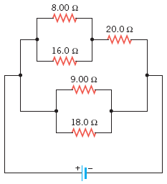
The current in the 8.00-Ω resistor in the drawing is 0.440 A. Find the current in the following.
a The 20 Ω resistor
b The 9 Ω resistor

Slide 5
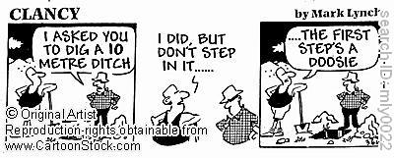
Back to Work!!

