Slide 1
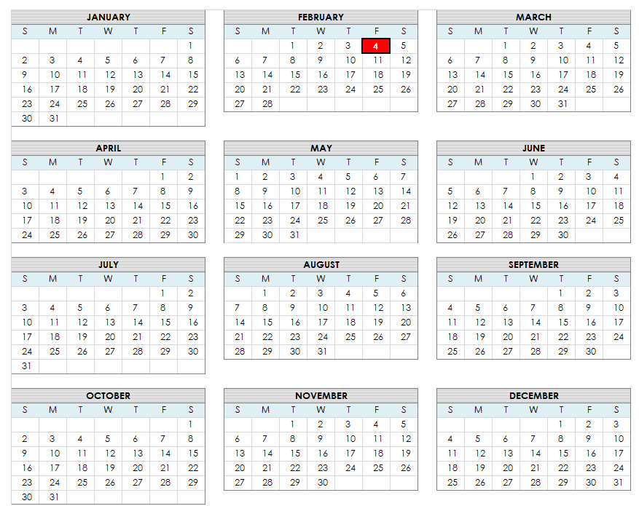
E
X
AM
2
Examination #2
Wednesday, March 16th.

Slide 2
What’s Up
This week
More on DC circuits including Kirchoff’s Laws
Quiz on Friday
Current thought on next exam:
Wednesday, March 16th
All material will be covered up to the previous Monday. All of the current chapter will be concluded. We may have some material on magnetism if we are sufficiently lucky.
Problem Solving Sessions
Nobody seems interested but we will do a session this Friday at 12:30 (In Physical Science Building) if there is interest. Tell me!
The equivalent can be obtained during office hours .. larger groups can be accommodated in the small conference room at the end of my hallway.

Slide 3
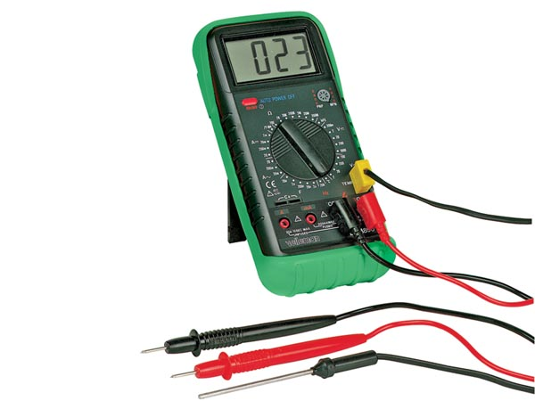
Our Meter - OHMS
Temperature Sensor

Slide 4
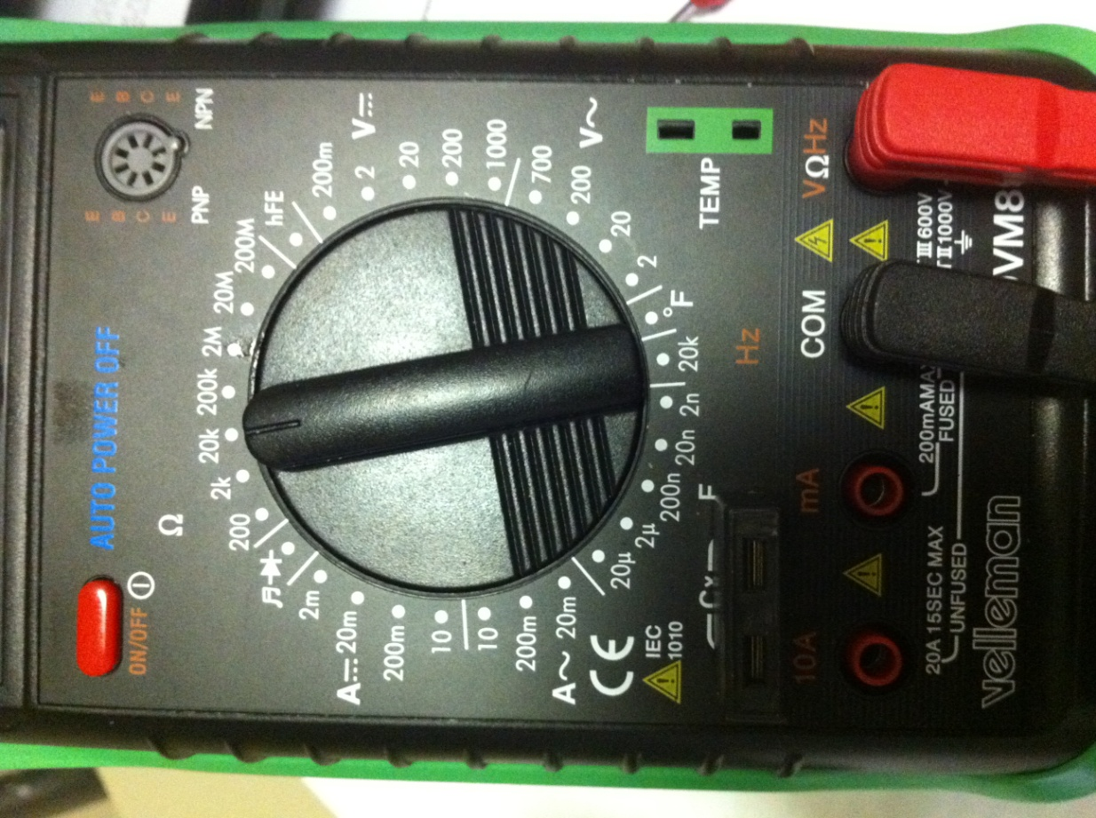
The (*#&) Multimeter
Display
Scale
Selector
Connections

Slide 5
The Issues??
Bulb has specifications of
V=2V
I=60ms
From this: R=V/I=2/0.06=~33 ohms.
These numbers vary from bulb to bulb.

Slide 6
The Scales
The numbers you posted are full-scale readings for each range. For example, if you get a reading of 3.87 with the scale set to 20K, then the resistance is 3.87K ohms. If you had the same reading with the scale set to, say, 2M, then the resistance is 387K ohms. The reason they use a "2" is to use what is known as a half of a digit. In other words, a typical 8-segment display can show all 10 digits, whereas a 1 can be displayed with a vertical line (the 'half digit'). So the max readout is actually 199. (with a 2-1/2 digit readout)

Slide 7
The Measurements
2KΩ Scale
0.004 Ω
200 Ω Scale
4.0Ω
Βattery ~1.5V → I= v/R = 1.5/4.0 = 0.4 AMPS
What’s going on here??

Slide 8
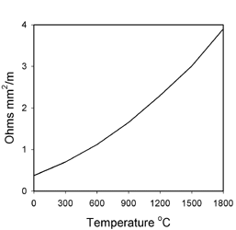
R _{bulb} Not a Constant
Linear Approximation

Slide 9
The Numbers (T in ⁰K)
Note: A light bulb operates at about 2700 ⁰K
Mystery Solved!

Slide 10
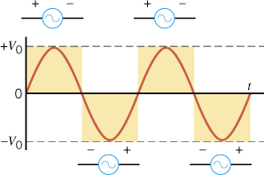
Our wall provides AC

Slide 11
Averages
Average Voltage is ZERO

Slide 12
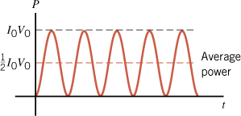
What is the average POWER?

Slide 13
RMS Voltage
Root Mean Square (rms) voltage
The rms Voltage Delivered to
your home is 120 Volts

Slide 14
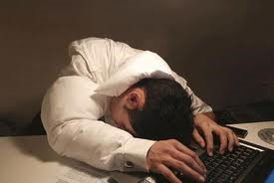
WAKE UP!!
Get back to Unit - 08

