Slide 1
W4D1 Continuous Charge Distributions
Chapter 16
Electric Field of Distributed Charges
The Math for
the rod (from class)
www.iclicker.com

Slide 2
Activity – The Hard Part!
BREAKING UP
THE ROD

Slide 3
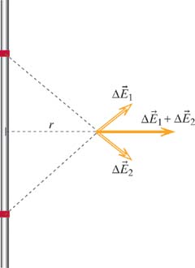
Let’s review the math a little
y=L/2
Total charge = Q
Total Length=L
μ=Q/L
dy
y
O
switch from dy to Δy
dq=μdy
x-axis →

Slide 4
Doing the math
From tables of integrals …

Slide 5
What happens when L gets really big compared to L? (Infinite line of charge)

Slide 6
What happens when L is very SMALL compared to r?? (Teeny Tiny.)
coulomb’s Law!!

