Slide 1
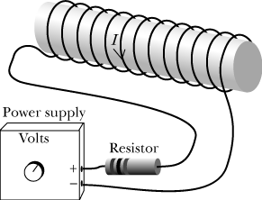
W14D2
More Faraday Stuff
Let’s Do The Quiz First!

Slide 2
C
O
U
N
T
D
O
W
N
Monday | Wednesday | Friday | Saturday
14 Chapter 22 Gauss | 16 (Read rest of chapter) 2 WebAssigns Chapter 22 Gauss | 18 QUIZ Chapter 22 Lentz & More
21 Chapter 23 Faraday | 23 QUIZ Chapter 23 Faraday | HOLIDAY
28 Chapter 23 Faraday | 30 Chapter 24 EM | 2 Chapter 24 EM Optional Exam (22-24) | 3 FINAL EXAM

Slide 3
Back to Faraday – Turn on the current
Close the switch and the current will start to increase.
The coil will produce a “back” emf to oppose the current.
That back emf will be proportional to the rate of change of the current (and the field in the solenoid)
This means that
L is the Inductance
measured in henries (h)

Slide 4
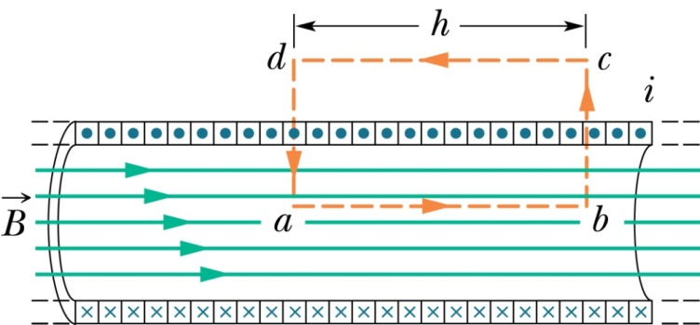
Induced EMF in a Solenoid
Recall that for a long solenoid we used Ampere’s Law to obtain the field in the interior.
where n is the number of turns per unit length in the solenoid

Slide 5
More Better …
Note that L depends only on the geometry of the solenoid.

Slide 6
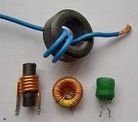
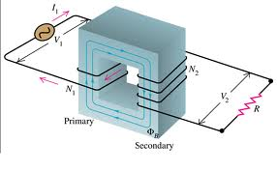
I
n
d
u
c
t
a
n
c
e

Slide 7
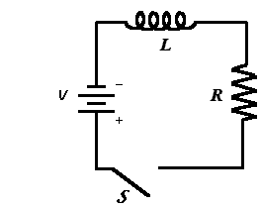
A New Kind of Circuit
emf
Similar solution to capacitor charge/discharge

Slide 8
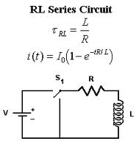
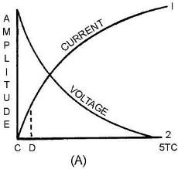
Same ole same ole
What would the short look like?
Review this in the textbook – (968-9)

Slide 9
Let’s do some presentations from the last activity that we didn’t quite finish.

Slide 10
Activity Discussion

Slide 11
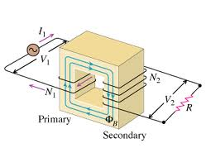
If a voltage V₁=V₀Sinωt is applied to the primary side of this device, what does V₂ look like? The two coils are wrapped around a square metal support that carries the flux from one side of the transformer to the other with little change. In other words, the “core” maintains a constant magnetic flux throughout its structure.
Coil:

