Slide 1
Department of Physics
Physics for Engineers and Scientists II
PHY 2049 – SCALE-UP
Student-Centered Active Learning Environment for Undergraduate Programs
September 2011

Slide 2
J. B. Bindell, Phd jeffrey.bindell@ucf.edu
Evan Smith evansmith@knights.ucf.edu
Class Website (includes syllabus) www.physics.ucf.edu/~bindell

Slide 3
Please Note
Today’s presentation and iclicker-2 instructions are posted on the class website under week #1.
www.physics.ucf.edu/~bindell
(click on our class – top of the list.)

Slide 4
How do you contact me??
email: jeffrey.bindell@ucf.edu
Office Phone – I am never there! And, my voicemail is full.
Cell Phone – Private number (Business)
Via WebAssign communication’s section. Please use WA for any homework extension requests. Begging is permitted.
Note: I check email multiple times a day. I check WebAssign most evenings.
HELP: Saxon Sum – Please email your email address and have it added to myUCF.com.

Slide 5
How Do I Contact You???
email – only through Knights account
WebAssign Mail or Communications Panel.

Slide 6
NOTE:
Feel free to ask questions at ANY time.

Slide 7
Lecture Approach
Process:
Lecturer Lectures
Student Absorbs
Test Scheduled
Student Studies
Test
Etc.
Go
Ahead.
Learn
Me.

Slide 8
WELCOME!
The Learning Environment is Important

Slide 9
WHY ARE YOU HERE??
Because this is a required course.
Because you like the schedule.
Because you like the idea of working in a team environment.
Because you want to really learn and understand physics.
Because an hour of lecture doesn’t hold your attention.
Because you want a class where you get to know the instructor and the instructor gets to know YOU.
Because you think this would be easier than the standard format of a physics class (Lecture section of 250 students + a 3 hour session with one hour or recitation.) – It isn’t.

Slide 10
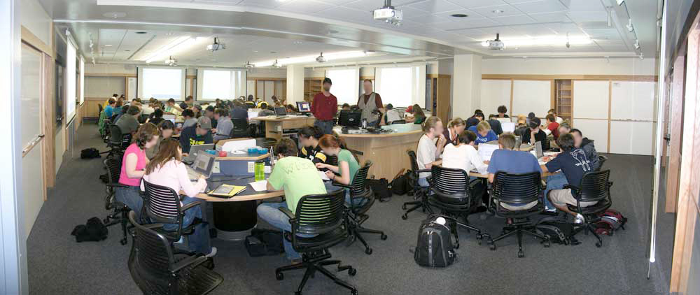
Round Tables are Better (Sorry)

Slide 11
Approach to Physics
Physics in Studio Mode and a Team Environment
Builds on Physics I (Which uses a different textbook)
Focuses on the needs of Scientists and Engineers
Centers on Conceptual Understanding
Material
Electricity and Magnetism
Electromagnetic Waves
Focus on the concept of the FIELD

Slide 12
How does a typical physics student approach the standard course?
Attend the lectures
Do the homework
Google the first few words of the question.
If that fails, look at examples or maybe even read the material that you need to answer the question.
Do all of this the night that it is due.
Oh, Oh … a QUIZ!
Read the chapter or whatever part of the chapter that you think will be covered by the quiz.
Review the homework material and any notes you may have taken
Take the quiz.
Eee Gads …A TEST!!
Same thing but with more intensity. Reading the textbook is more intense.
  This is where limited learning takes place.

Slide 13
SCALE-UP is a Different Approach!
Reading Assignment Before Class Session.
Usually short. Sometimes WebAssign
Brief Clicker Quiz on Pre-reading assignment
Usually easy but sometimes challenging.
Sometimes by Group
CLASS SESSION
Brief discussion of the topic or review of where we are.
Activities focusing on group learning (Teams will be ASSIGNED and changed after each exam).
Problems to solve & Some will present solutions to the class. Sometimes, opposing approaches will be discussed and/or argued
Experiments
Challenges
Recitation Problem solving and Q/A sessions (Usually on Friday)
AFTER CLASS
WebAssign Homework
Office Hours
NOTE: This approach keeps the pressure on you to keep
up with the class.

Slide 14
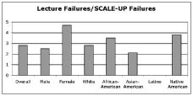
Does it work? (NCSU DATA)
Three times as many
failures in standard
format!
Figure 5. Ratio of failure rate percentages. Overall, students were
nearly three times as likely to fail in a traditionally taught section
than an equivalent SCALE-UP section of the course. The Latino ratio
could not be calculated because no Latino students have failed in a
SCALE-UP section

Slide 15
What will you learn?
Physics (of course)
Teamwork
Problem Solving Methodology

Slide 16
Who is Here???

Slide 17
Important Course Information
SCALE-UP
All of this is in the syllabus at the class website
www.physics.ucf.edu/~bindell

Slide 18
This course uses a different textbook than does the other PHY-2049 sections. Specifically, we will be using
Chabay and Sherwood, “Matter and Interactions”, Volume II – Electric and Magnetic Interactions. 3rd Edition, Wiley, (2011).

Slide 19
You will also need to purchase WebAssign Access. You do not need the Physics 2049 Laboratory Manual or any of the Course Paks in the bookstore. Materials will be provided in class, as needed.
WebAssign
WebAssign Login (From Bookstore or on-line). It is easy to register for WebAssign on-line at www.webassign.net. If you have used WebAssign before, your old password may still work. Your ID will be your PID number with the leading zero but no leading letter. If you are new to WebAssign, your initial password will be “ihatephysics”. Institution is “ucf” in lower case.
Class: PHY-2049S, section 0003-4

Slide 20
You need to purchase an i-clicker2
SCREEN

Slide 21
Class behavior
When a mini-lecture is being given by one of the instructors (often unprepared but based on what is happening in the class), there will be quiet.
During class activities, quiet is forbidden! Discussion is important for learning.
Try to maintain the groups of 3 but it is recognized that the close proximity of two groups on one badly designed table will often create a “super group” of six. If this happens, a worklable solution to the country’s financial problems will be expected.
REMEMBER: NOISE IS GOOD!
Within reason, of course.

Slide 22
Be Aware of the Snake

Slide 23
A Small Twist
This course will involve some computer calculations; some as homework.
The best language to use is V-Python, an easily learned program for even novice programmers.
Secret: I have to learn this along with you!!!
Appropriate references to tutorials will be provided.
You may use other programs if you wish (Excel, Mathematica, Finger Counting ….
Good Reference, NOT required.
There is much online material available:
www.vpython.org

Slide 24
Test Dates: These dates are subject to change slightly but at least one week’s notice will be provided.
Final Exam: according to the University Final Exam Schedule.
EXAMINATION | DATE | Comment
#1 | September 21st
#2 | October 12th
#3 | November 9th
#4 | November 28th | The fourth exam may or may not be scheduled, depending on the desires of the class. If scheduled, it will be during the last week of class and will give students the opportunity to drop the lowest exam grade.

Slide 25
Grades
SCORE | GRADE
85-100 | A
75-84 | B
60-74 | C
50-59 | D
<50 | F

Slide 26
Weights – Not Totally Final
Item | %
Mid Semester Examinations | 30
Final Examination | 20
Homework (Subject to change) | 10
In Class Quizzes | 10
Class Participation (Clicks) | 15
Inquiry Component | 15

Slide 27
Approximate Schedule
Week | Chapter | Topic (s)
1 | 14 | Coulomb’s Law
2 | 14 | The Electric Field
3 | 14,15 | Electric Fields & Matter, Charge
4 | 16 | Distributed Charges
5 | 17 | Electric Potential
6 | 18 | The Magnetic Field
7 | 19 | Electric Fields & Currents
8 | 20 | Circuit Elements (DC Circuits)
9 | 21 | Magnetic Forces
10 | 21,22 | Magnetic Forces, Field Patterns
11 | 22 | Field Patterns and Gauss’s Law
12 | 23 | Faraday’s Law
13 | 23 | Faraday’s Law
14 | 24 | Electromagnetic Waves / Optics
15 | 24 | Electromagnetic Waves / Optics
16 | ALL | FINAL EXAMINATION

Slide 28
Today
A 30 minute evaluation test (doesn’t count!) to allow us to get a handle on what you know now.
A brief magic show (stolen from YouTube)
A brief discussion about how it was done.
Handout about vectors. This is basically what you already know but our textbook uses a slightly different notation:

Slide 29
Brief WebAssign is Due on Wednesday
Provided that the system works

Slide 30
Welcome to SCALE-UP!

