Slide 1
Hydrated Minerals on asteroids: the relationship between the 0.7 and 3 micron absorption bands
E. S. Howell (Arecibo Obs.), A. S. Rivkin (JHU/APL), F. Vilas (PSI) and others

Slide 2
Asteroid Hydration Bands
The 0.7 micron band is a charge-transfer absorption Fe²⁺-Fe³⁺
Easier to observe with CCD spectrometers
Used as a proxy for hydration
The 3 micron absorption band arises from OH (2.7 microns) and overlapping overtones of H₂O (6 microns)
Harder to observe through the atmosphere
Fewer instruments appropriate for asteroids

Slide 3
Asteroid Hydration Bands: correlation
Aqueous alteration of iron-bearing silicates results in hydrated minerals with both 0.7 and 3 micron absorption bands.
The 0.7 micron band can be “cooked’’ out at moderate temperatures, so the 3 micron band can appear alone.
The 0.7 micron band should never be seen without the 3 micron band, if it really only comes from hydrated minerals.
Extreme thermal processing can eliminate both bands, or the asteroid may be anhydrous.

Slide 4
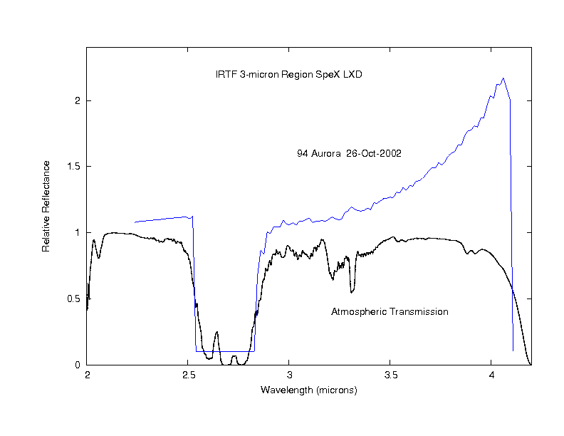
3-micron Observations: through the atmosphere

Slide 5
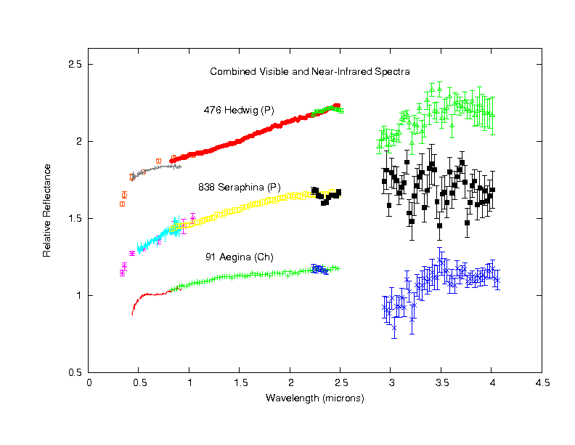
3-micron Observations: thermal emission removed

Slide 6
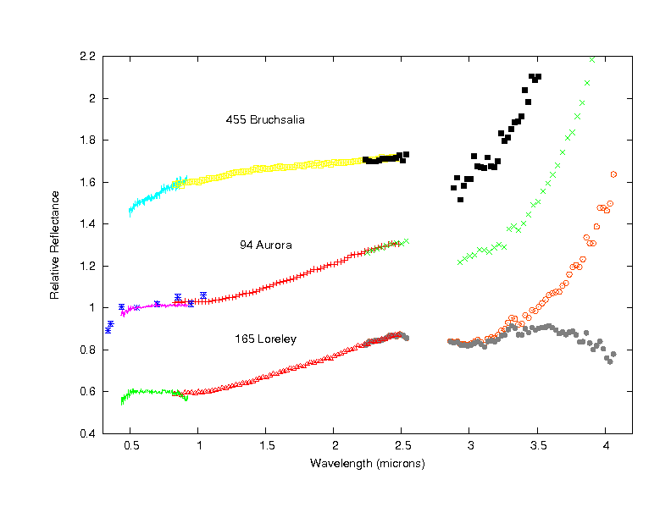
Asteroids with 3-micron band but no 0.7 micron band

Slide 7
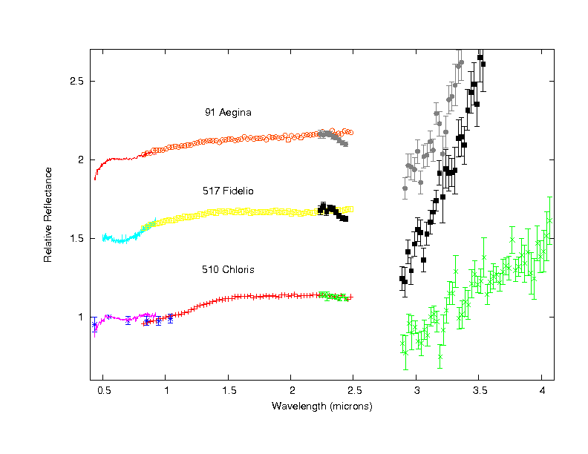
Asteroids with 3-micron and 0.7 micron band

Slide 8
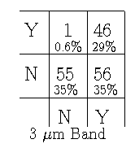
Correlation of Absorption bands: 158 Asteroids measured at both wavelengths
Most with 0.7 band have 3 micron band
Many without 0.7 band have 3 micron band
One object YN is 505 Cava, rotational variability
0.7 Band

Slide 9
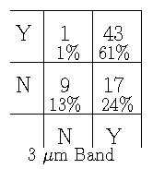
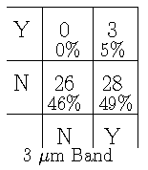
Correlation of Absorption bands with Bus-DeMeo taxonomic groups: C-complex X-complex
0.7 Band
Most Cs have 0.7 band (Ch) and most Xs do not
Half of Xs have 3 micron band, and thus hydrated minerals of some sort.
0.7 Band

Slide 10
Correlation of Absorption bands: 158 Asteroids measured at both wavelengths
Most with 0.7 band have 3 micron band
Many without 0.7 band have 3 micron band
One object YN is 505 Cava, rotational variability
0.7 Band

Slide 11
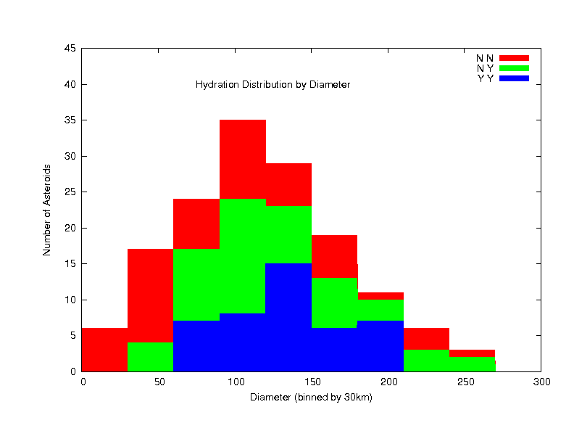
Trends with size?

Slide 12
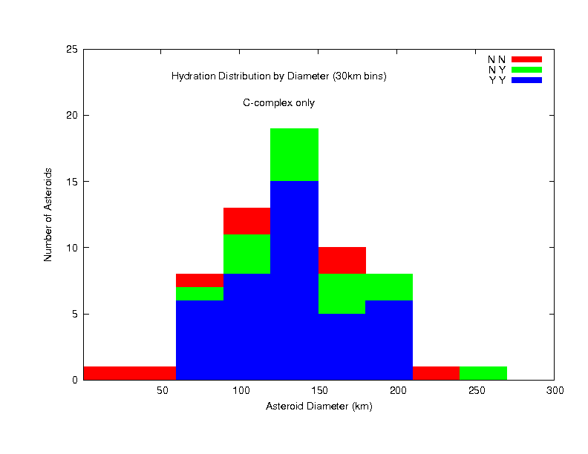
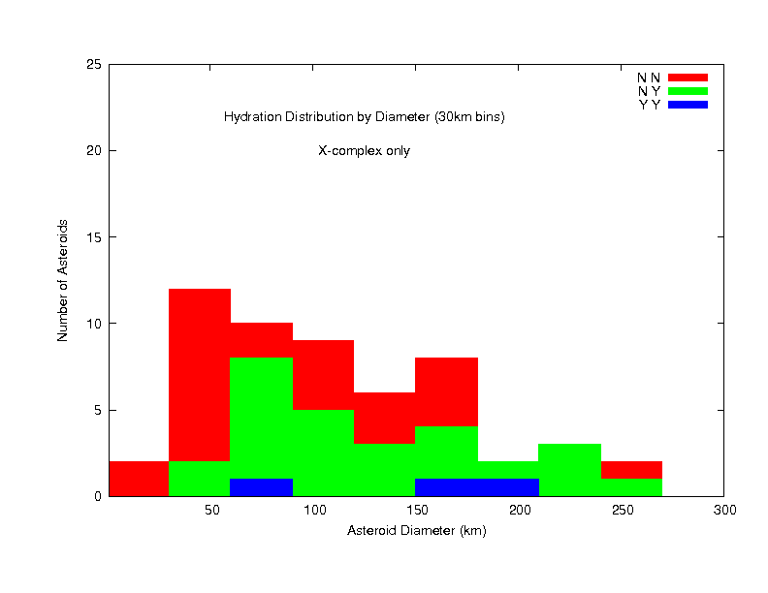
No clear trends with size
C-complex
X-complex

Slide 13
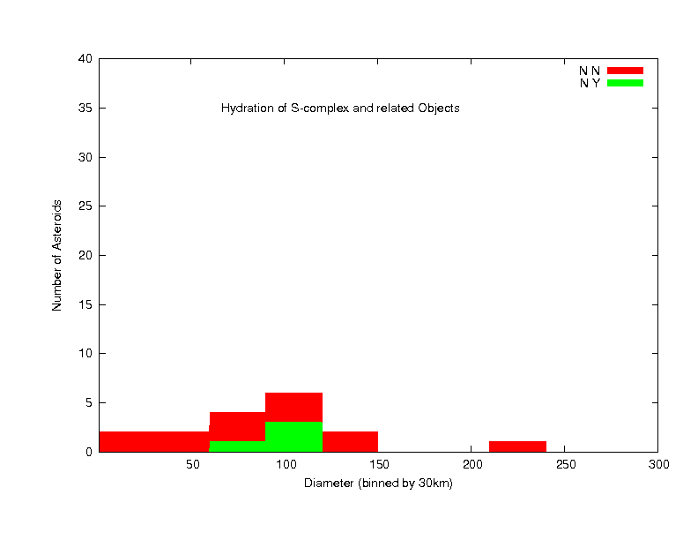
Trends with size: S-complex and related (V,R,L,K)

Slide 14
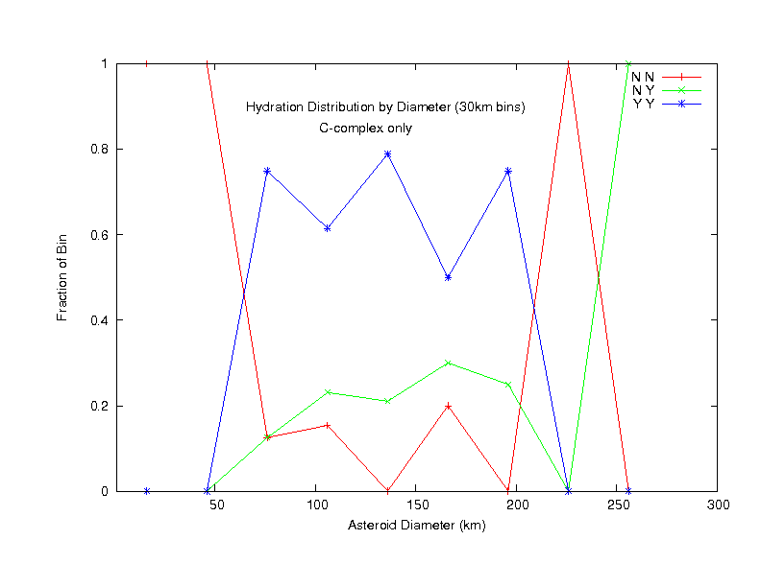
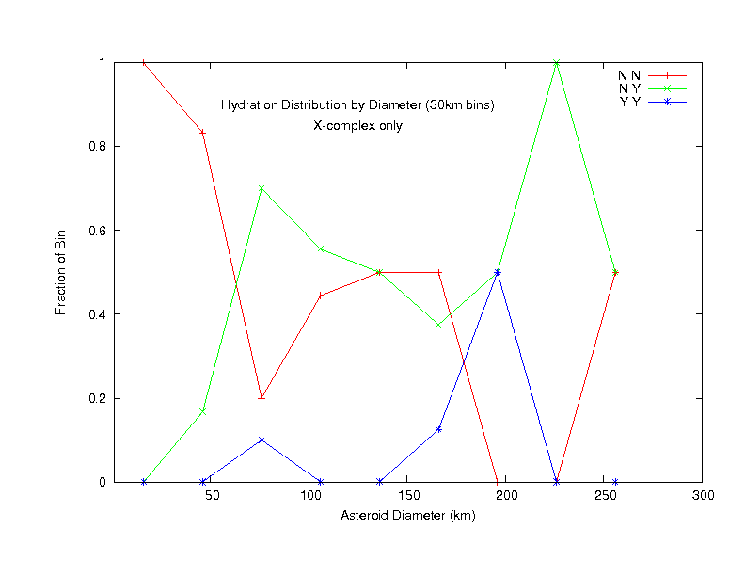
Fraction with size – 30km bins
C-complex
X-complex

Slide 15
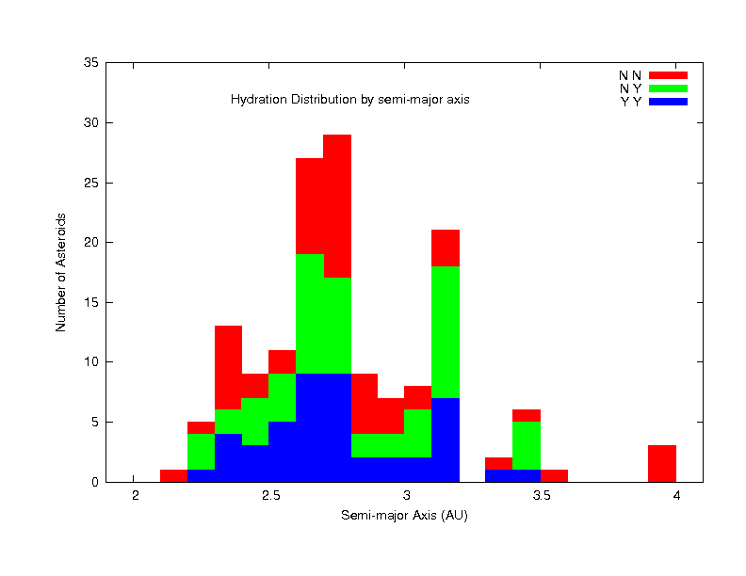
Trends with semi-major axis?

Slide 16
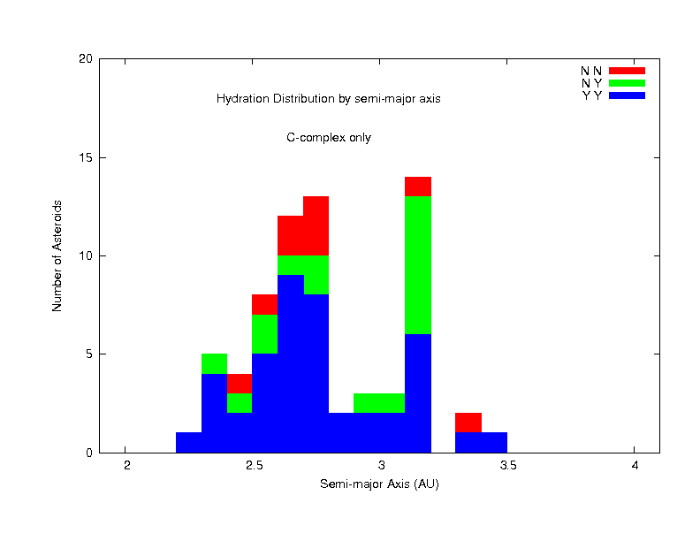
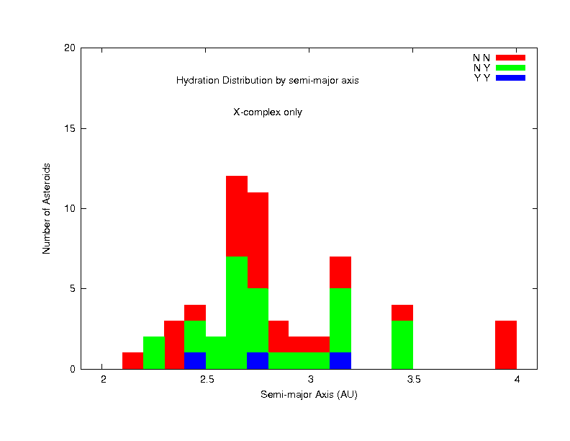
Trends with semi-major axis
C-complex
X-complex

Slide 17
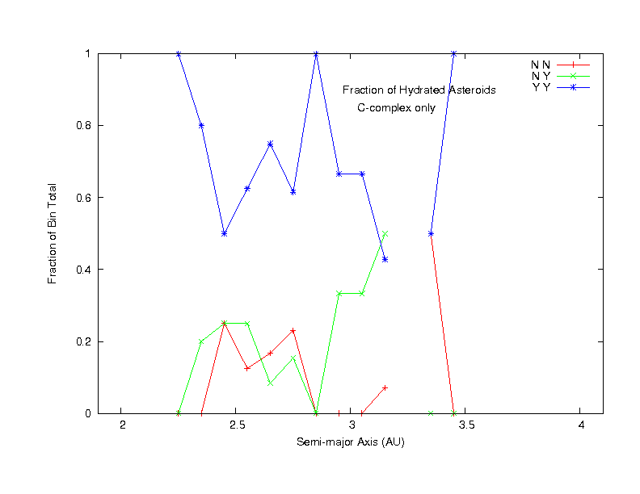
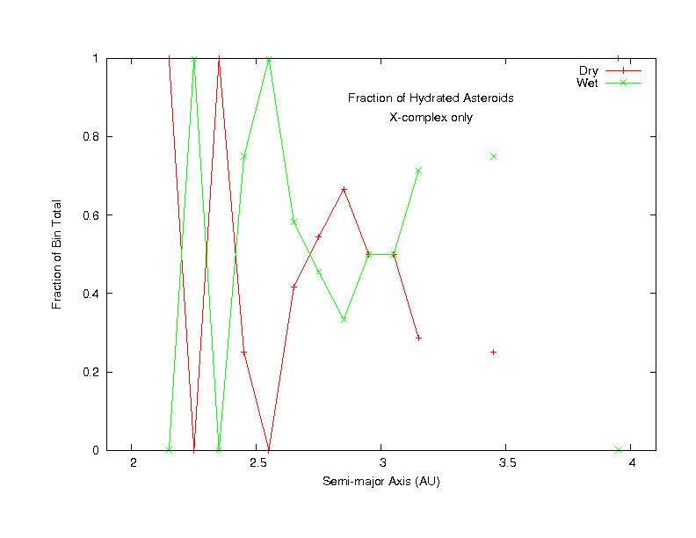
Fraction with semi-major axis
C-complex
X-complex

Slide 18
Conclusions
We confirm that 0.7 micron band is a good indicator of hydration when it is seen.
When the 0.7 micron band is not seen, this does not mean the object is anhydrous
Important to consider 3 micron band to get a complete picture of asteroid hydration
The hydration patterns among the C-complex and X-complex objects are different, and may reflect formation, composition, thermal history, or all of above.

