Slide 1
Water in Laboratory
J.R. Brucato INAF-Arcetri Astrophysical Observatory, Firenze Italy
jbrucato@arcetri.astro.it
Water in Asteroids and Meteorites Paris 29-30 Sept. 2011

Slide 2
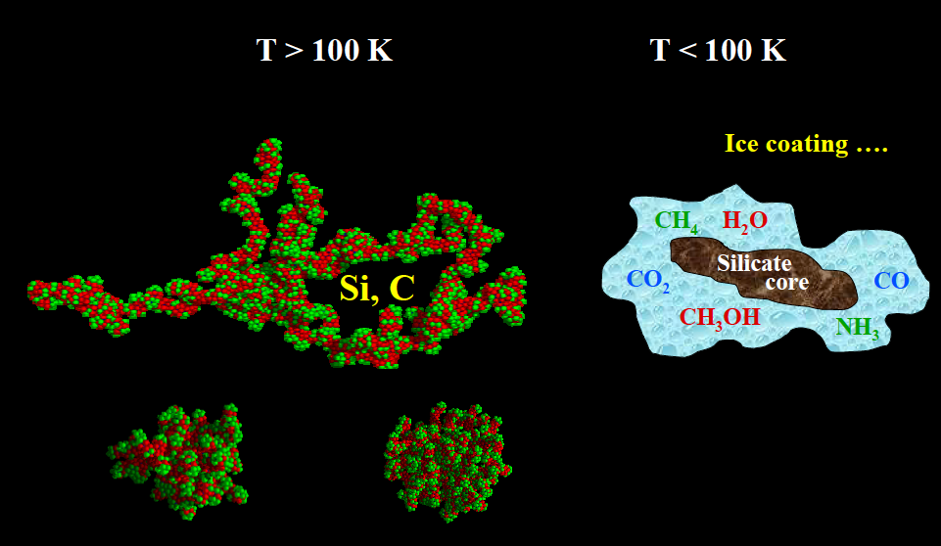
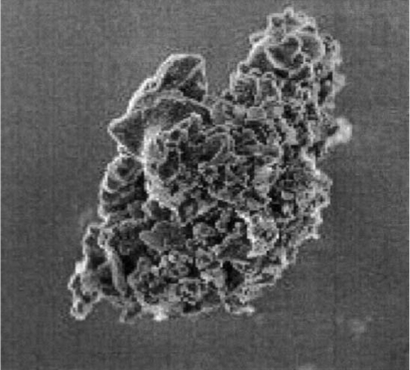
Dust particles: the seeds of planets and molecules

Slide 3
Studies were performed on configurations and energies obtained by adsorption of dissociated water molecules on a range of different perfect and defective:
forsterite surface site (King et al. 2010);
silica (Du and de Leeuw 2004):
zeolites (Baram and Parker 1996; Higgins et al. 2002);
ionic oxides (de Leeuw et a. 1995);

Slide 4
Energy inputs (%) and Fluxes (cm⁻² s⁻¹)
Solar Photons 2 eV Visible (50%) 2.0·10¹⁷
4 eV NUV (10%) 1.5·10¹⁶
6 eV FUV (0.02%) 3.0·10¹³
Solar Wind (1 AU) 1keV H⁺ (95%) 3.0·10⁸
4keV He²⁺ (5%)
Solar Flares (1 AU) >1 MeV H⁺(95%) 10¹⁰ (cm⁻² yr⁻¹)
>1 MeV He²⁺ (5%)
Galactic cosmic rays >1 MeV H⁺ (87%) 10¹
>1 MeV He²⁺ (12%)

Slide 5
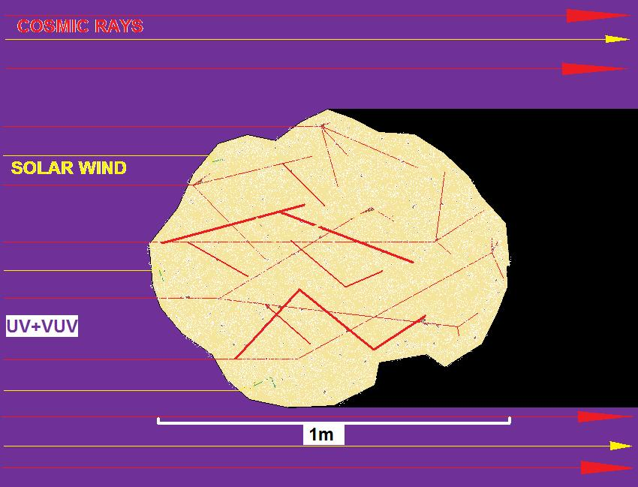
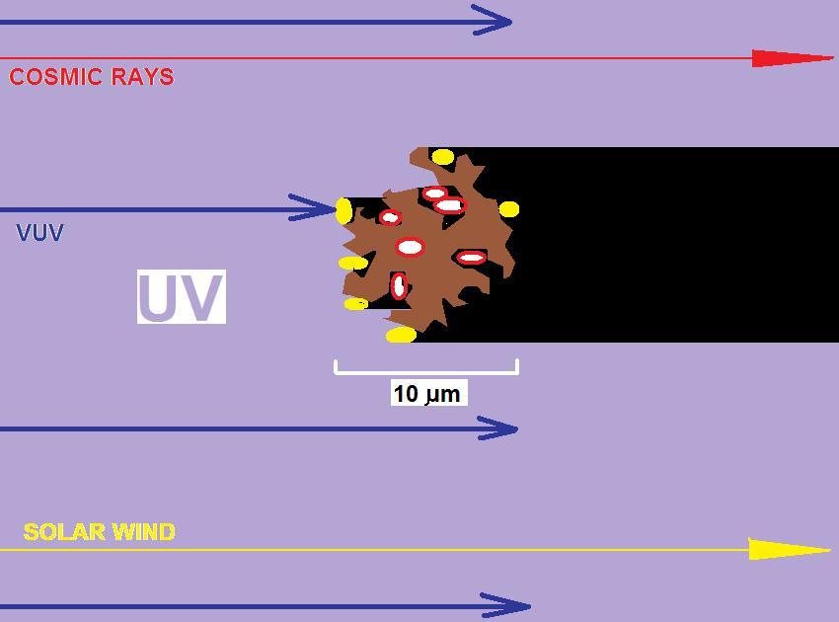
Big Rocks
Small grains

Slide 6
Energy released by impinging particles

Slide 7
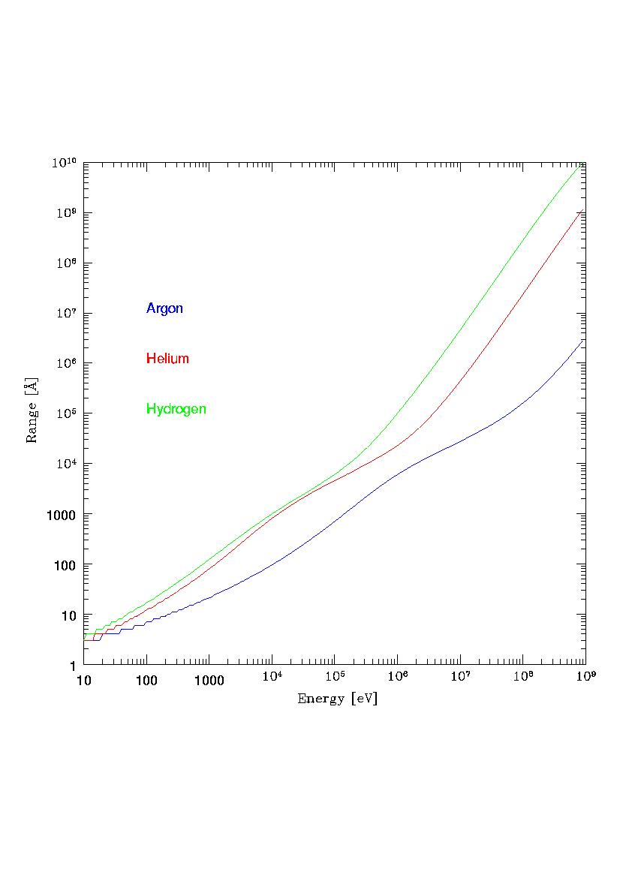
Ion range in forsterite

Slide 8
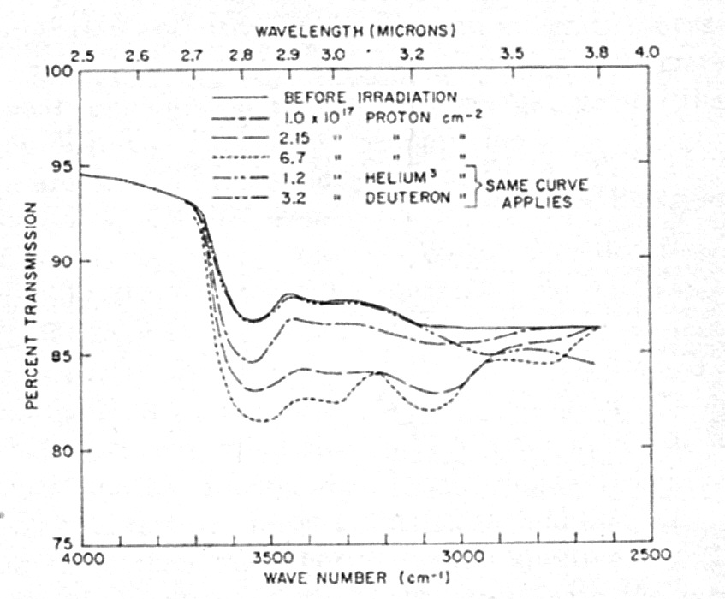
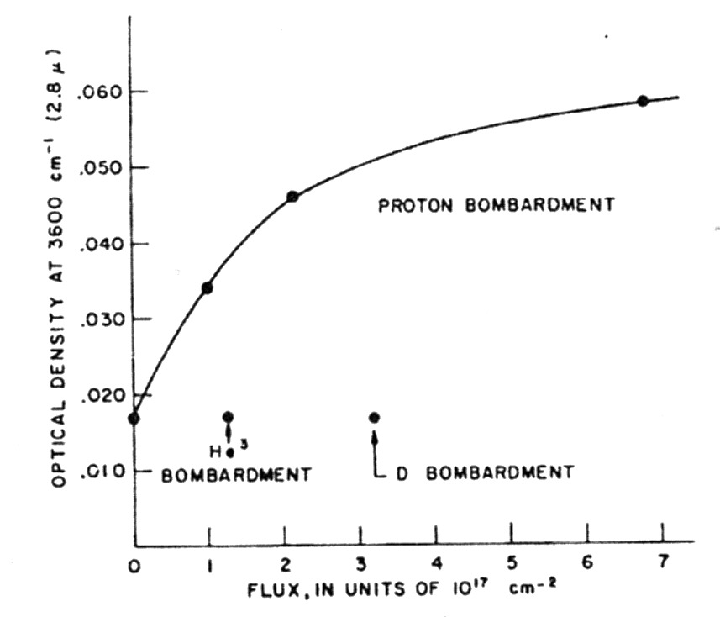
Proton-induced hydroxyl formation
Estimate of the OH produced in the upper centimeter of the lunar surface material by proton bombardment: 4x10¹⁶ OH cm⁻³
(Zeller et al. 1966)

Slide 9
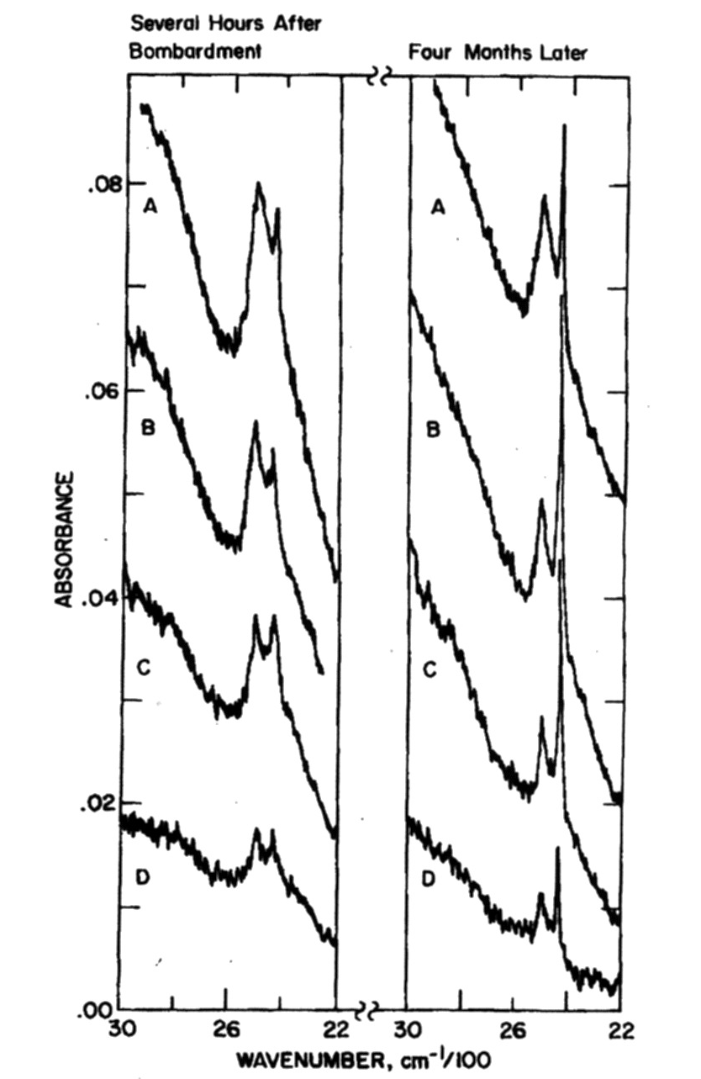
Chemical implantation of 10 keV H⁺ and D⁺ in rutile
OD stretching: 2505 and 2438 cm⁻¹
In same implanted samples no sharp peak exists initially
The intensity ratio of the two peaks changes with time:
slow, partial reordering of the damage
diffusion of deuterium and exchange with hydrogen
(Siskind et al. 1977)

Slide 10
Water formation by ice irradiation
Brucato et al. 1997

Slide 11
H
H
H
H
1)
H + O₂ → HO₂ → H₂O₂ → H₂O + OH → H₂O
(Ioppolo et al. 2008, 2010)
H
H₂
2)
O + O₂ → O₃ → O₂ + OH → H₂O + H
(Tielens & Hagen 1982)
H
3)
H + O → OH → H₂O
(Dulieu et al. 2010)
Some argues that species formed by these exotermic reactions will immediately desorb (Paoupular 2005). However, models predicts that most (99.1%) of OH and H₂O formed remain on surfaces (Cupper and Herbst 2007).

Slide 12
Surface catalysis
Surface catalysis allow molecules formation that are not possible in the gas phase. It open pathways for the chemical evolution in space.
1
3
Adsorption
Desorption
Eley-Rideal mechanism
Reaction
2
1
4
Adsorption
Desorption
Langmuir-Hinshelwood mechanism
Reaction
Diffusion
3
2

Slide 13
Silicate production in laboratory
Amorphous olivine & pyroxene
Laser ablation
Electron Beam
P= 10 mbar O₂
P= 10⁻⁵ mbar

Slide 14
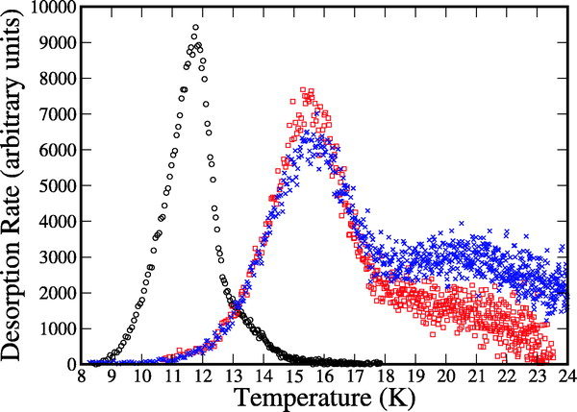
H & D beams irradiation of amorphous olivine silicate (Fe, Mg)SiO₄
(Perets et al. 2007)
Desorpion rate of HD molecules vs. surface temperature during TDP on polycrystalline and amorphous silicates

Slide 15
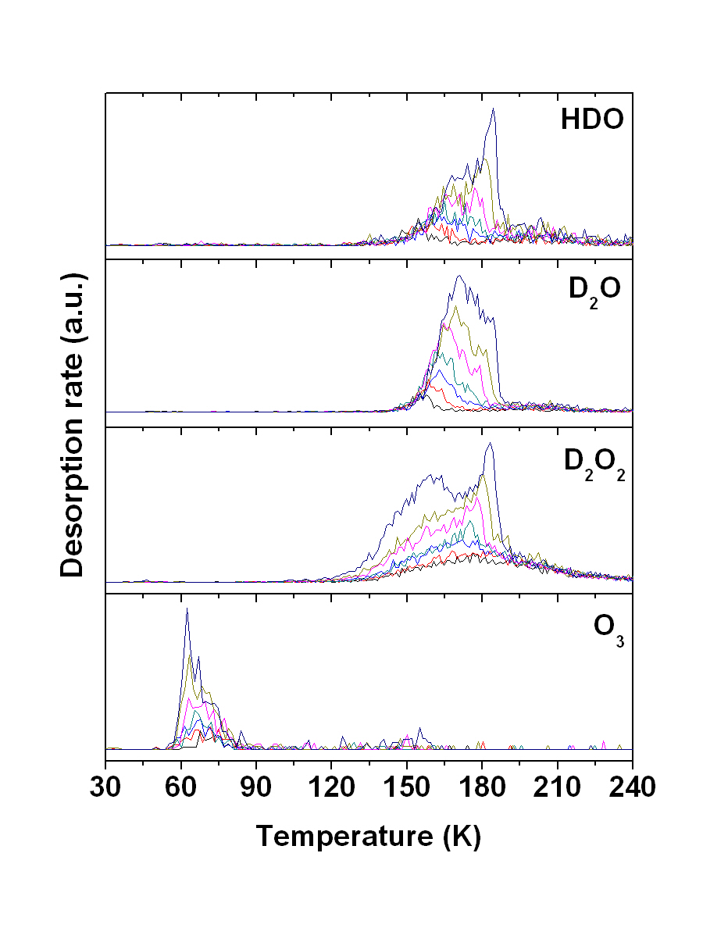
Desorption peaks for various species after D and O co-exposure. From bottom to top: 10 min, 15 min, 22.5 min, 30 min, 45 min, 60 min and 90 min.

Slide 16
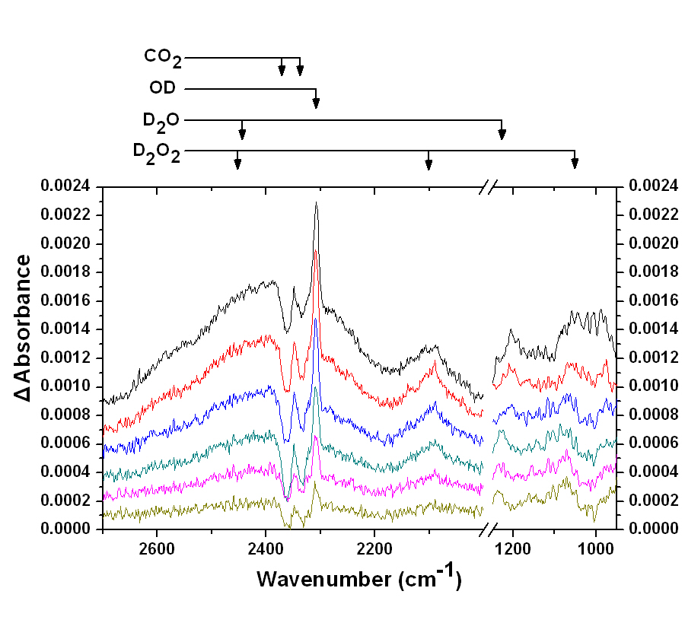
RAIR spectra of D and O co-exposure for (from bottom to top) 1 hour, 2 hours, 3 hours, 4 hours, 5 hours and after annealing the sample at 70 K for 5 min after exposure. The spectra are displaced on the vertical axis for clarity.

Slide 17
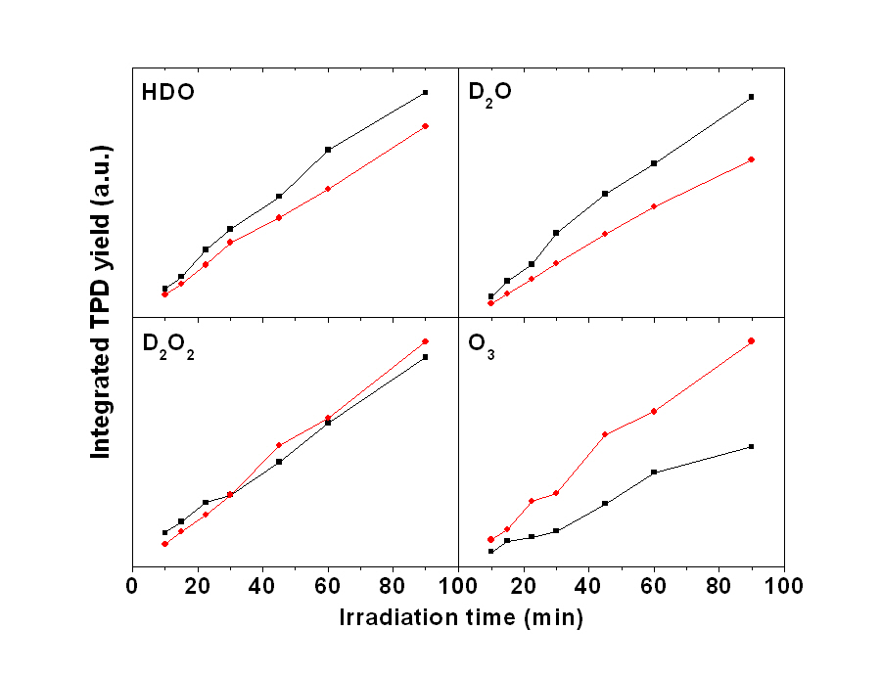
15 K
25 K
 | HDO | D₂O | D₂O₂ | O₃
15 K Slope (cm⁻²min⁻¹) | 1.5×10¹³ | 4.2×10¹³ | 7.6×10¹³ | 2.6×10¹²
25 K Slope (cm⁻²min⁻¹) | 1.2×10¹³ | 3.0×10¹³ | 8.9×10¹³ | 4.9×10¹²
15 K Formation efficiency | 0.043 | 0.12 | 0.22 | 0.007
25 K Formation efficiency | 0.034 | 0.087 | 0.26 | 0.014

Slide 18
Conclusion
Interaction between protons & minerals.
free protons in the interstitial space
protons trapped in material defects chemical reactions with oxygen atoms in metal oxides (SiO₂, TiO₂, Al₂O₃) and formation of hydroxyl groups.
Interaction between hydrogen and minerals
The formation of water can follow hydrogenation of both O and O₂ pathways.

Slide 19
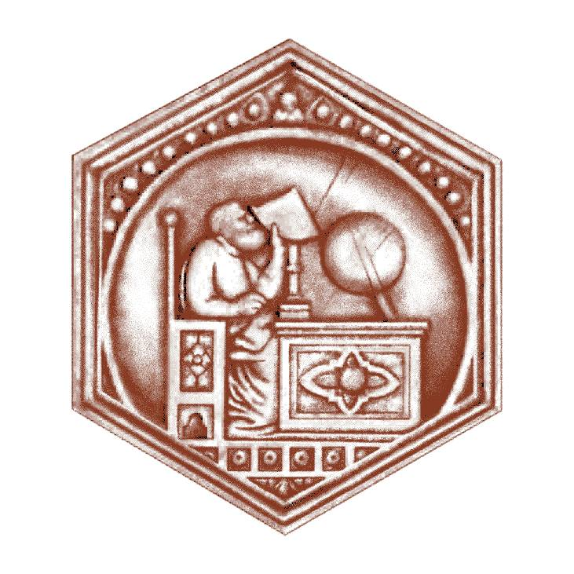
Acknowledgments
G. Vidali - Dept. Physics, Syracuse University, USA
G. Strazzulla - INAF – Astrophysical Observatory of Catania, Italy
University of Florence, Firenze, Italy
CNR – National Institute of Optics, Firenze, Italy
National Institute of Nuclear Physics, Frascati, Italy
-

