Slide 1
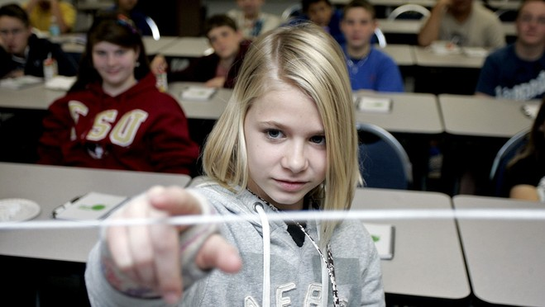
Welcome
techPATH 2011 Annual Meeting
STEM

Slide 2
Starters
Welcome –
Jeff Bindell, FHTCC techPATH Director
Around the Table Introductions of attendees
Welcome –
Our Host
Dr. Roger Smith, Chief Technology Officer, Florida Hospital Nicholson Center

Slide 3
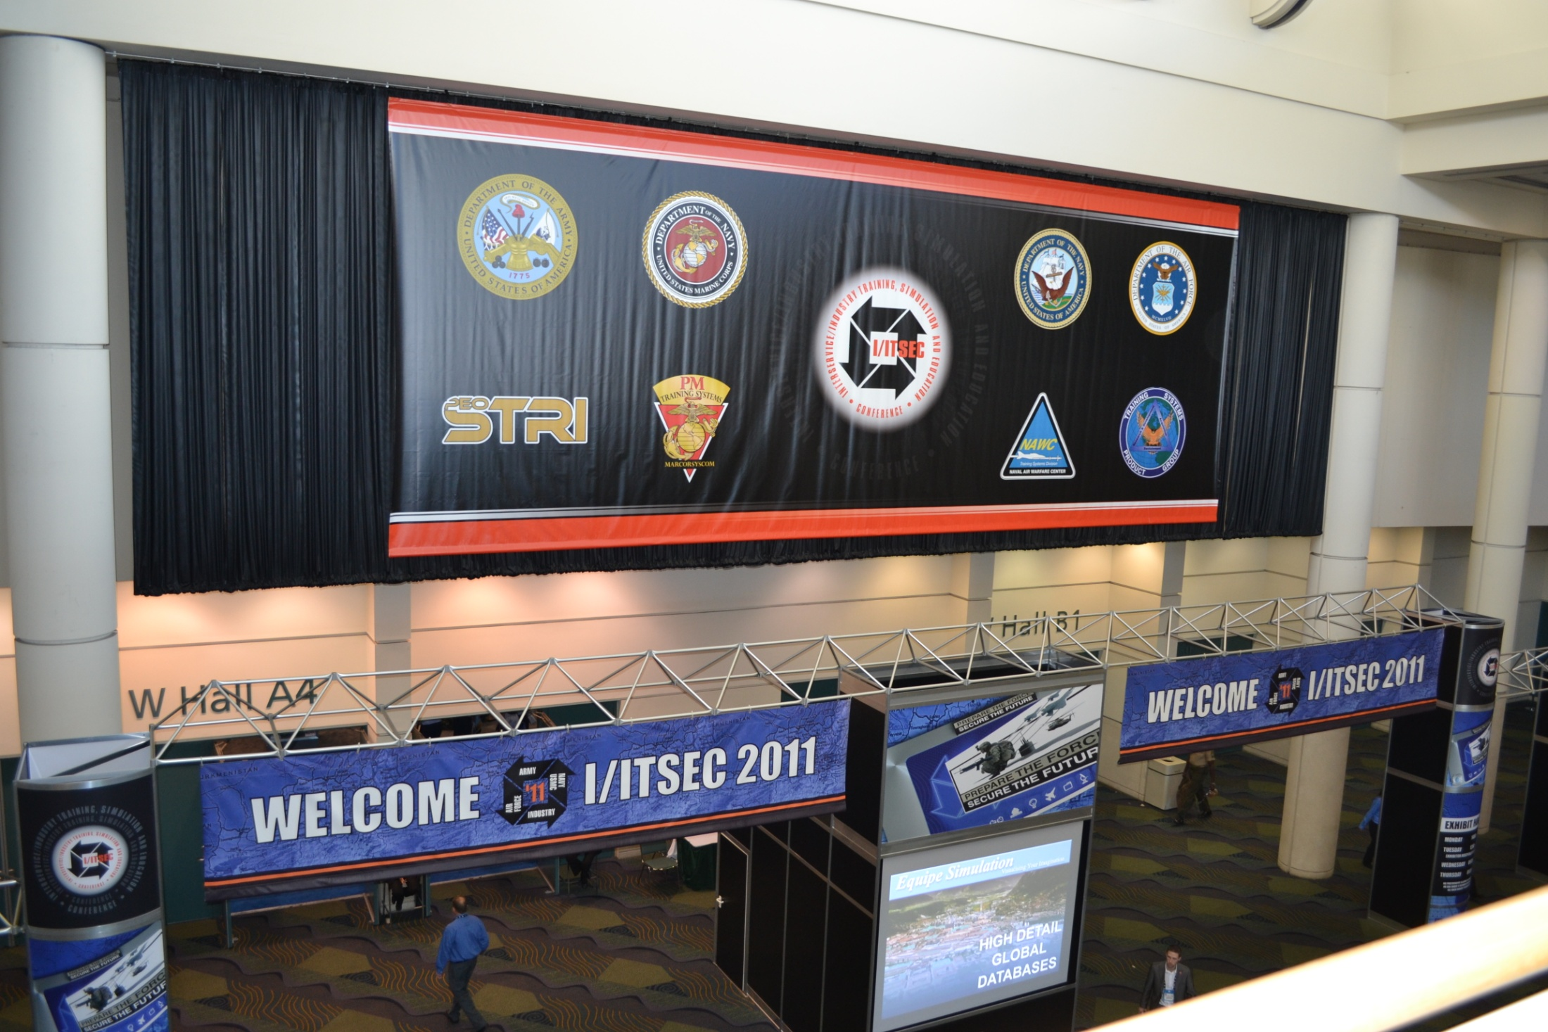
I/ITSEC 2011

Slide 4
Programs
Programs for Teachers
Programs for Students (Mostly Middle School)
Math and Science Program
Robotics Program
Programs for Teachers
I/ITSEC Program with I/ITSEC as partner
Microscope/Analytical tools (Not Recently!)
Relationships with other organizations
NAVAIR (SeaPerch Program)
Valencia College – Cyber Security Program
Orlando Science Center

Slide 5
Some Pictures & Stuff →
Quick Program Review

Slide 6
I/ITSEC Teacher Program
Combined with I/ITSEC’s America’s Teachers Program
Welcome by Randy Berridge
Intro to Robots (Bindell)
History of Simulation (Okraski)
Virtual and Augmented Reality (E. Smith)
Simulation in the Military (Finkelstein)
SeaPerch (Navair – Seltzer)
Surgical Robots (R. Smith)
Two speakers who didn’t show up!
Tour of I/ITSEC Floor

Slide 7
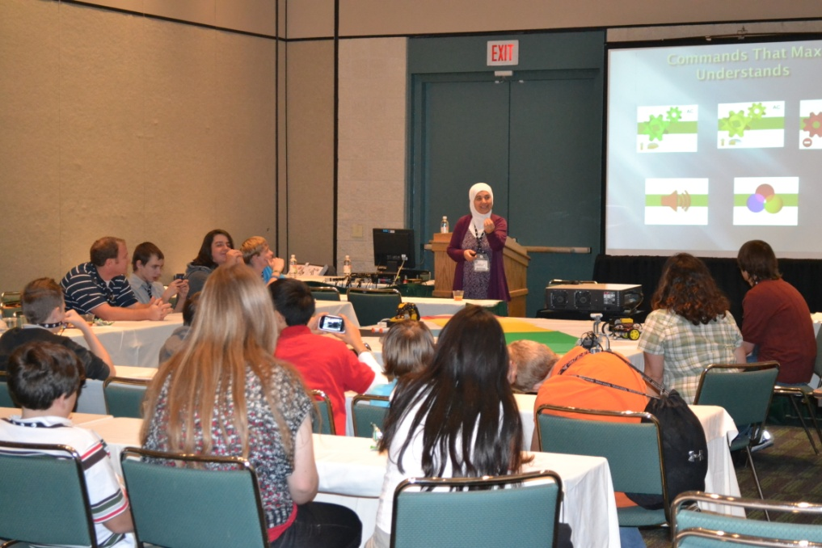
Student Program

Slide 8
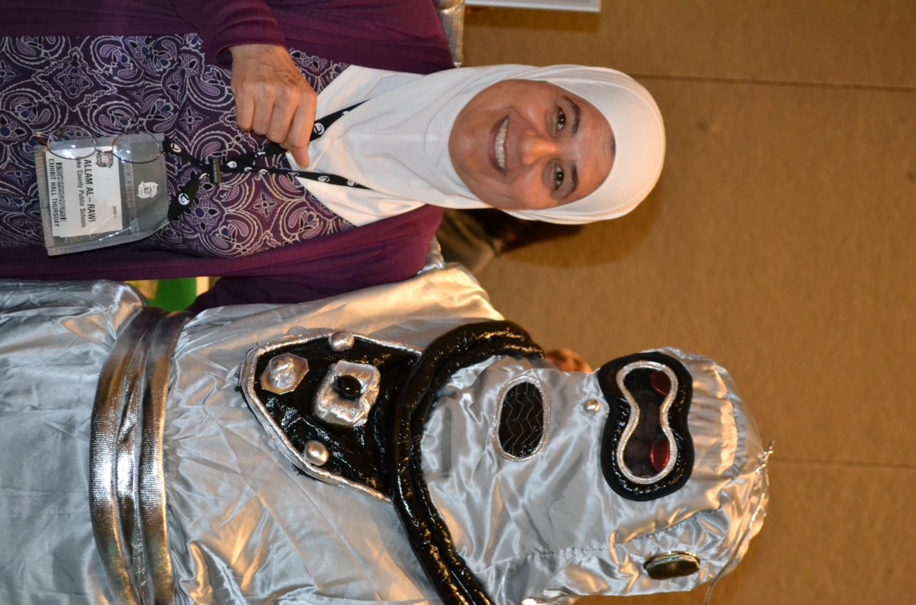
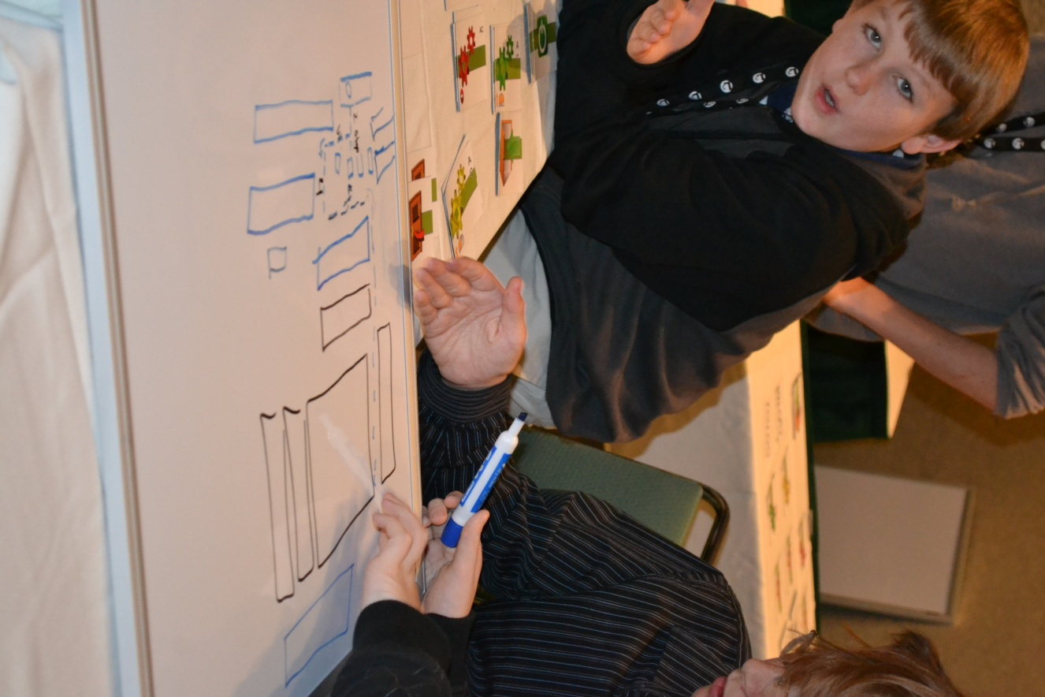
Dr. Al-Rawi
(UCF/Physics)
REAL Robot
Autonomous
Programmers

Slide 9
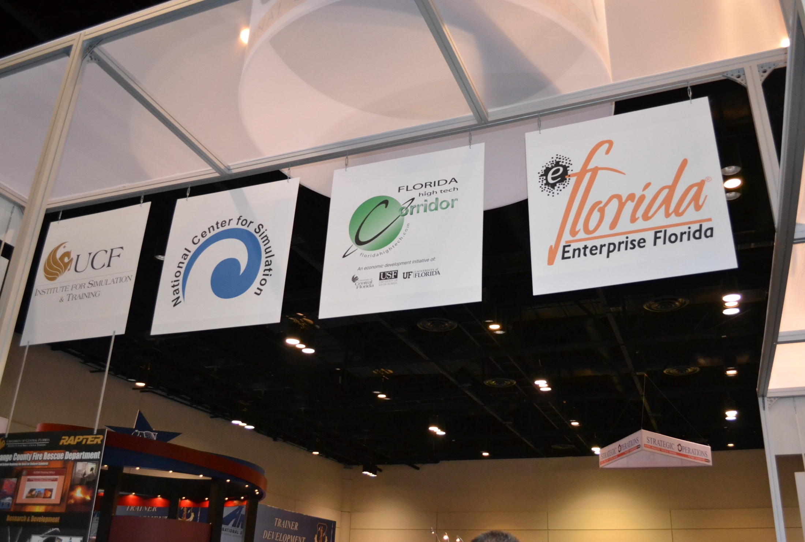
Workforce Partners at I/ITSEC
Robot

Slide 10
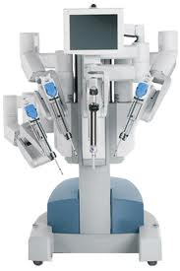
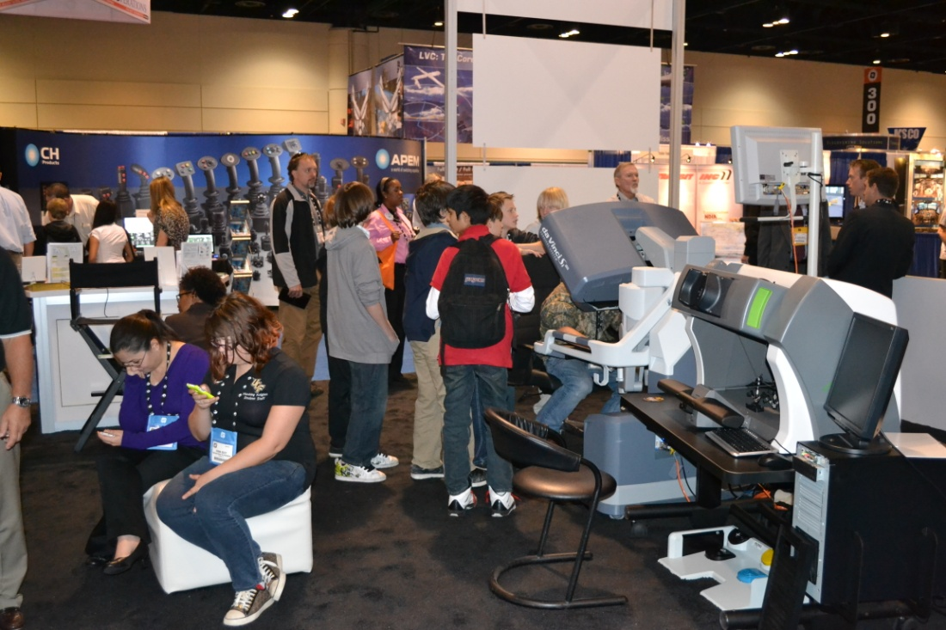
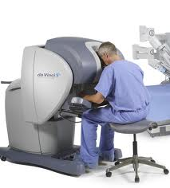
Down Below is 50% of the DaVince Robot
You Will See This Later!

Slide 11
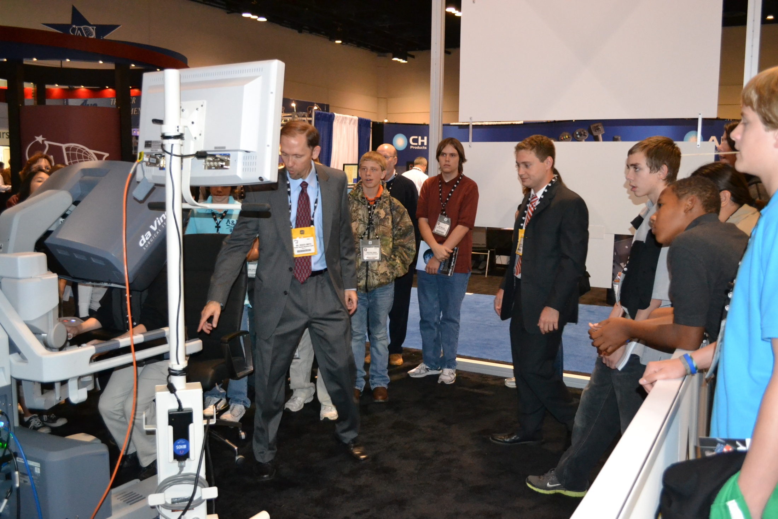
Dr. Roger Smith

Slide 12
Math and physics program
Program for Students – Middle School targeted

Slide 13
The Program
Discuss futures
Describe the fundamental laws of physics via popular demonstrations.
Students participate in most of them
Connect physics to
simulation
gaming
digital media
Show the importance of mathematics
Weave together with a tour

Slide 14
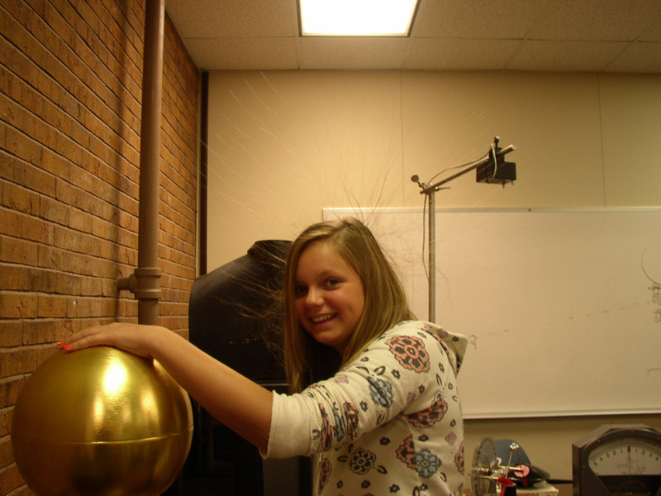
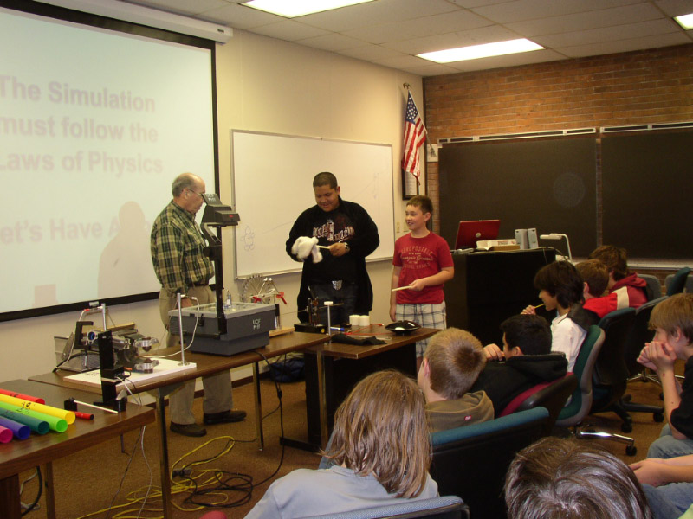
MUSIC & WAVES
MECHANICS
ELECTRICITY
MAGNETISM
MAXWELL’S EQUATIONS
LUNCH
Bad Hair Day
PHYSICS & MATH DAY

Slide 15
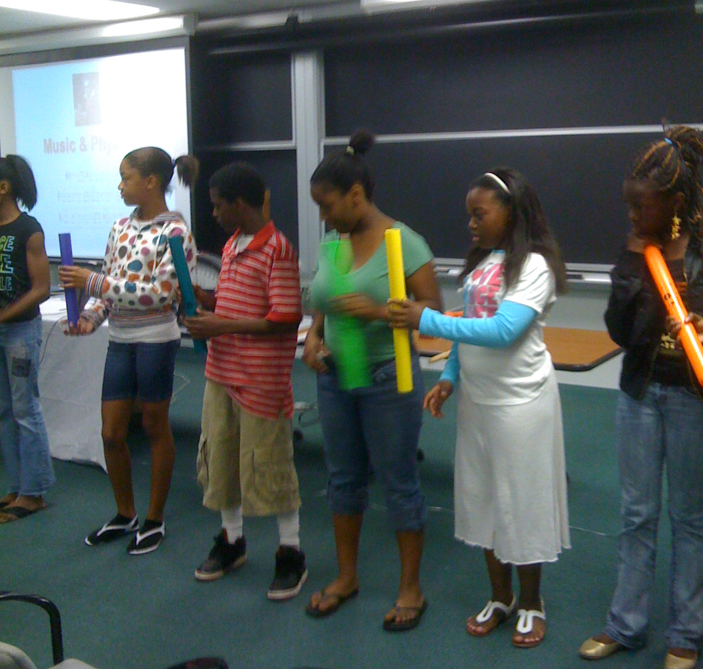

Slide 16
Who are these students?
SAIC

Slide 17
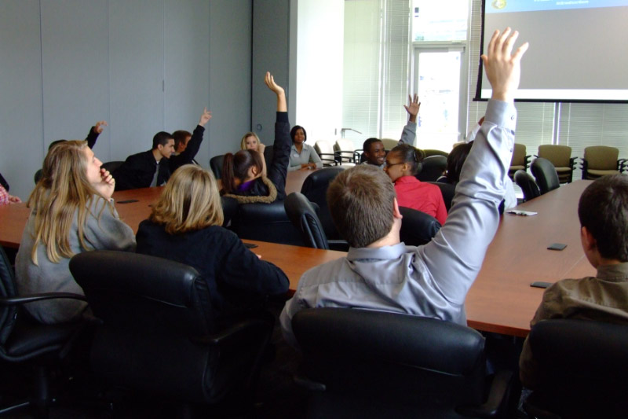
SAIC
Journeys

Slide 18
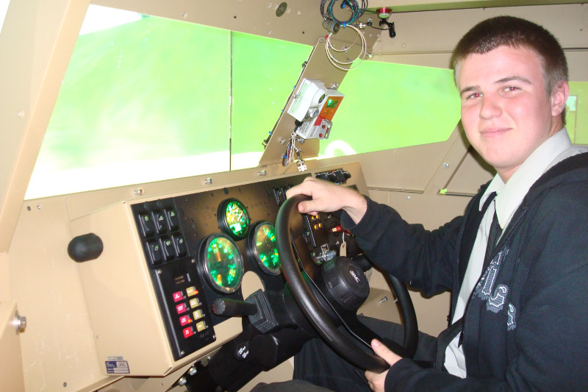
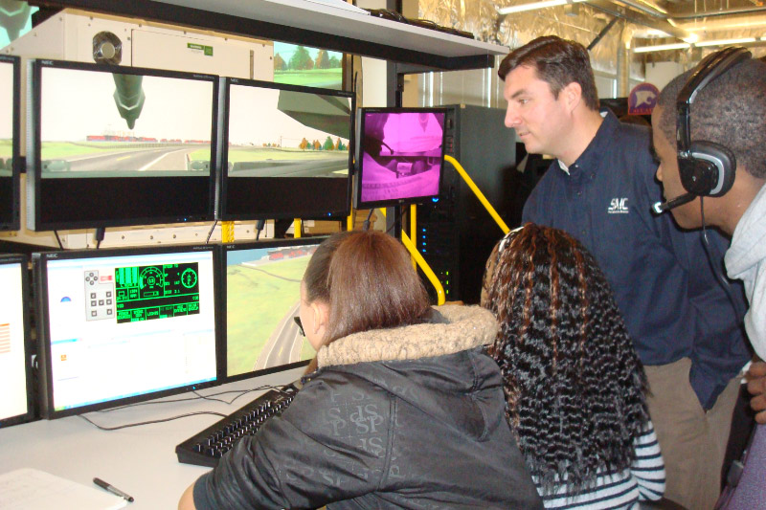
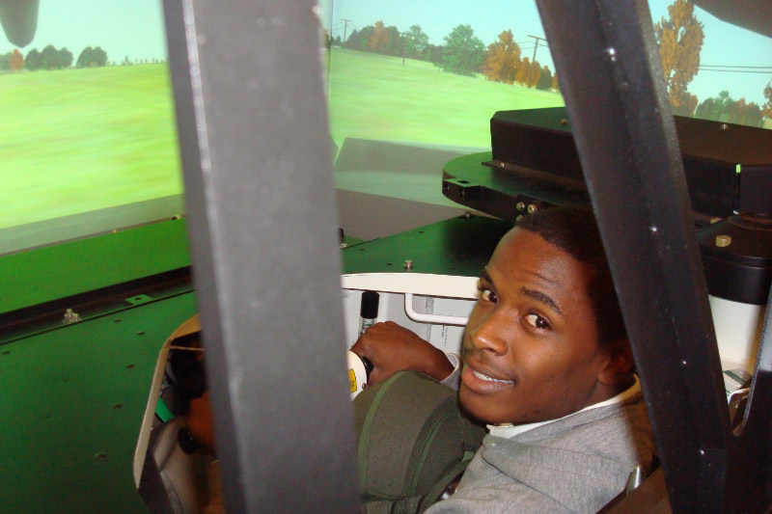
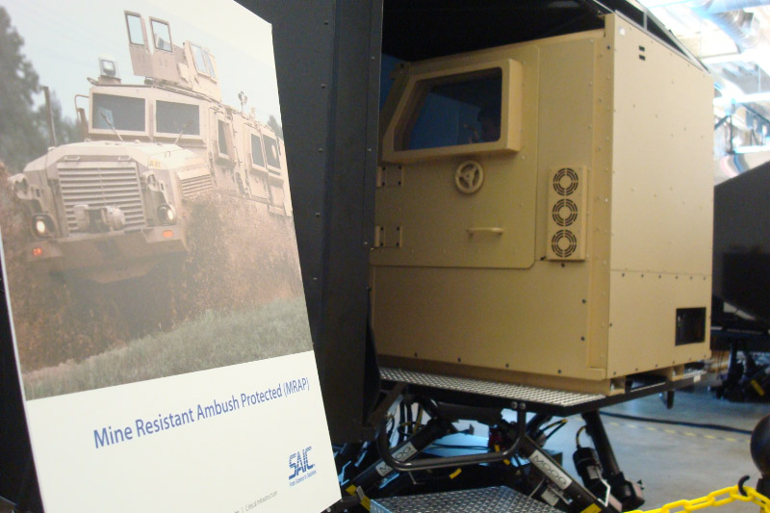
SAIC - Journeys

Slide 19
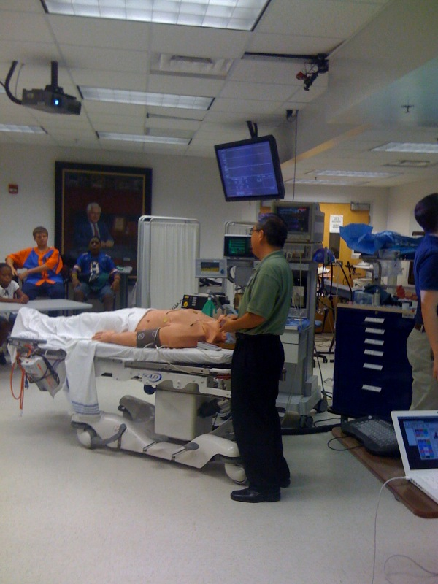
A Program in
Gainesville
UF Brain Institute

Slide 20
Microscope Program (Teachers)
Review/Learn about Microscopes
Magnifying Glass
Optical Microscope
Scanning Electron Microscope
Transmission Electron Microscope
Other high-tech characterization techniques
There is a scanning electron microscope that is available at the Orlando Science Center that can be used in a program over the internet or as a class trip.

Slide 21
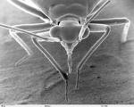

Slide 22
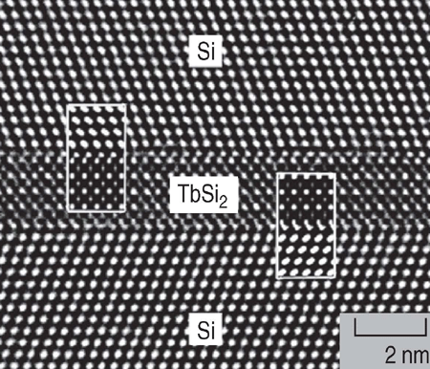

Slide 23
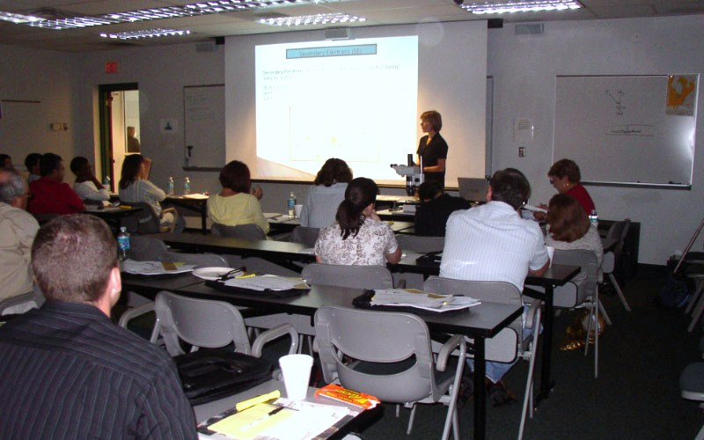
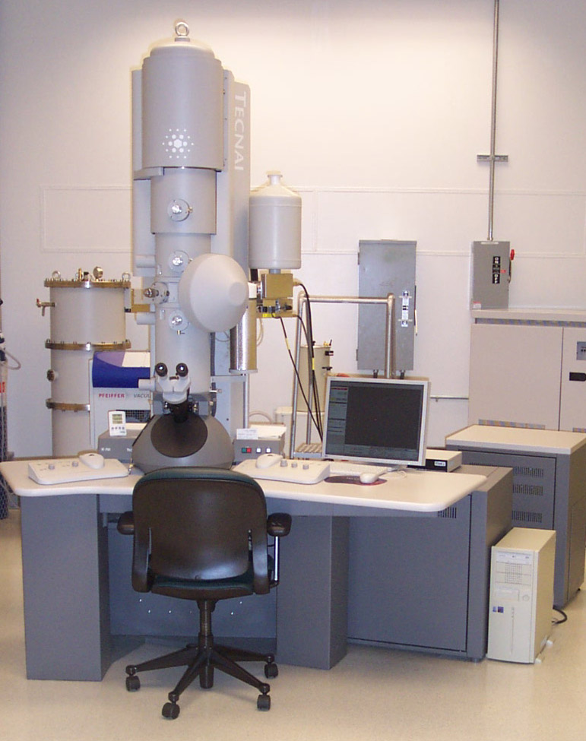
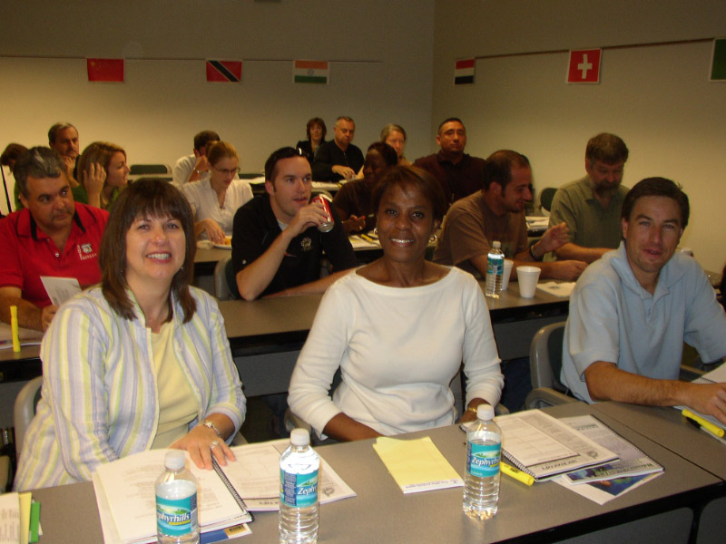
MICROSCOPE UPDATE FOR TEACHERS

Slide 24
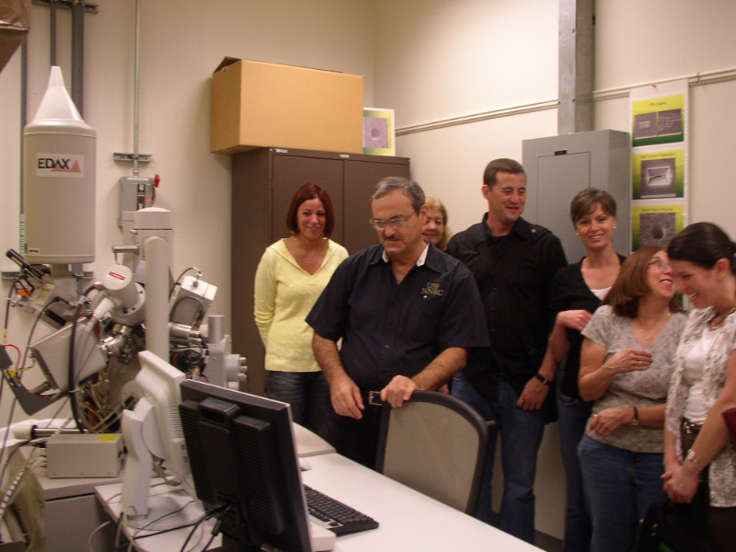
Limited Hands-On!

Slide 25
Science Through the Wire
(Looking for a better name!)
Classroom
asks
questions
Answers From
Faculty – USF, UF, UCF
State Colleges
Industry & Business

Slide 26
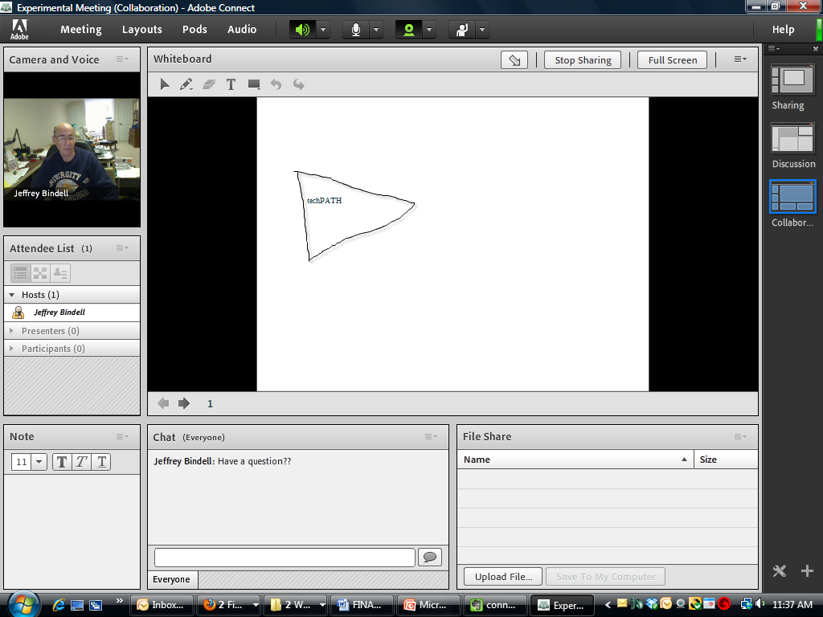
Mechanism: Adobe Connect
(License Purchased)
Live Guest Video
Stored Videos
Pictures
White-board
PowerPoint Slides

Slide 27
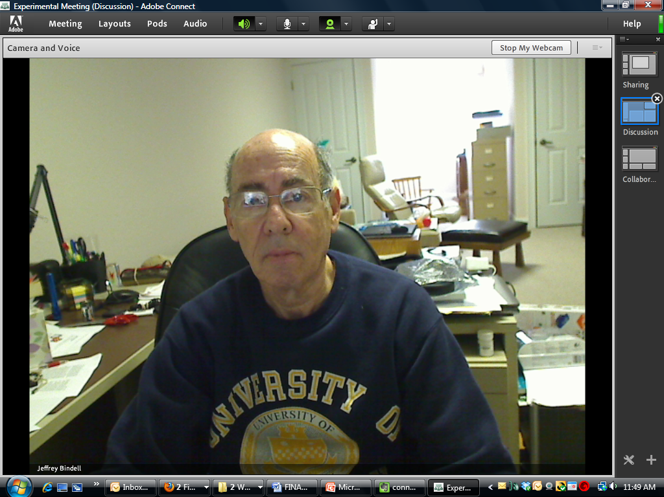
Classroom View
were I the expert.

Slide 28
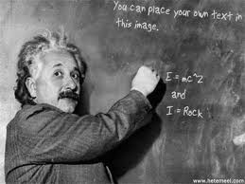
And Walla

Slide 29
Through the Wire
Figure out the technology
Working on it. Good reception from UCF Physics Department.
Other schools will be added after the program gets started. Hope to do the sign up at both ends with a form based data base.
Amass a group of experts willing to speak to a middle or high school on a topic that the class chooses.
Work with the school districts to find the appropriate classes.
Estimated session time ~30 minutes
Actually, MANY classes can view a session. (Recorded?)

Slide 30
OK – Let’s hear from our other speakers!
NCS – Hank Okraski
Cyber Security – Nasser Heyayat – Valencia College
SeaPerch – Bob Seltser – NAVAIR
METIL – David Medcalf (UCF)
Website Design – techPATH – Kerry Martin
Then some discussion and lunch! (11:30 – Probably a working lunch)
Tour of facility

Slide 31
Bye Bye!

