Slide 1
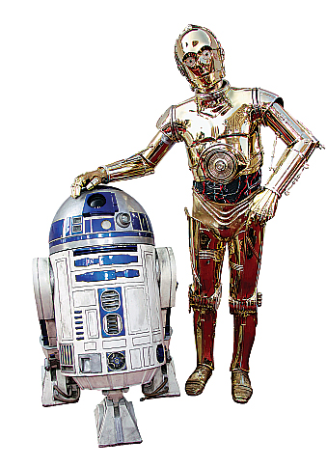

Slide 2
Florida Hospital’s Nicholson Center Hosts Middle School Students at Florida High Tech Corridor “techCAMP” Students from Howard Middle School
Robtics
April 28, 2011

Slide 3
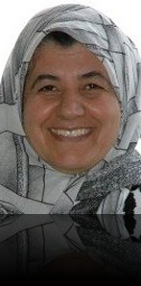
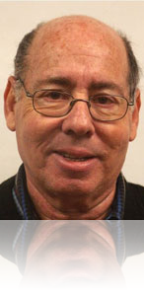
Starring
Dr.Al-Rawi
Ms. Morelli
Dr. Bindell

Slide 4
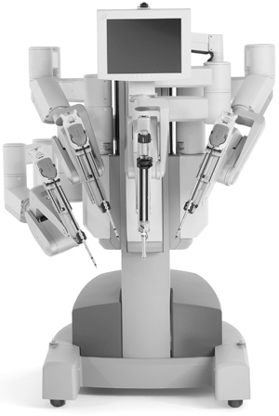
And the Nicholson Center’s Da Vinci Robot

Slide 5
A Wake Up Exercise
See if you can trace the circuit around the office....Find the red dot then click on it to move on...
If you’ve seen this one, please keep it to yourself!

Slide 6
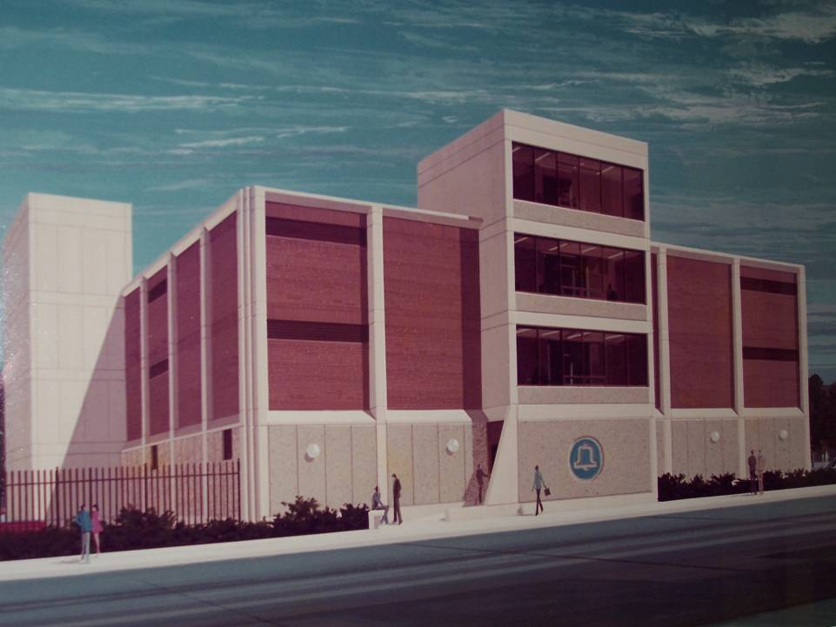

Slide 7
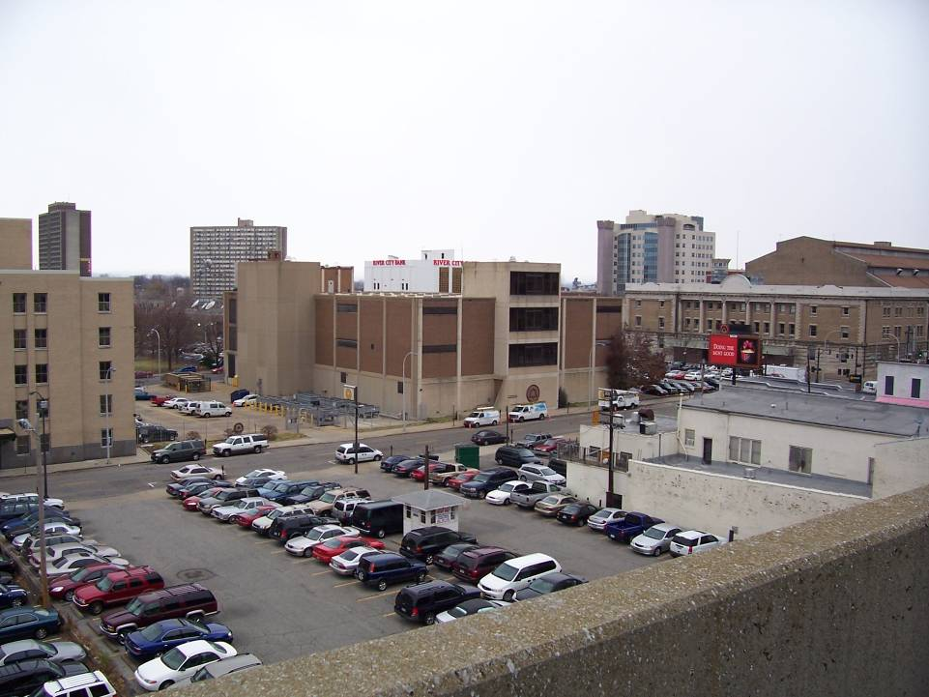

Slide 8
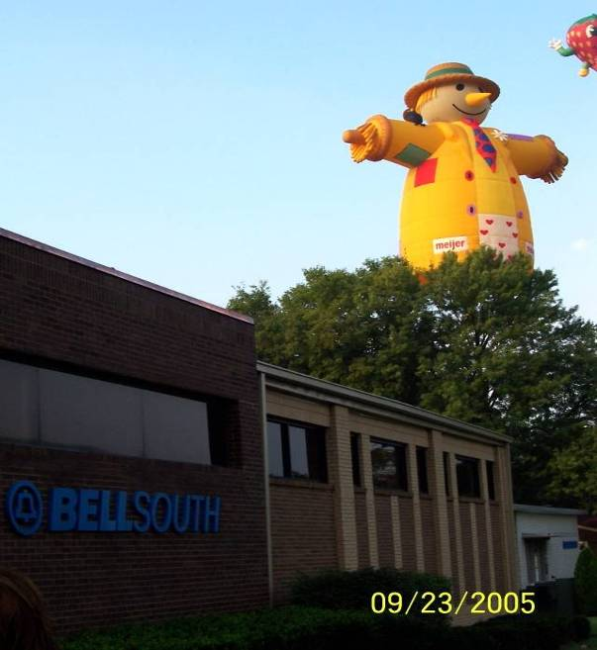

Slide 9
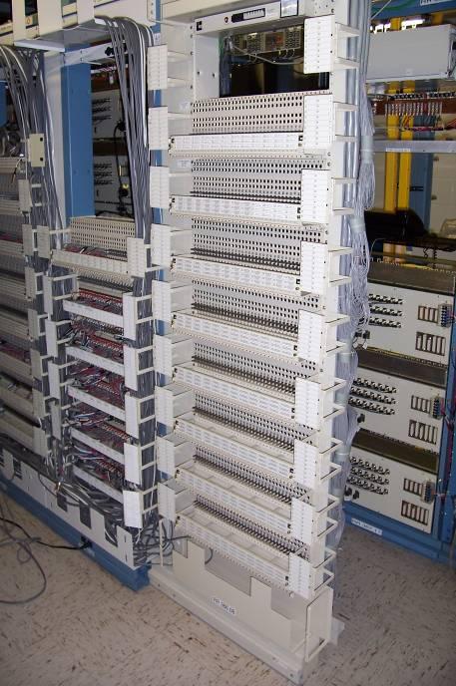

Slide 10
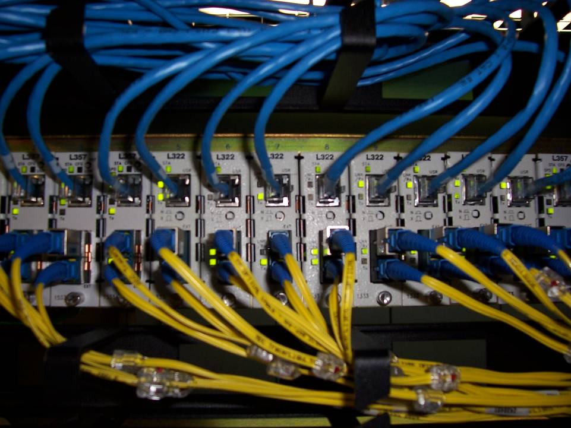

Slide 11
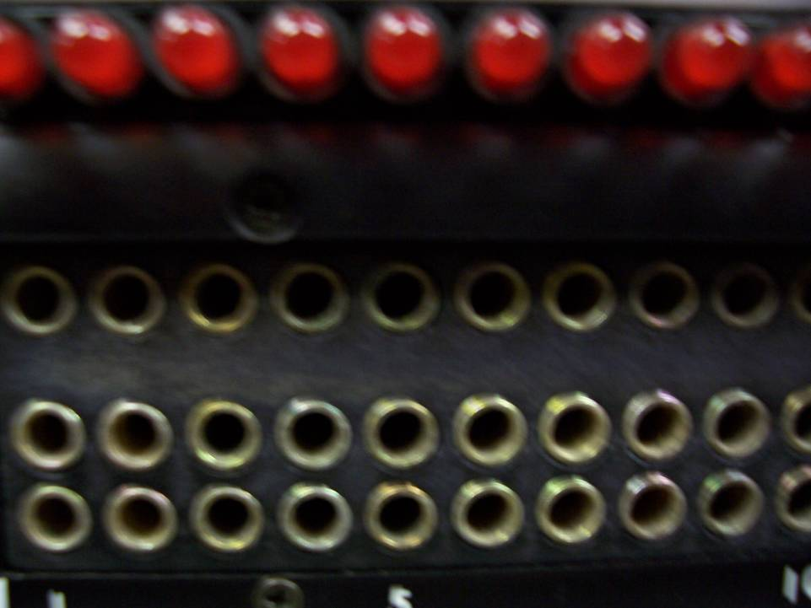

Slide 13
☺
Are you all
AWAKE??? !

Slide 14
Reasons for the Robotics Program
Tell you about robots
Tell you how robots could be involved in your future
Introduce you to a few robots
Jeff
Max
Leonardo
Explain a bit about what robots are
Talk about programming
Have lunch
Learn a little about medical robotics

Slide 15
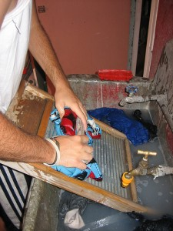
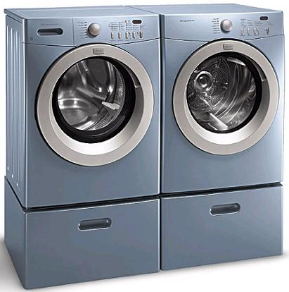
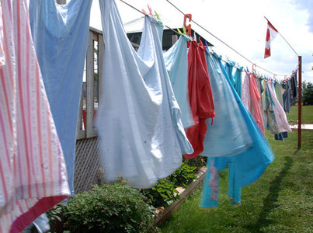
Robots are NOT New!
Air Dry
Wash
“Robot”

Slide 16
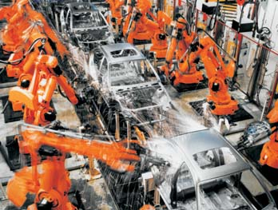
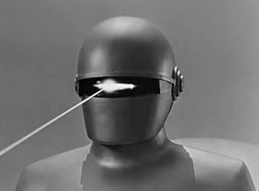
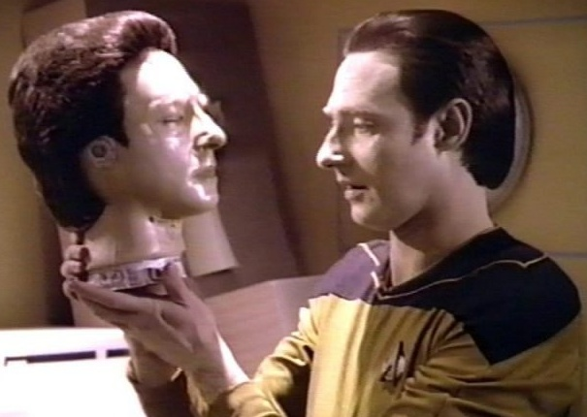
Are these Robots Real??
NO!
YES!!
NO!

Slide 17
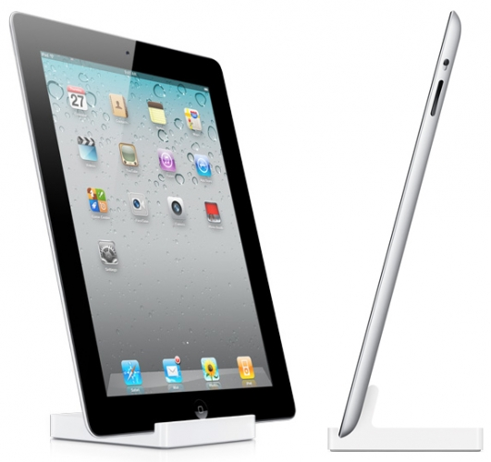
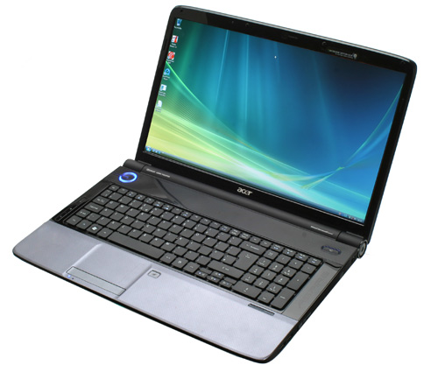
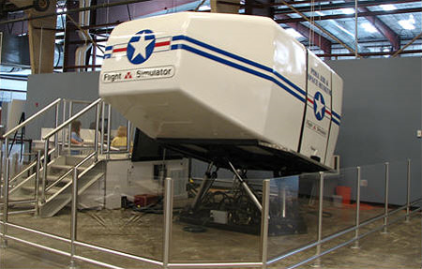
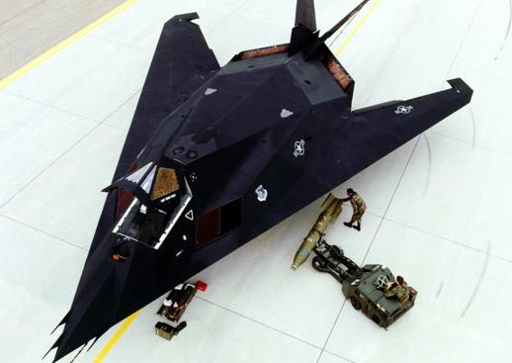
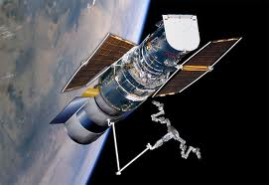
Are These Things Real??

Slide 18
Today, everything is technology!
Are You Going
to be Ready??

Slide 19
A test: Which of the following statements are true??
Technology can be fun.
You can get a good job in technology
You need a good education to take advantage of the future of technology
You need math and science to understand technology
The Unites States is the world’s leader in technology.

Slide 20
The following is about two years old but the message hasn’t change.
It moves quickly, so read quickly too!

Slide 21
This is about YOUR future!

Slide 22
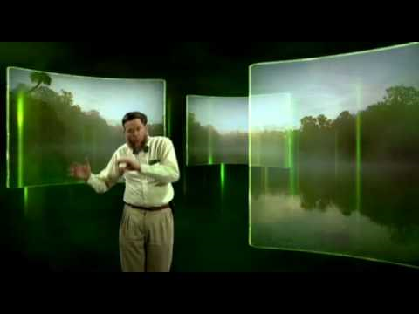
The Far Future?

Slide 23
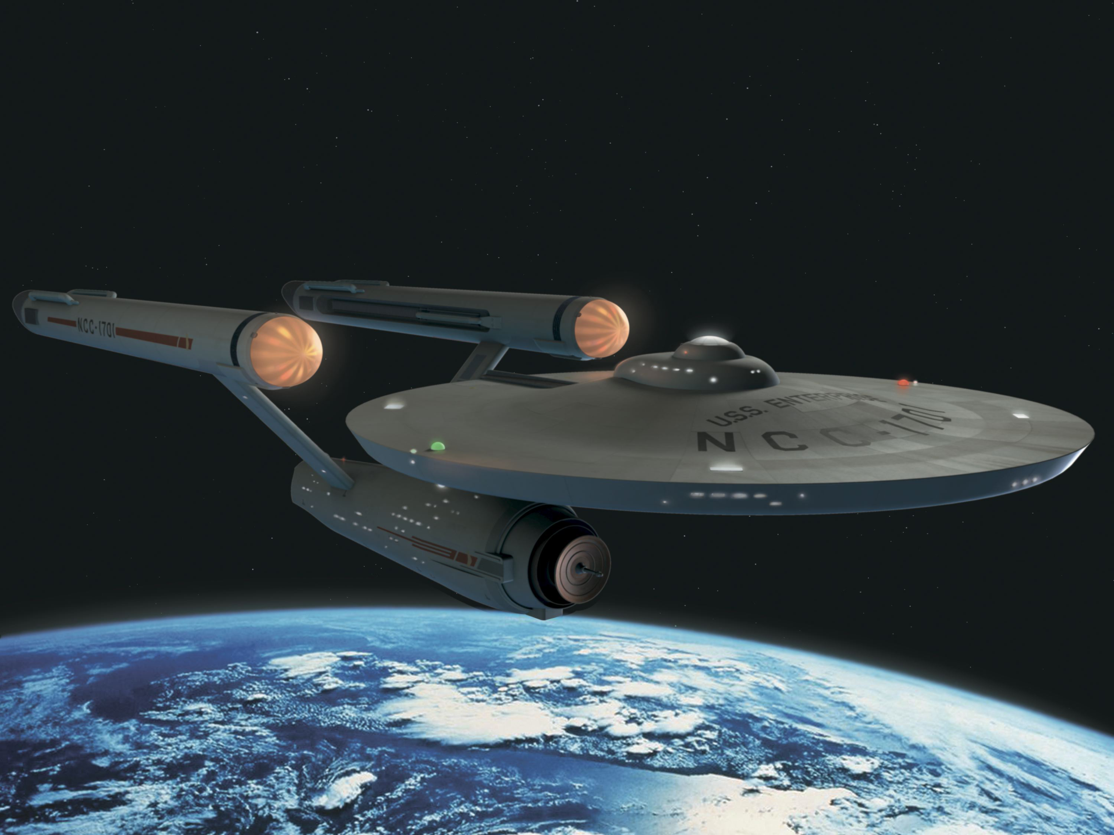
Because TOMORROW, this will be REAL!

Slide 24
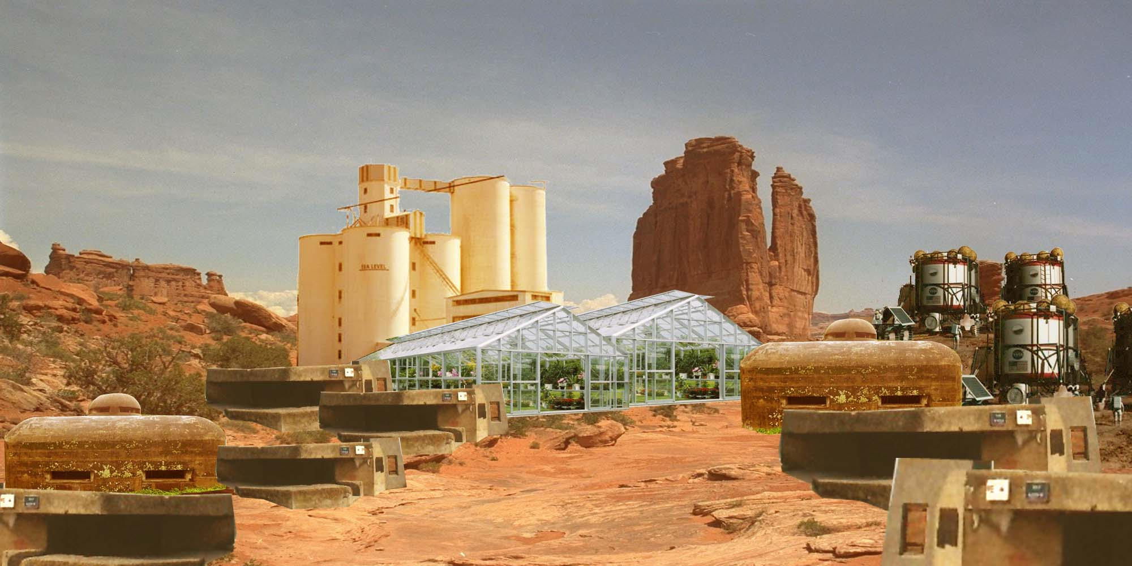
Mars Vacation?

Slide 25
You will see ALL
of this stuff in YOUR
LIFETIME!
Will you be ready??

Slide 26
Get Ready
For It!!

